Slide 1
T2 x T1
MERGE x Eta_T2 x Eta_T1
2021030700

Slide 2
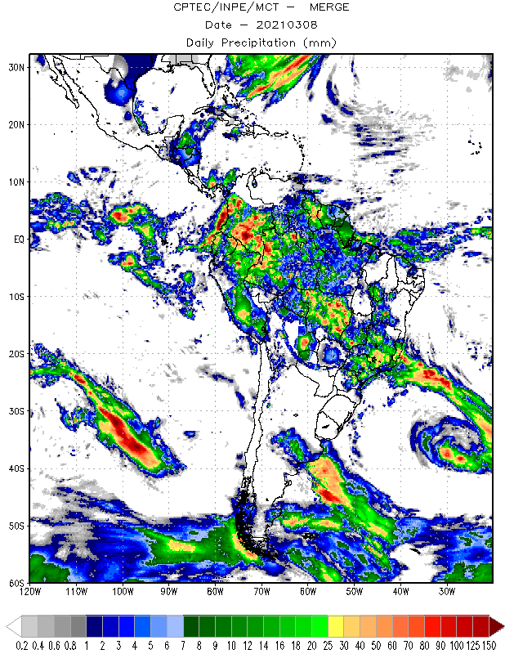
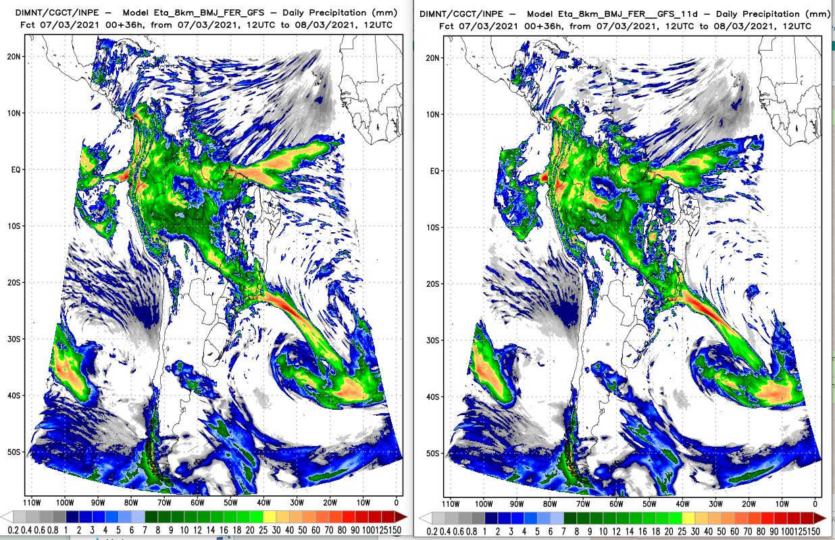

Slide 3
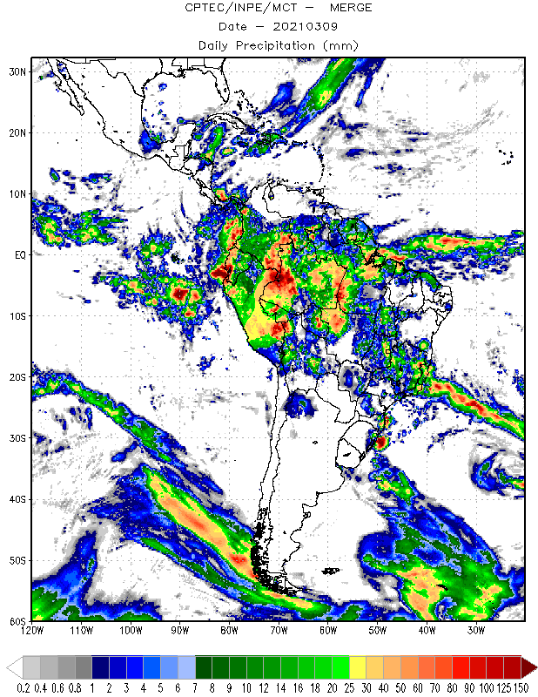
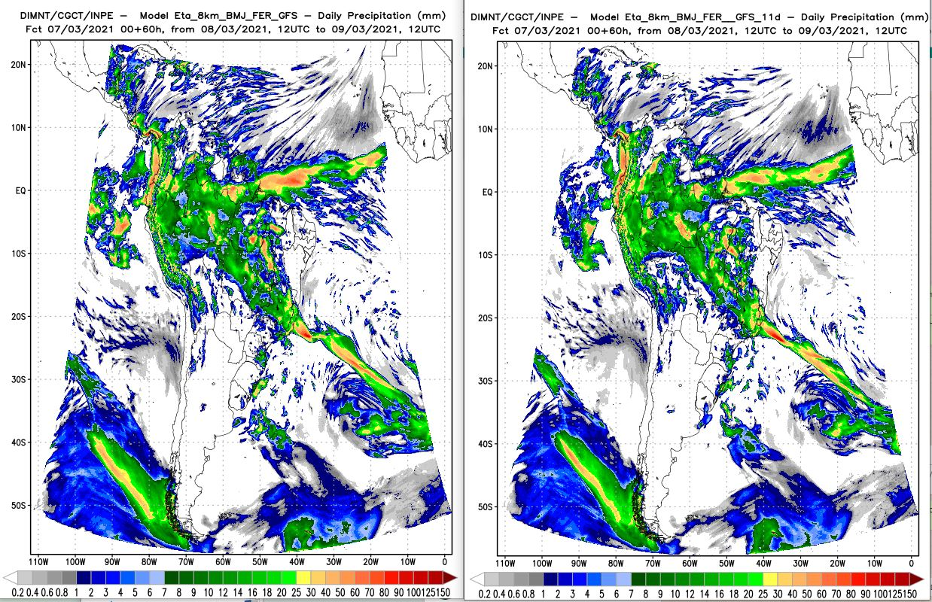

Slide 4
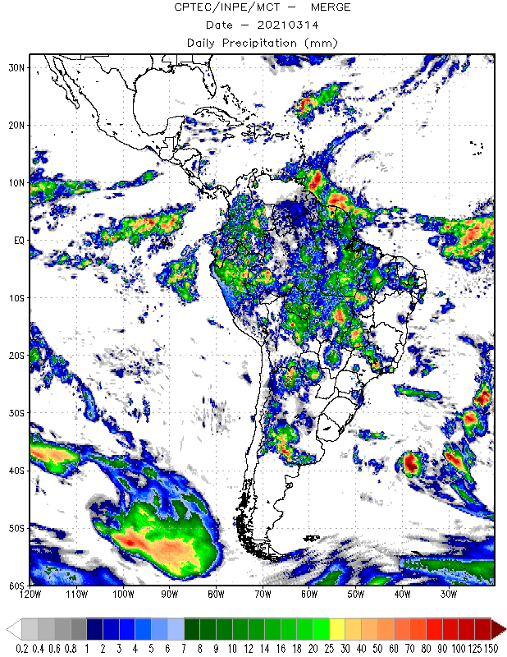
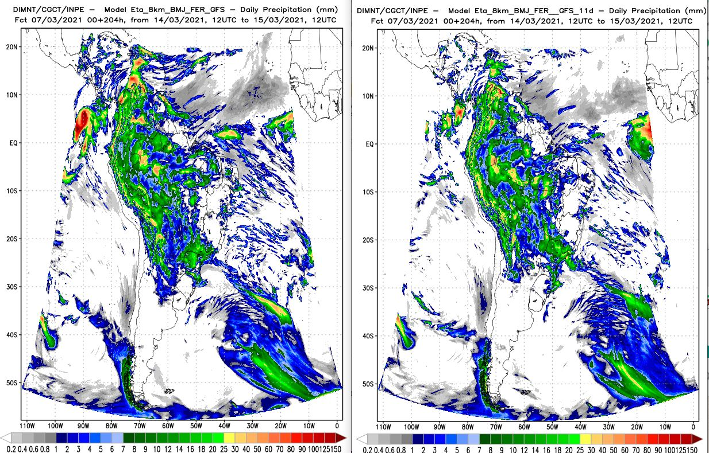

Slide 5
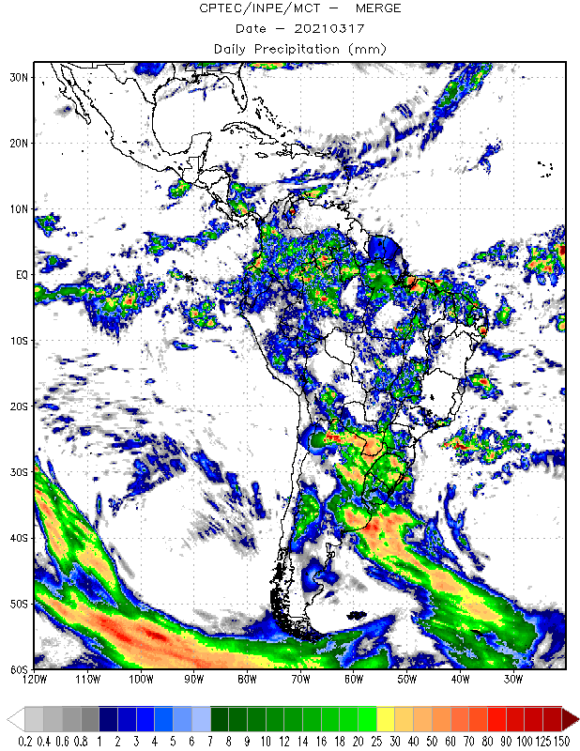
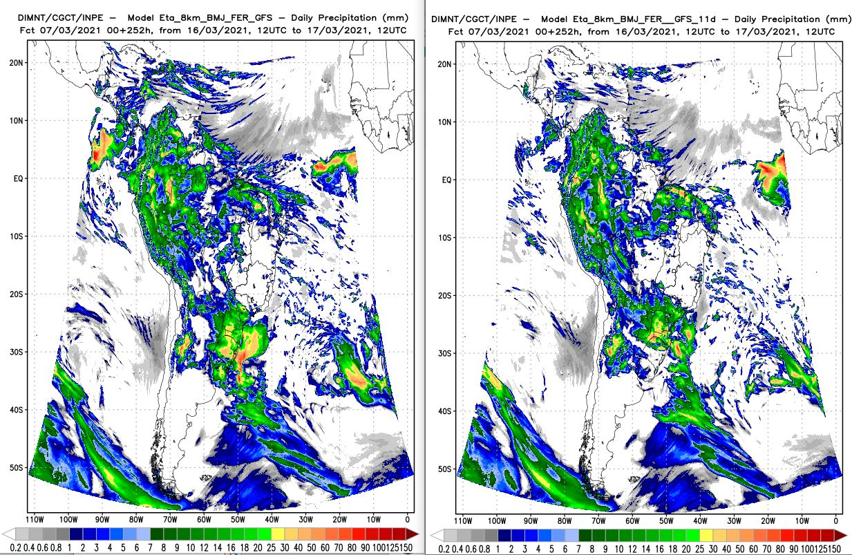

Slide 6
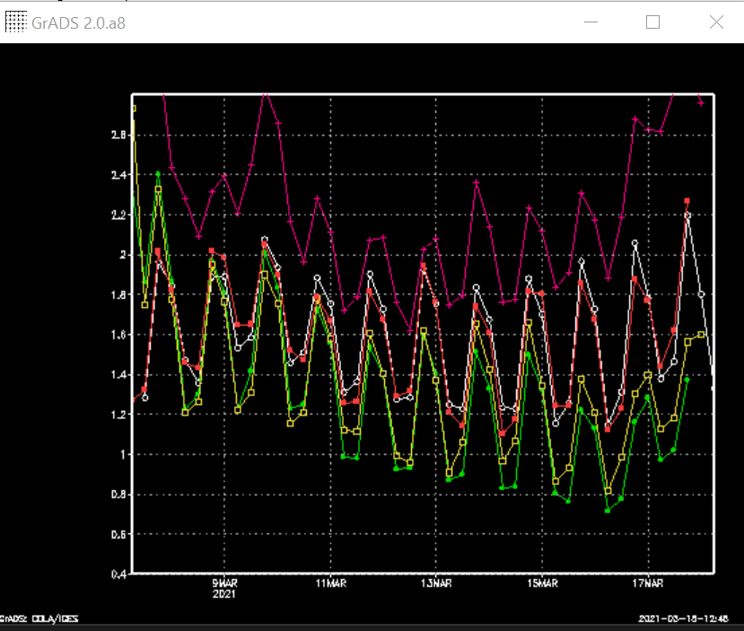
Branco: gfs00Z07
Vermelho: gfs12Z06
Verde:T1
Amarelo: T2
Rosa: lendo zgeo eta(l)

Slide 7
T2 x T1.1
MERGE x Eta_T2 x Eta_T1.1
2021030700

Slide 8
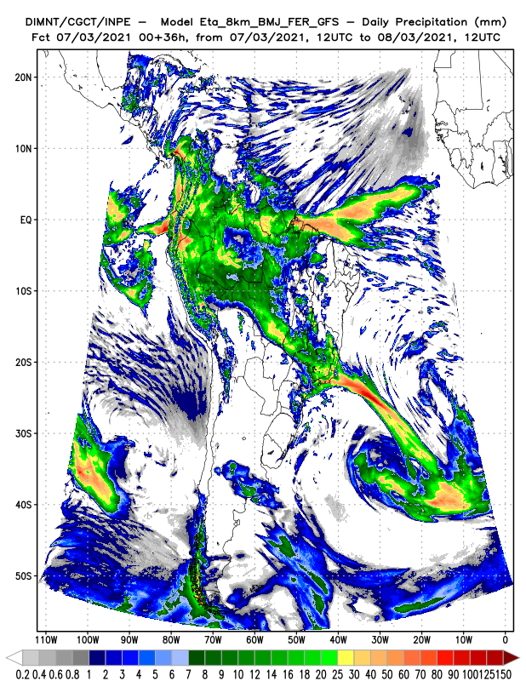
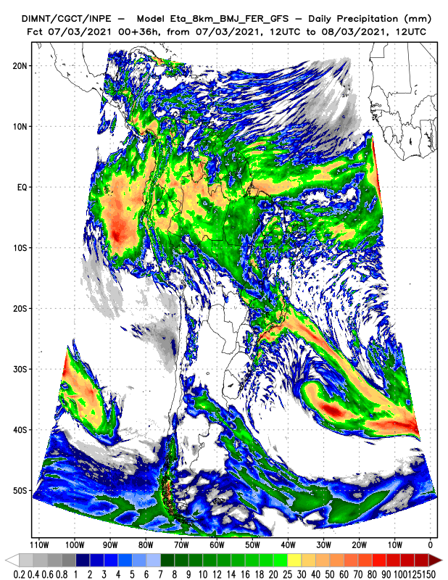

Slide 9
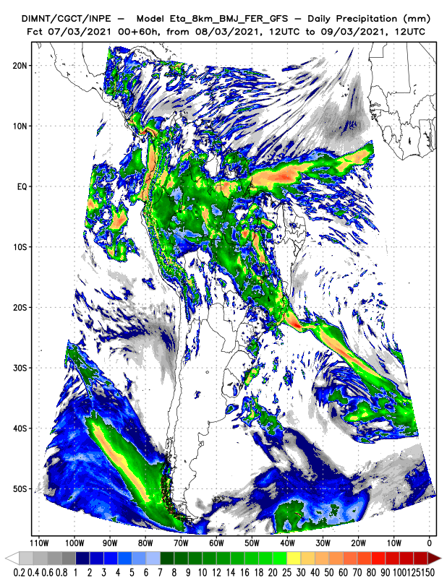
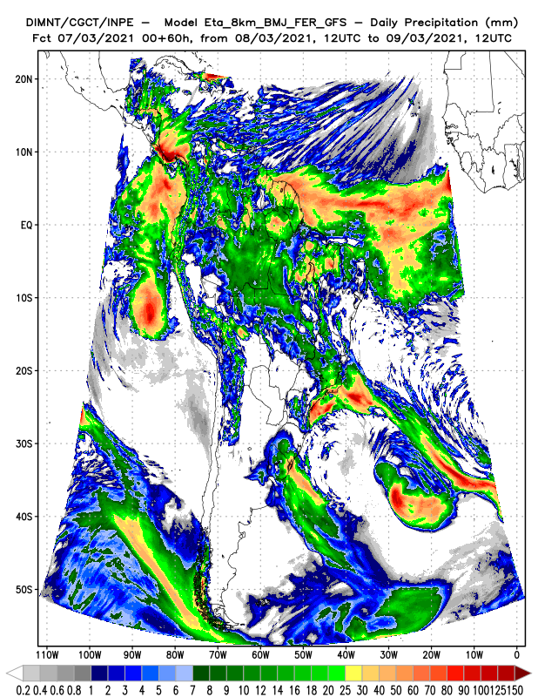

Slide 10
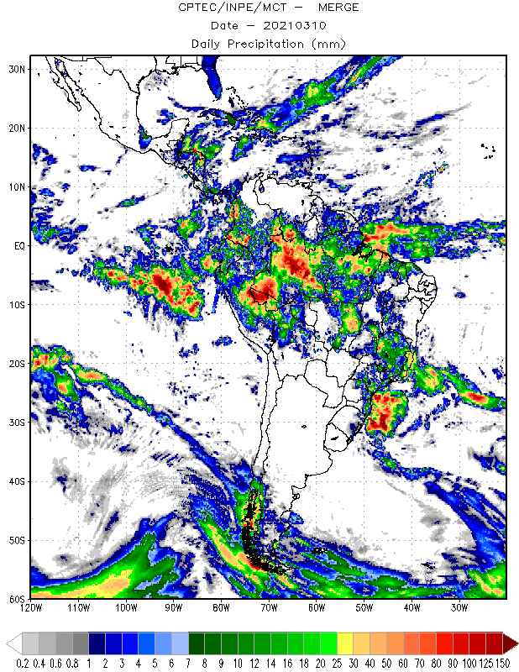
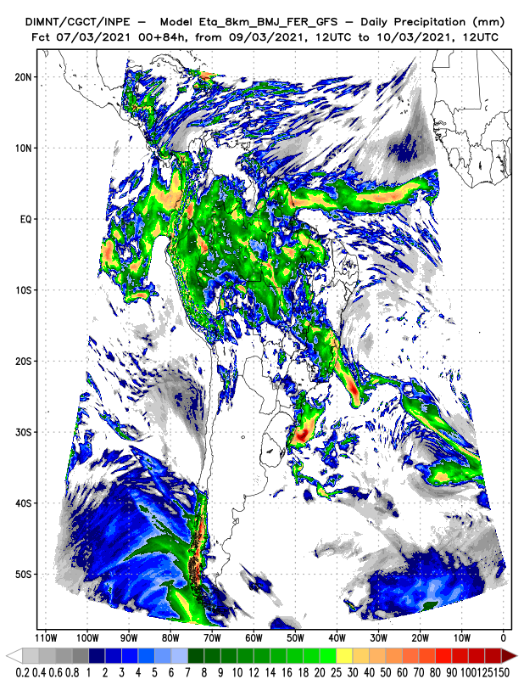
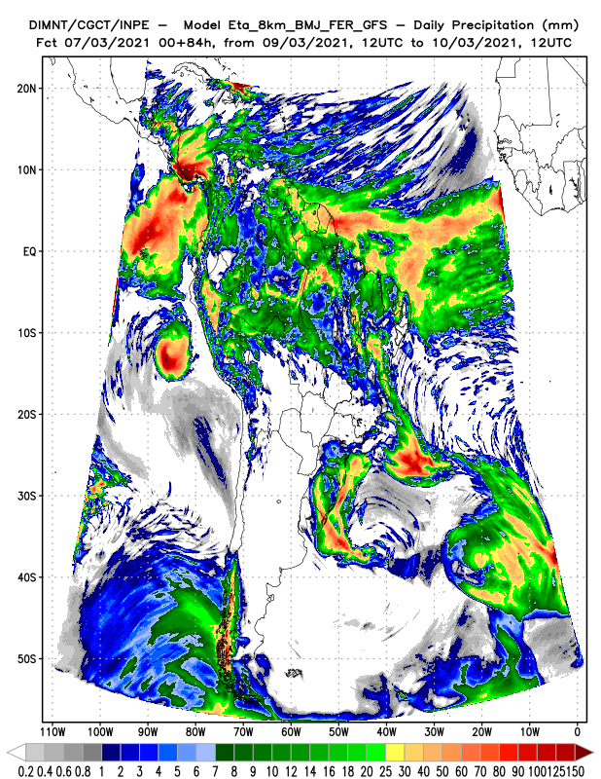

Slide 11
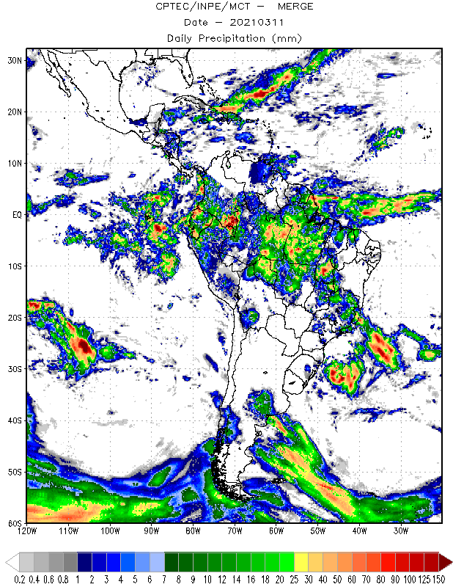
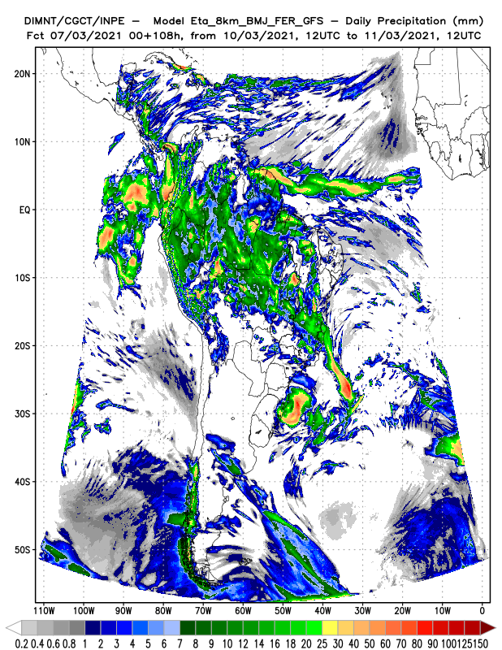
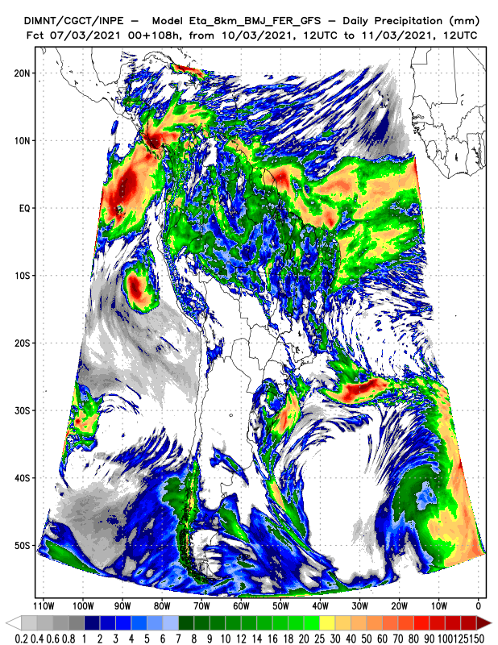

Slide 12
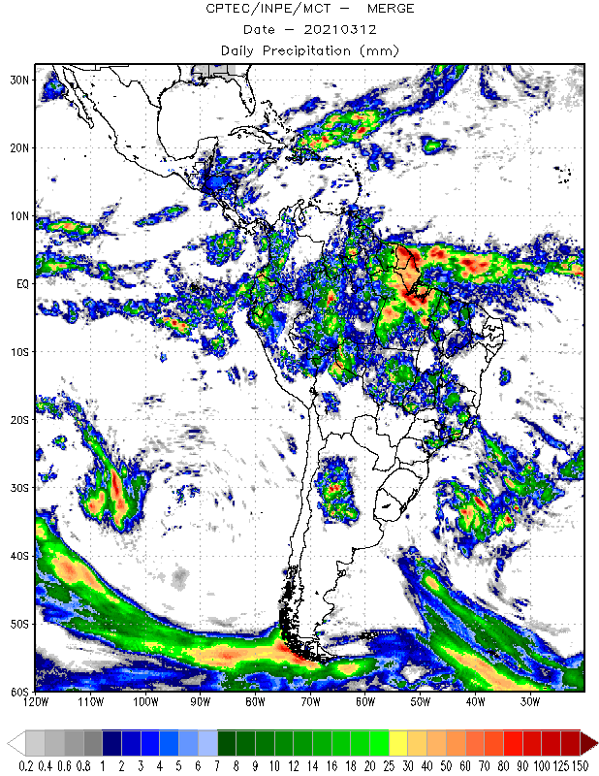
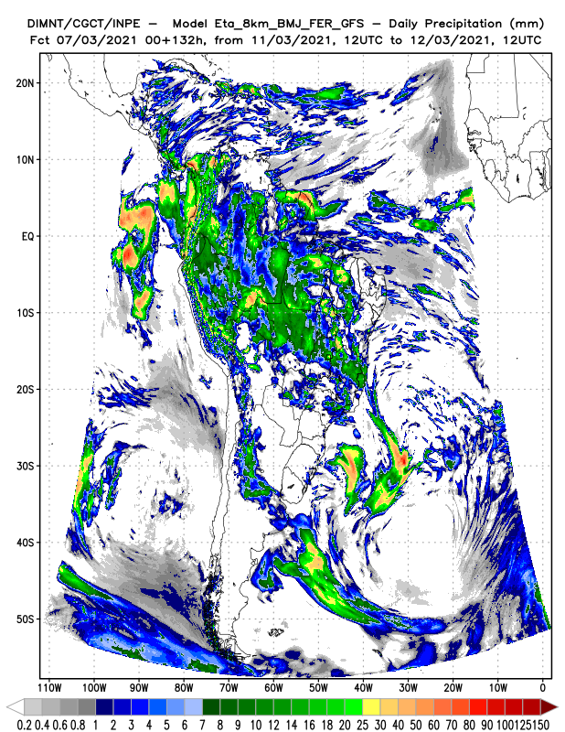
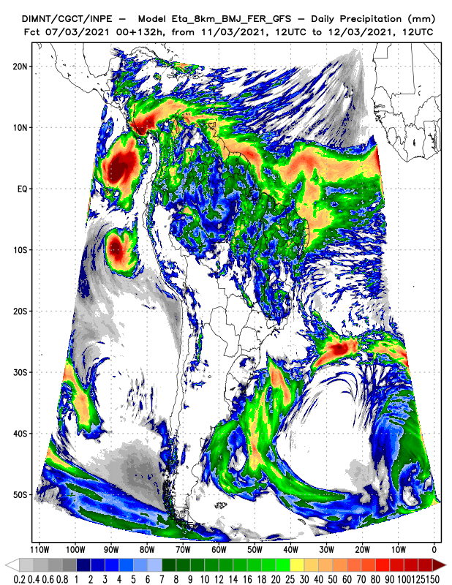

Slide 13
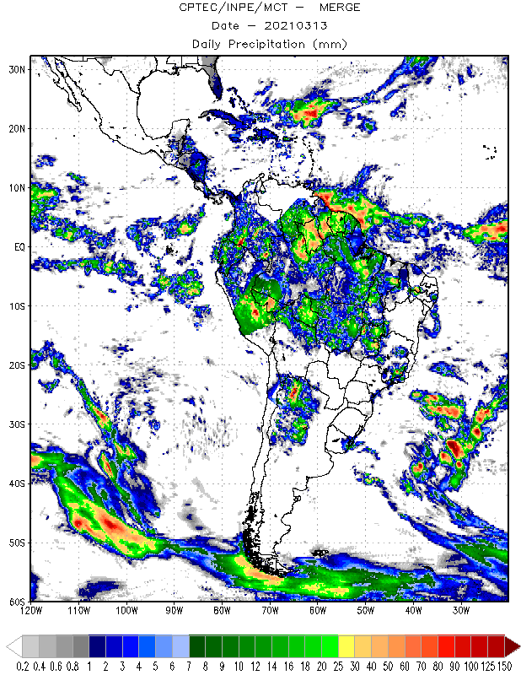
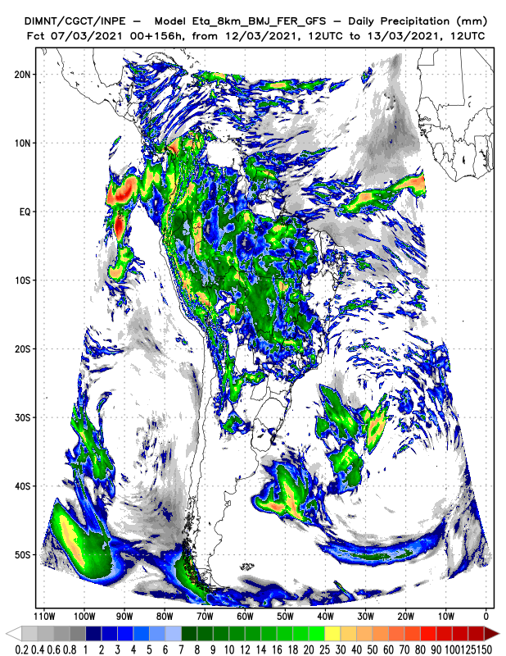
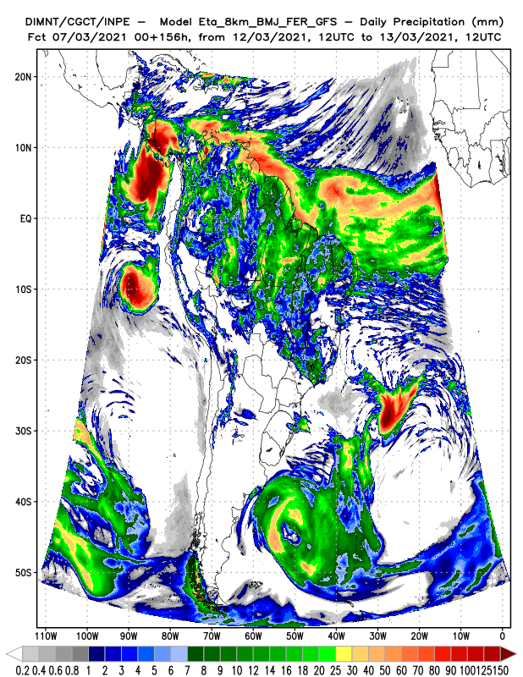

Slide 14
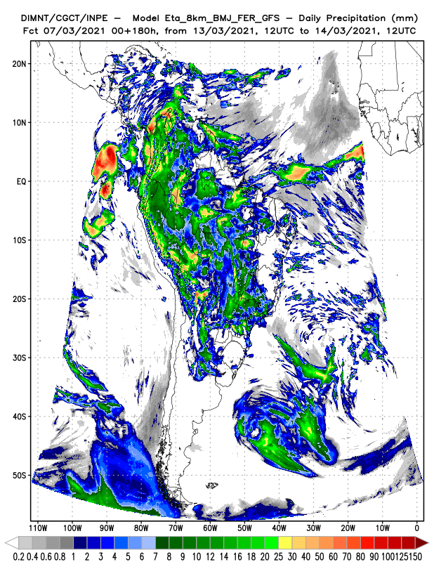
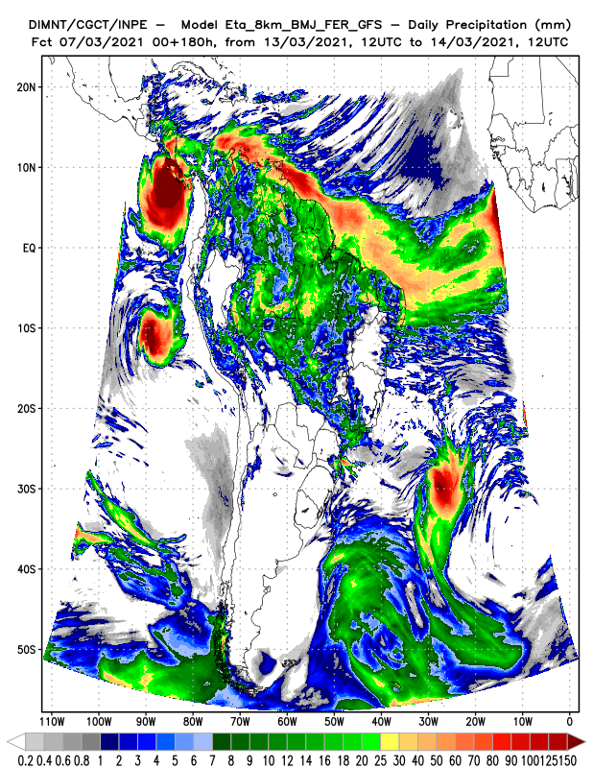

Slide 15
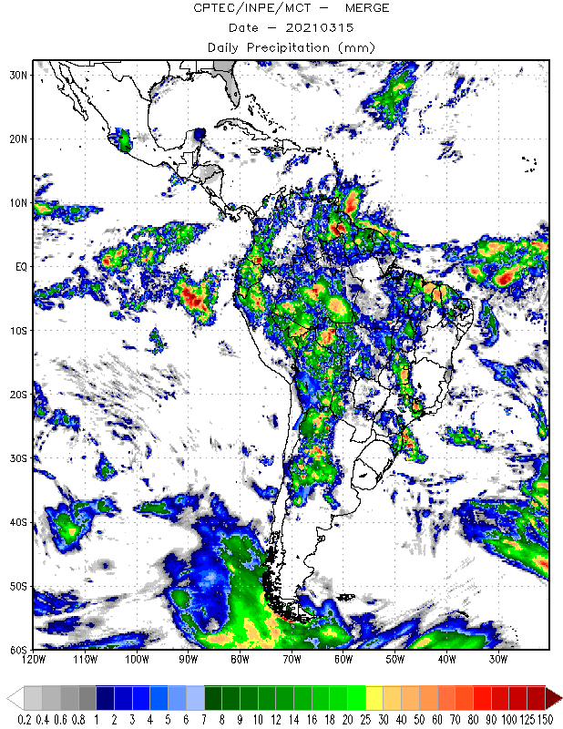
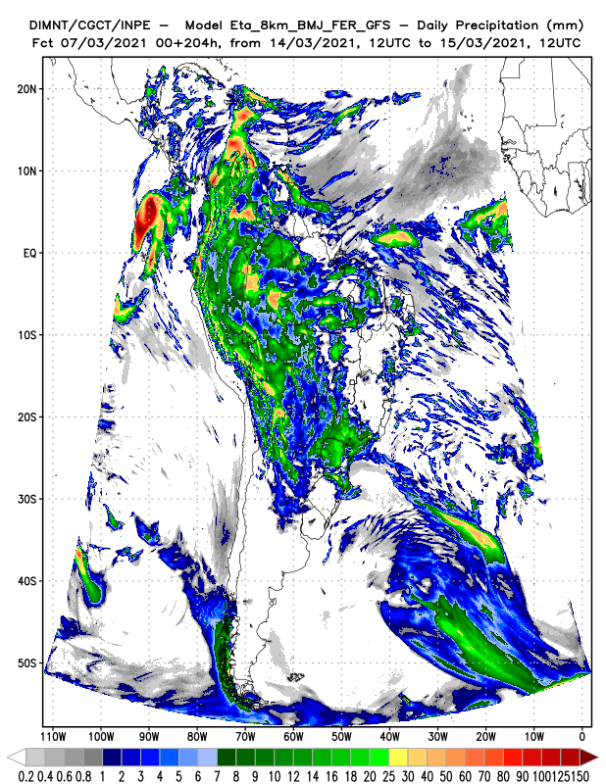
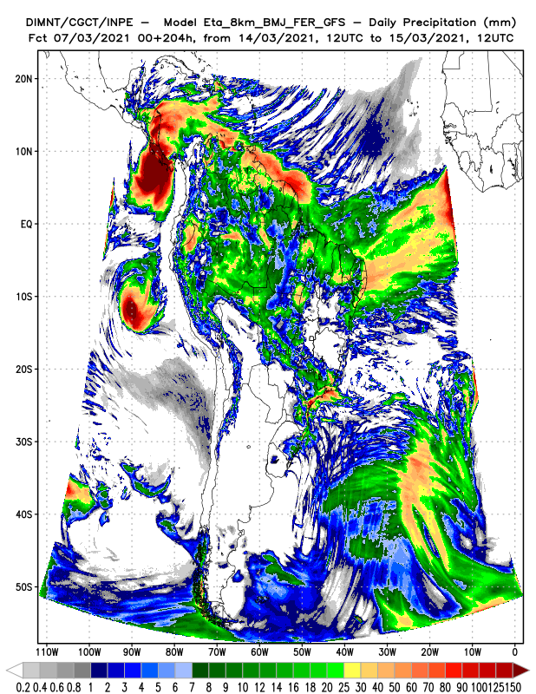

Slide 16
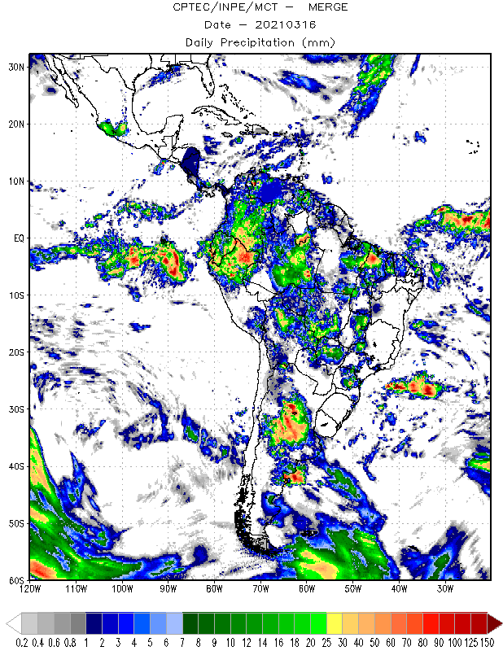
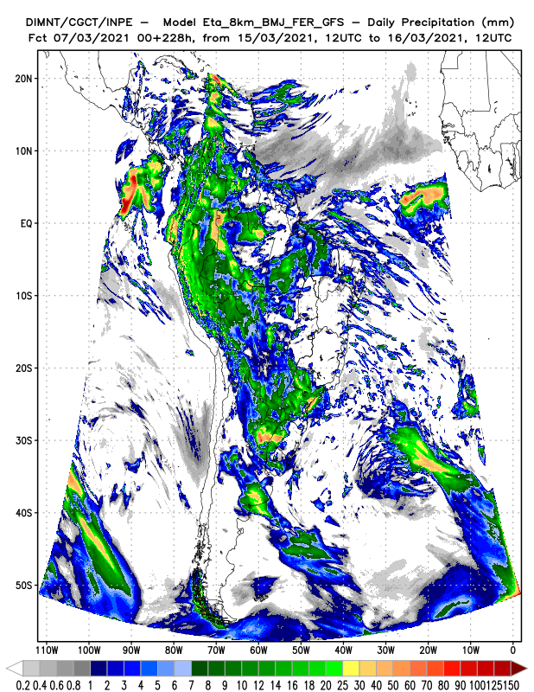
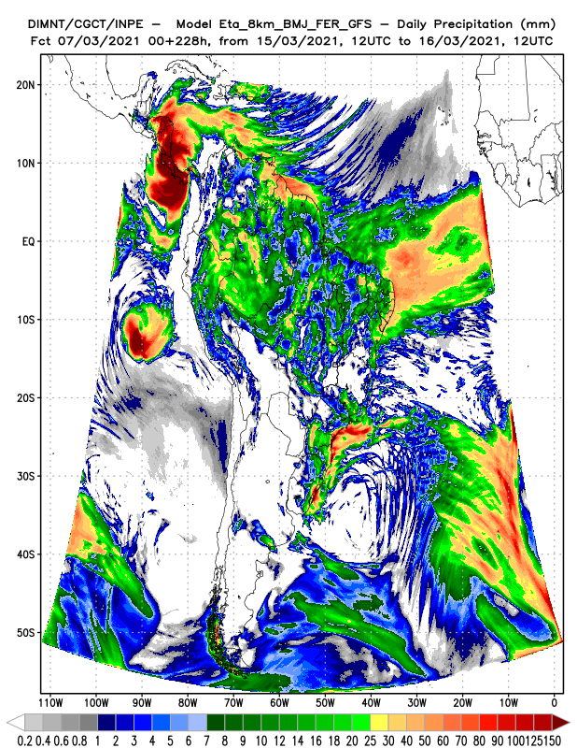

Slide 17
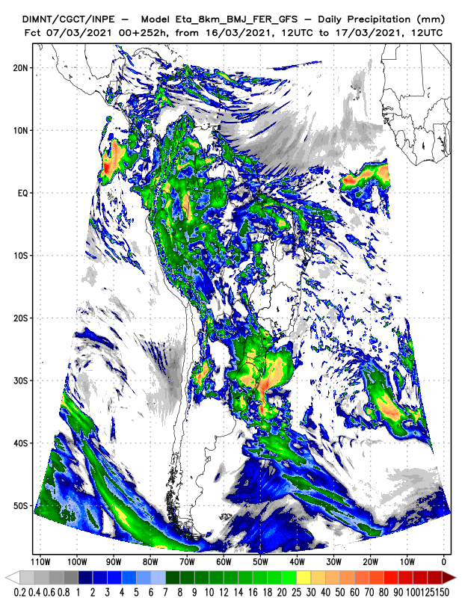
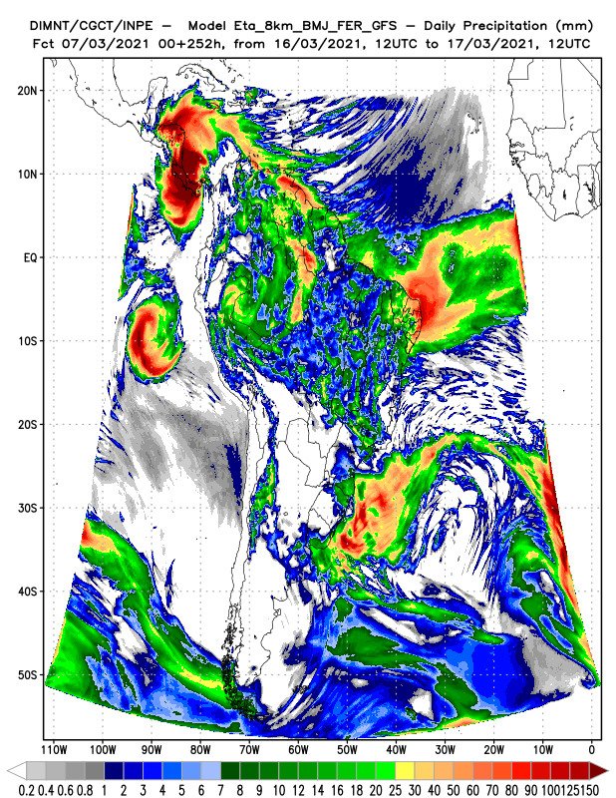

Slide 18
T2 x GFS
MERGE x Eta_T2x GFS
2021030300

Slide 19
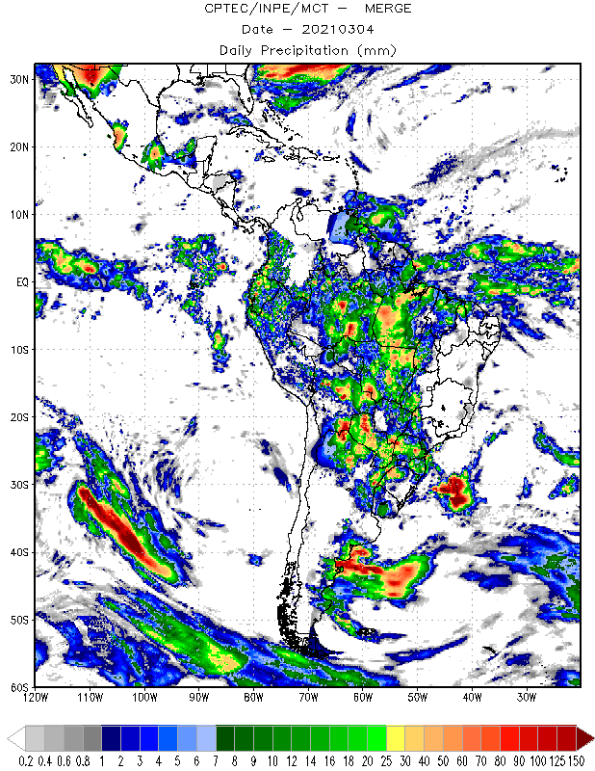
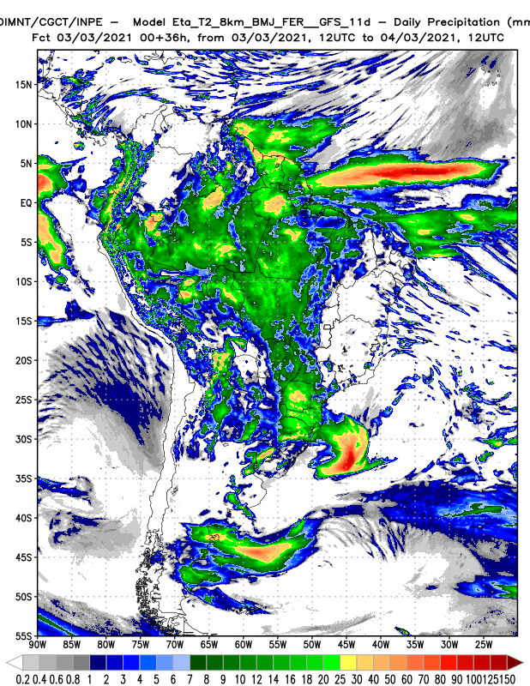
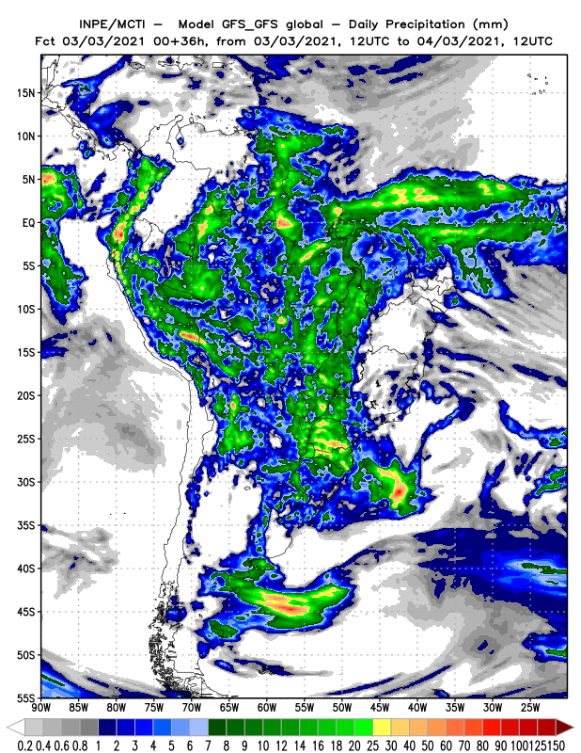

Slide 20
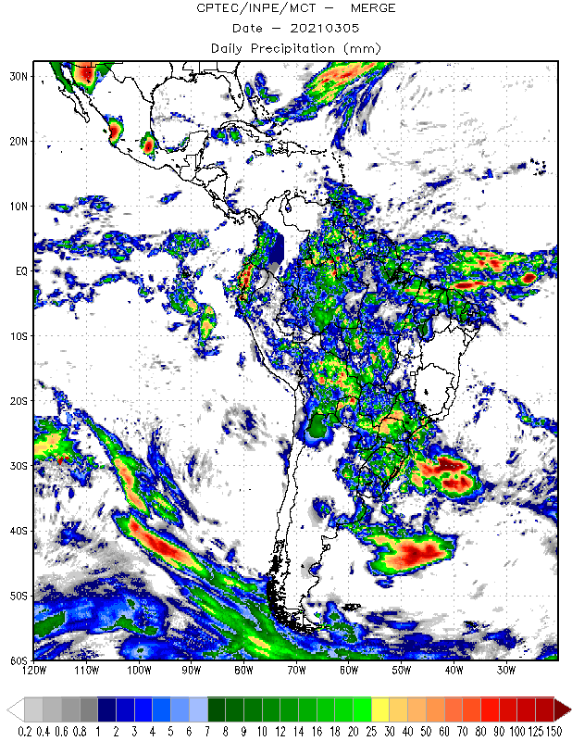
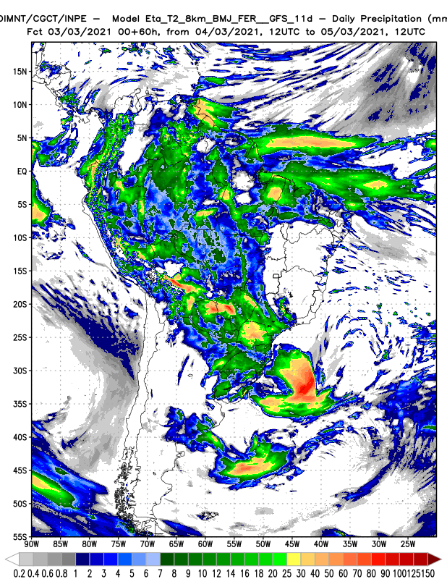
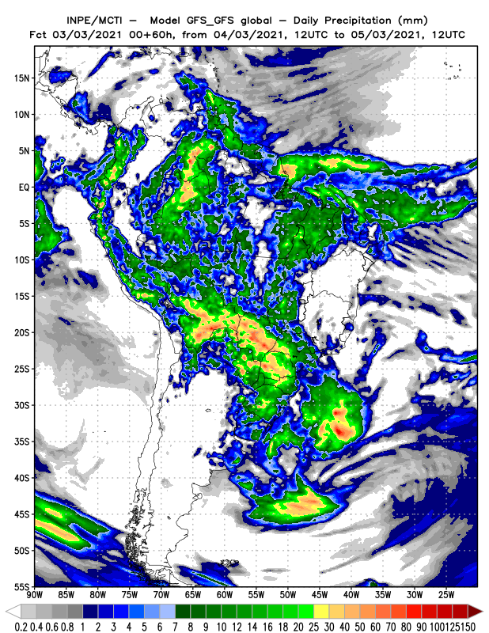

Slide 21
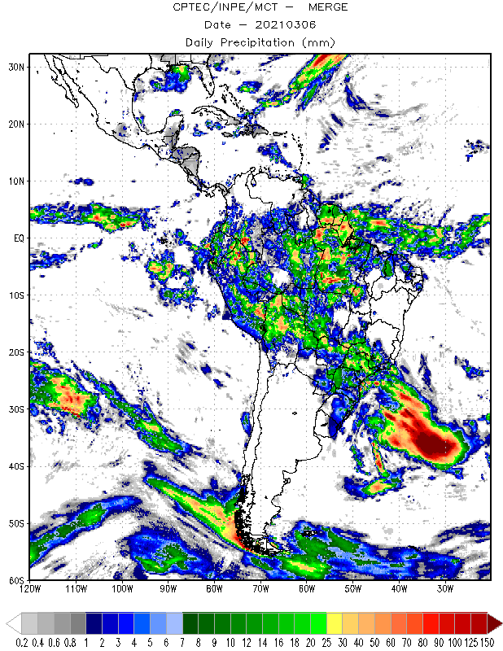
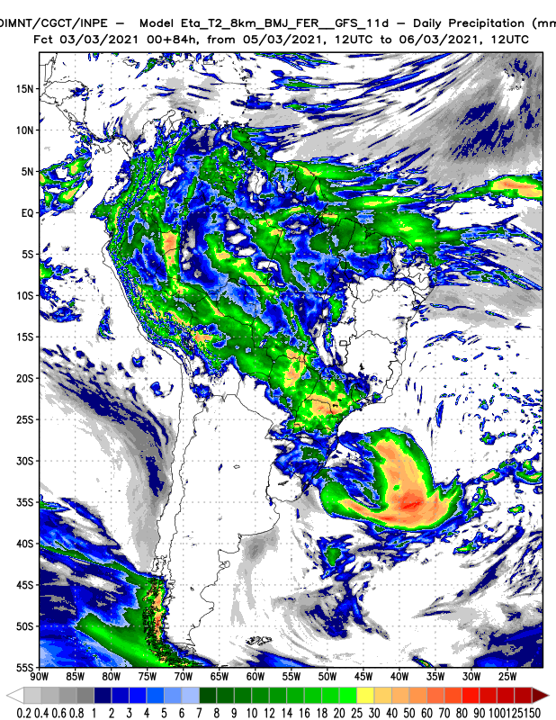
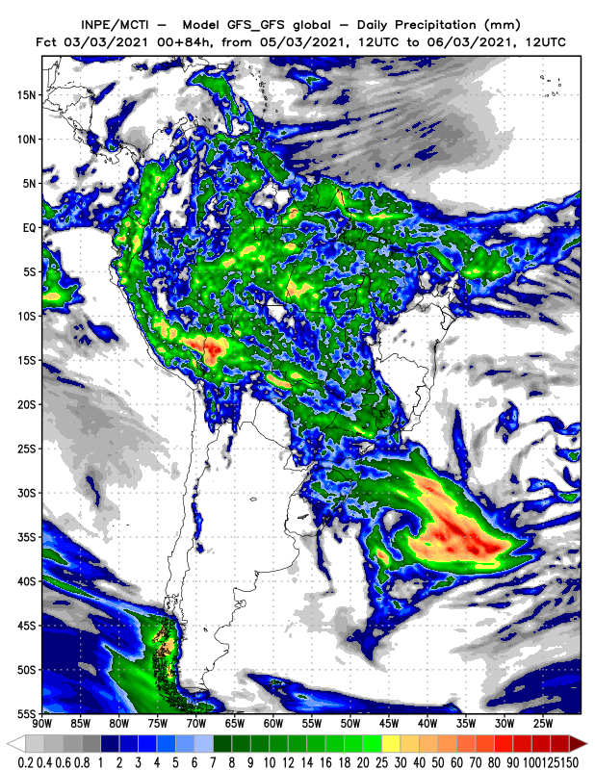

Slide 22
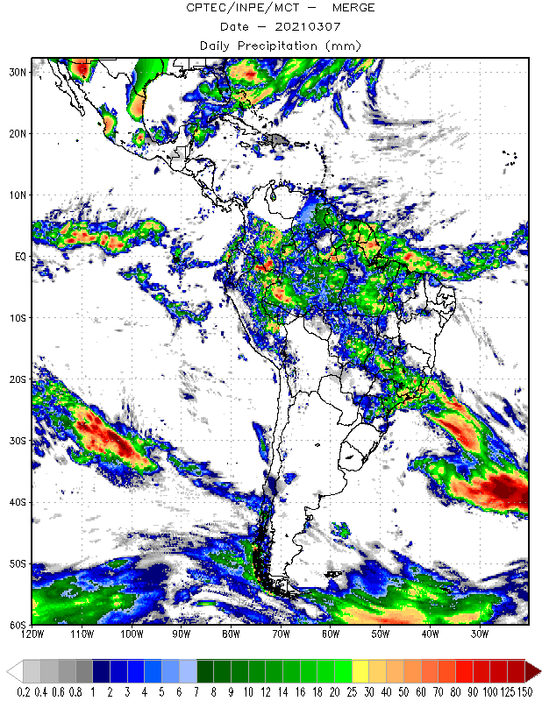
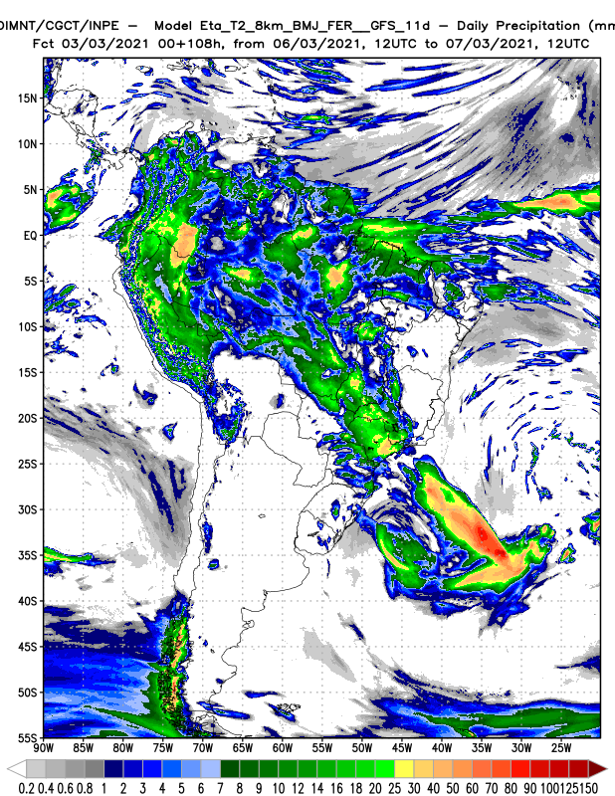
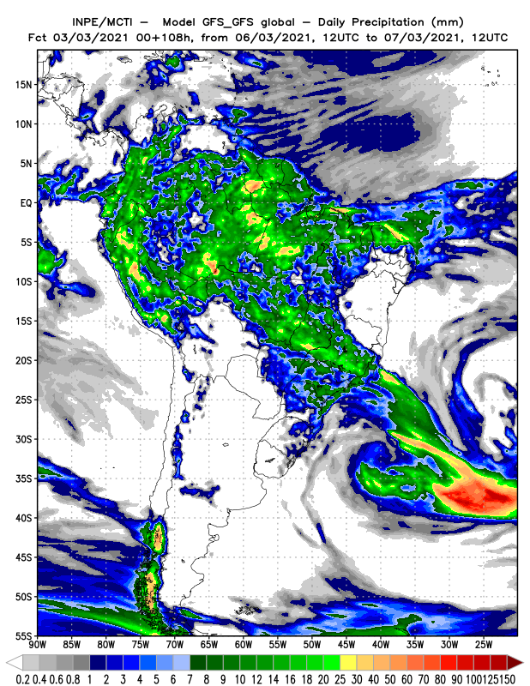

Slide 23
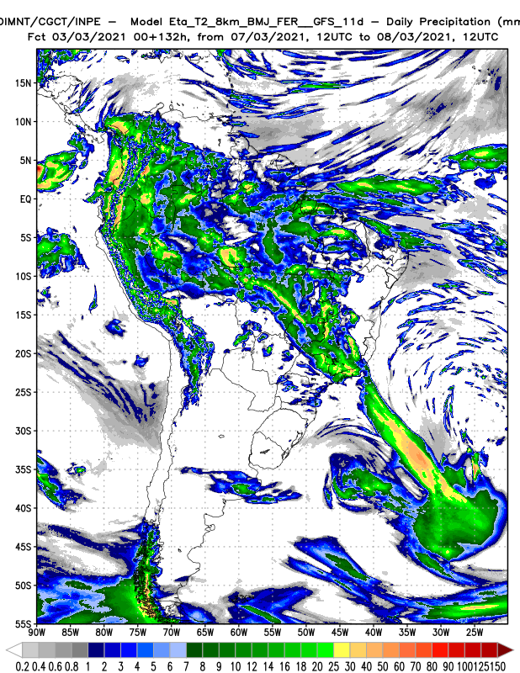
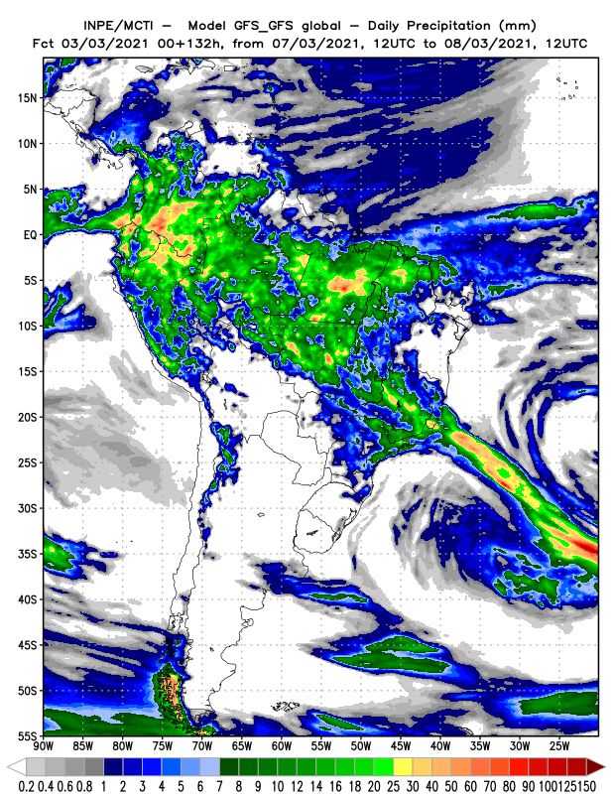

Slide 24
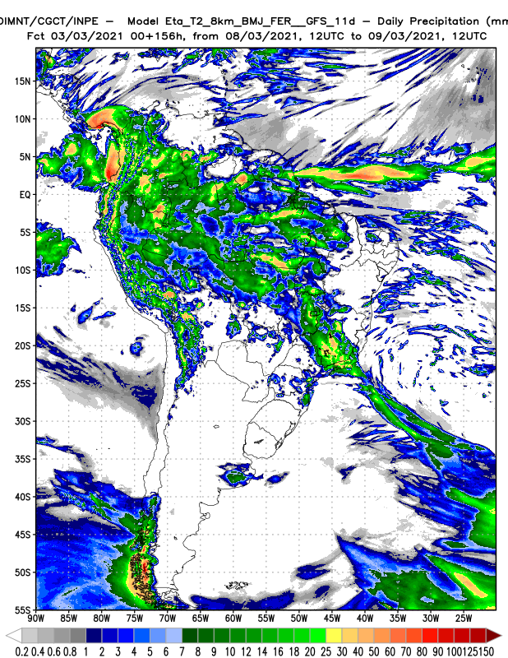


Slide 25



Slide 26



Slide 27



Slide 28



Slide 29


Slide 30
2021030400

Slide 31



Slide 32



Slide 33



Slide 34



Slide 35



Slide 36



Slide 37



Slide 38



Slide 39



Slide 40



Slide 41
2021030500

Slide 42



Slide 43



Slide 44



Slide 45



Slide 46



Slide 47



Slide 48



Slide 49



Slide 50


Slide 51


Slide 52


Slide 53
2021030600

Slide 54



Slide 55



Slide 56



Slide 57



Slide 58



Slide 59



Slide 60



Slide 61



Slide 62



Slide 63


Slide 64


Slide 65
2021030700

Slide 66



Slide 67



Slide 68



Slide 69



Slide 70



Slide 71



Slide 72



Slide 73



Slide 74



Slide 75



Slide 76


Slide 77
2021030700
T2 x T2.3

Slide 78

T2 x T2.3

Slide 79


Slide 80


Slide 81


Slide 82
2021030700
T2 x T2.3

Slide 83


Slide 84


Slide 85


Slide 86


Slide 87


Slide 88


Slide 89


Slide 90


Slide 91


Slide 92


Slide 93
2021030700
T2 (nphys=30, ncnvc=30)
x T3 (nphys=20, ncnvc=20)

Slide 94


Slide 95


Slide 96


Slide 97


Slide 98


Slide 99


Slide 100


Slide 101


Slide 102


Slide 103


Slide 104


Slide 105


