Slide 1
EC30 – EC28
CENAPAD (2D)

Slide 2
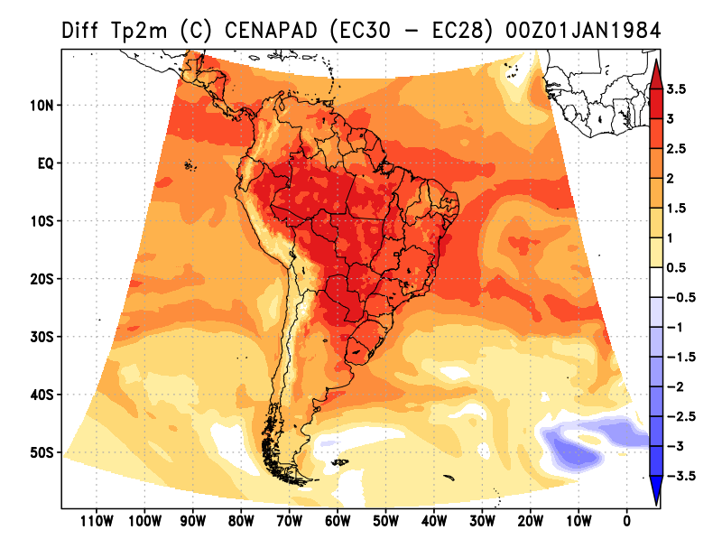
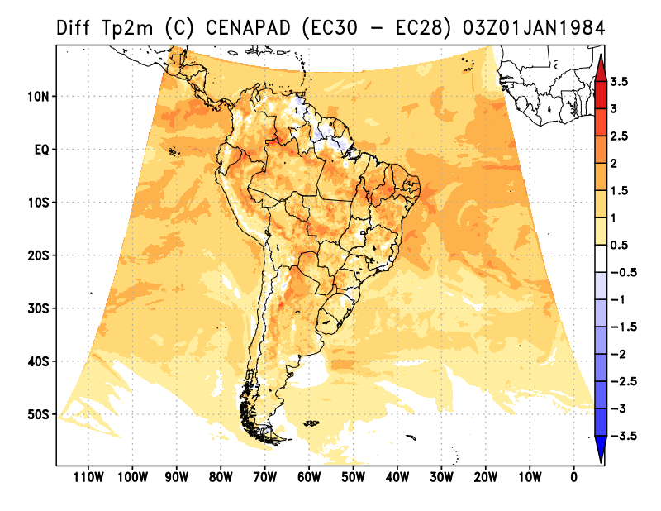
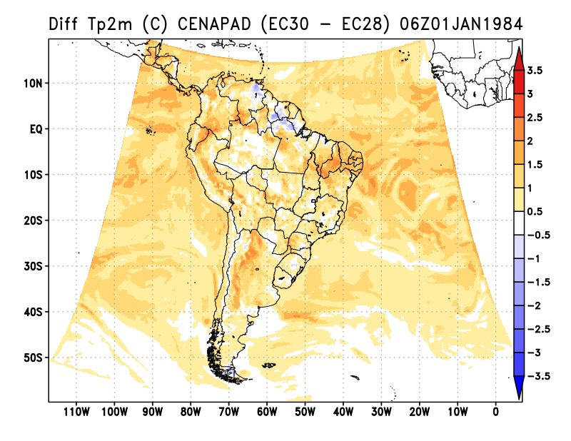
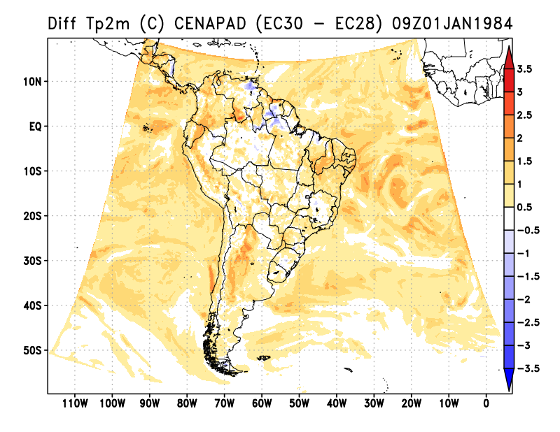
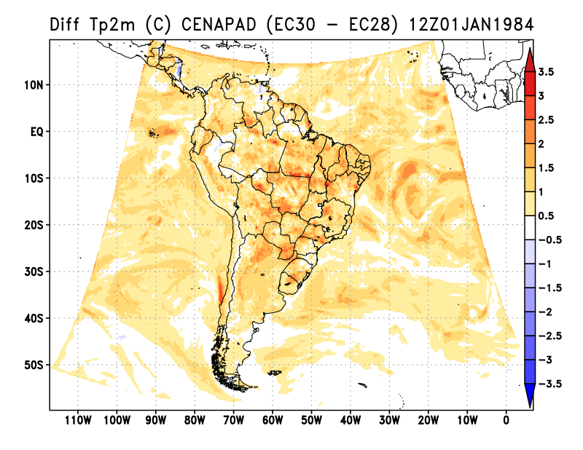
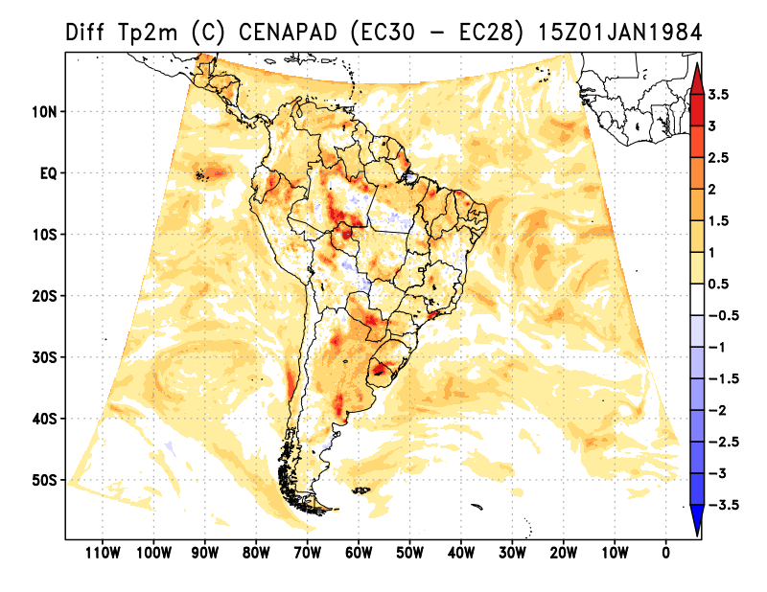
3-Hourly TP2M (°C) Difference CENAPAD(EC30 – EC28)
2D
00h
03h
06h
09h
12h
15h

Slide 3
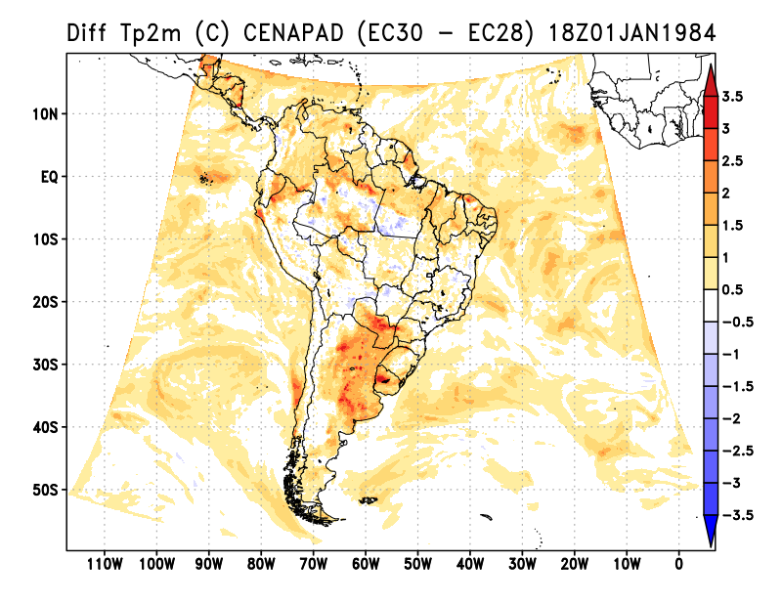
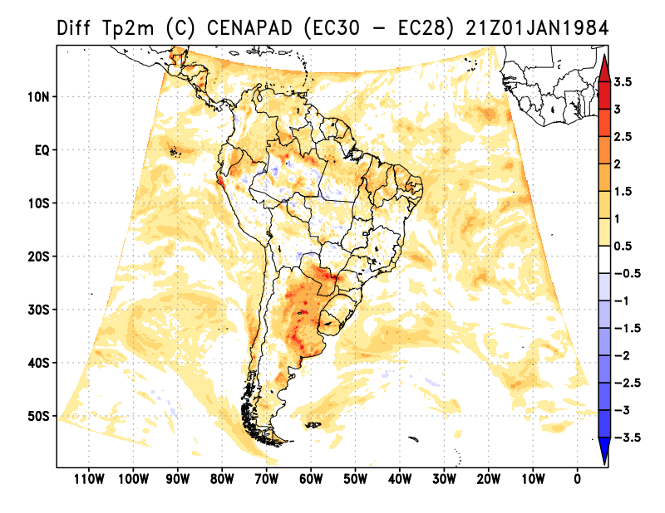
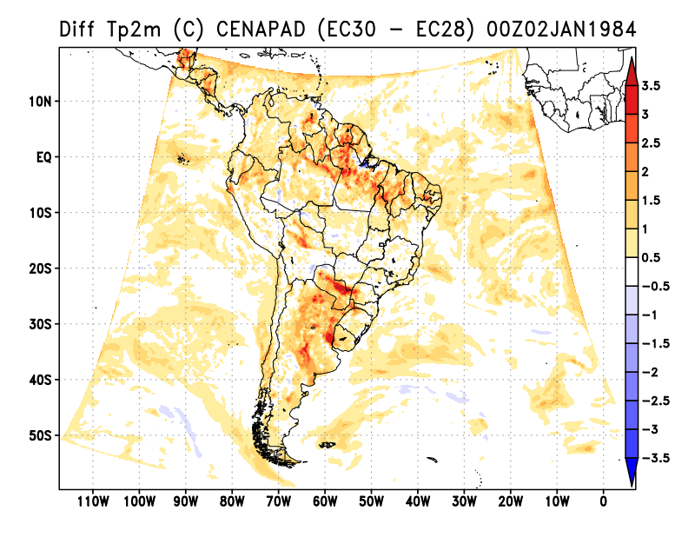
3-Hourly TP2M (°C) Difference CENAPAD(EC30 – EC28)
2D
18h
21h
00h

Slide 4
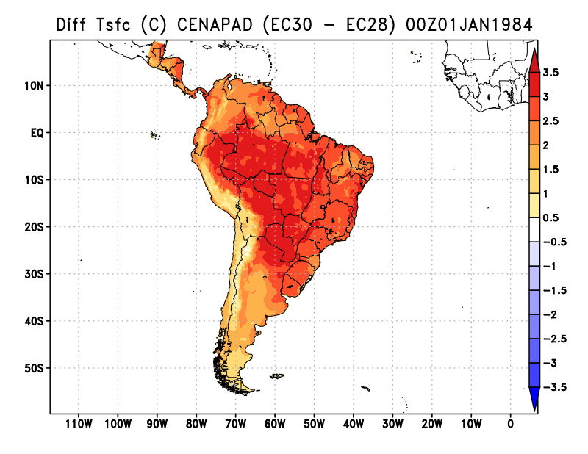
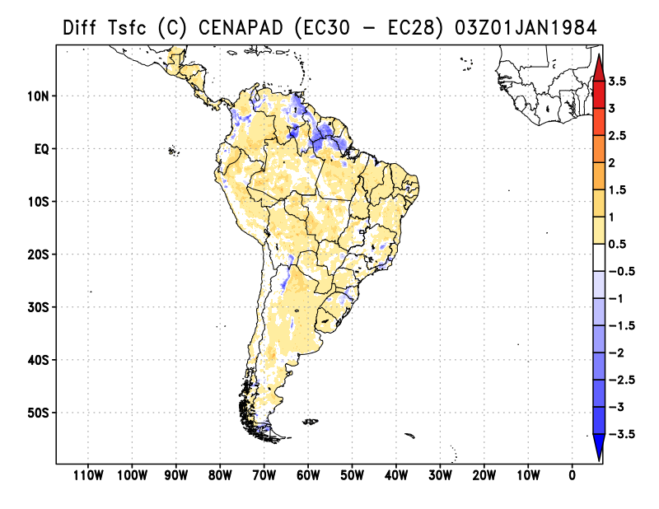
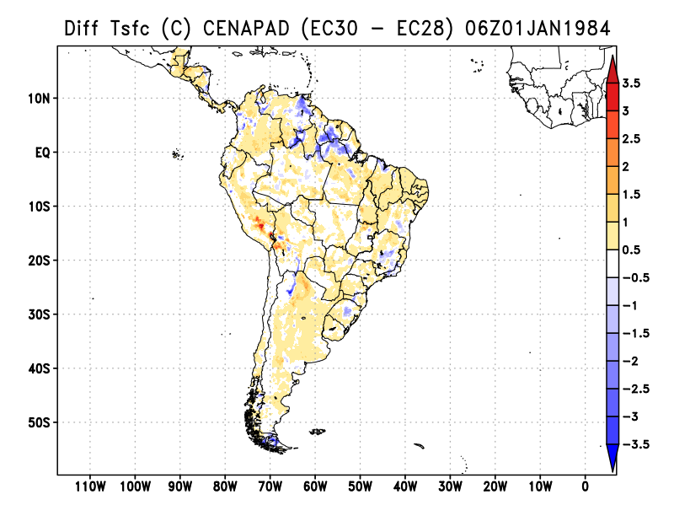
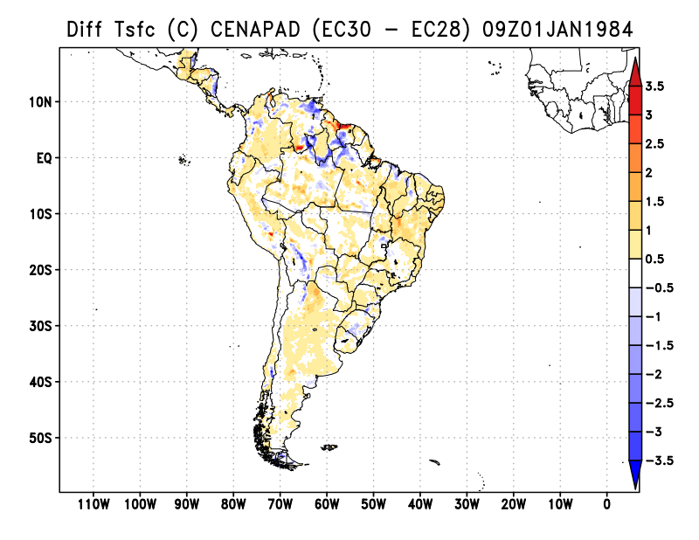
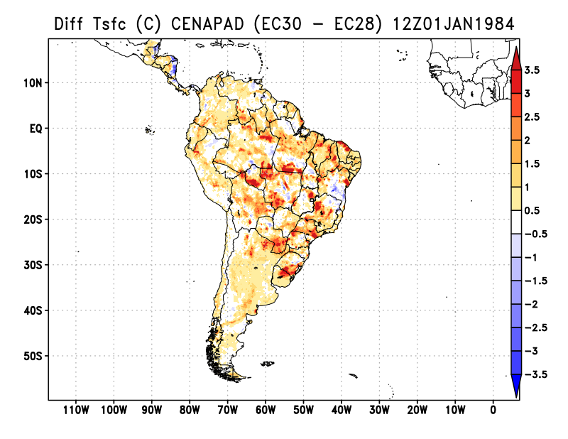
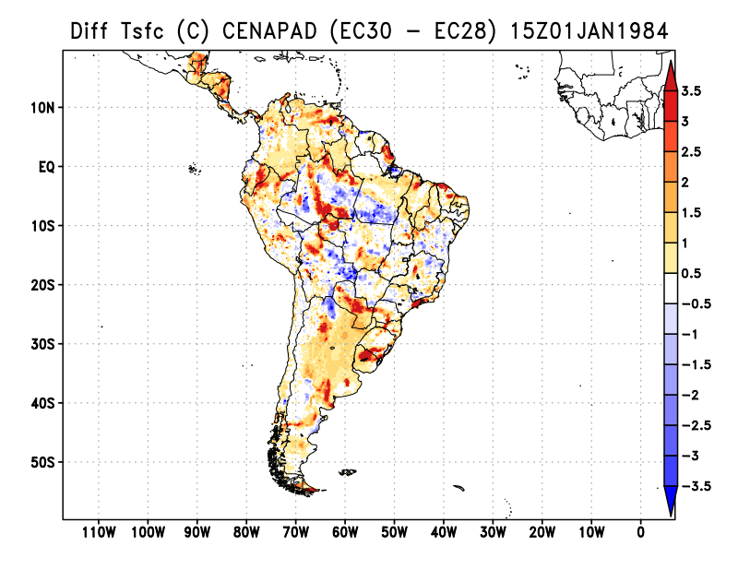
3-Hourly TSFC (°C) Difference CENAPAD(EC30 – EC28)
2D
00h
03h
06h
09h
12h
15h

Slide 5
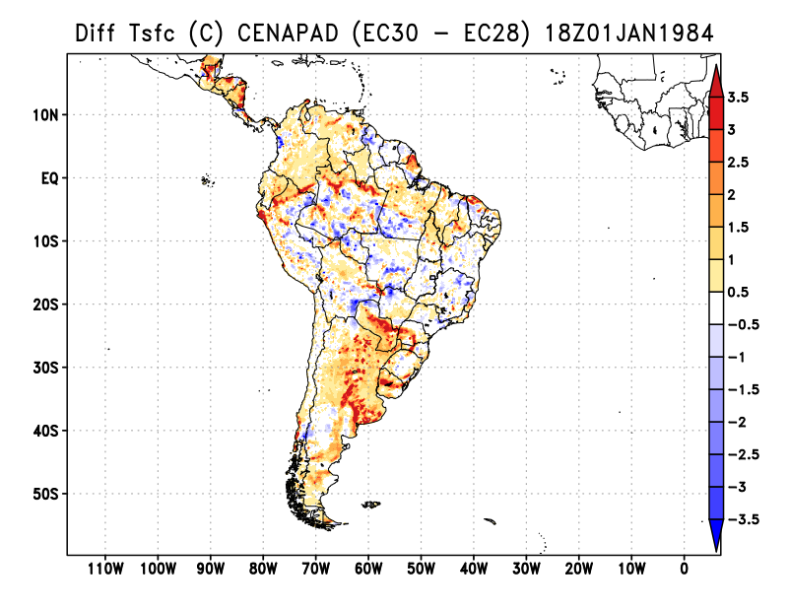
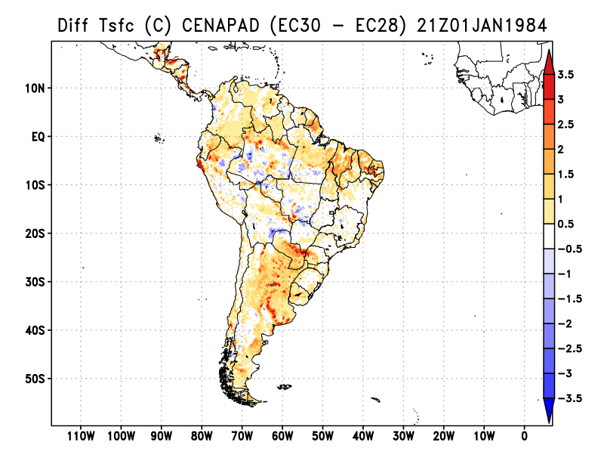
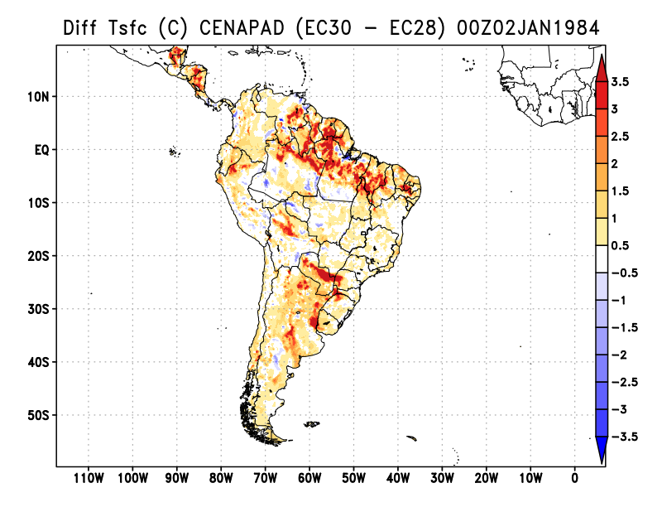
3-Hourly TSFC (°C) Difference CENAPAD(EC30 – EC28)
2D
18h
21h
00h

Slide 6
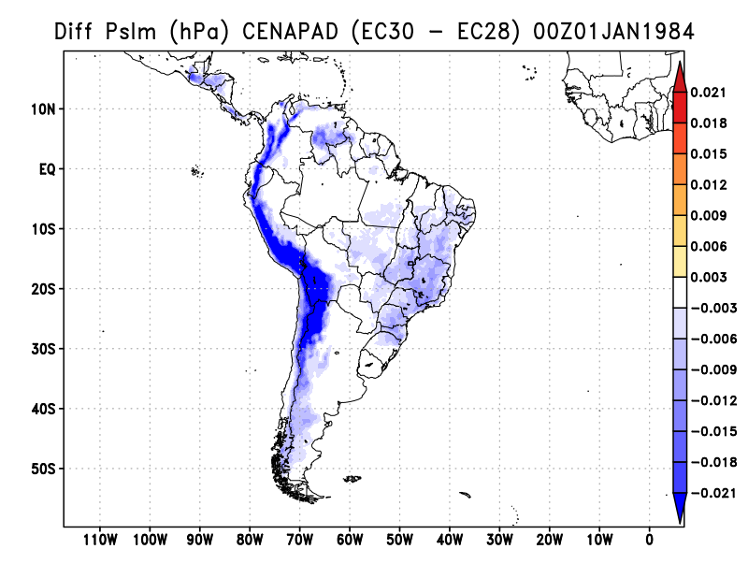
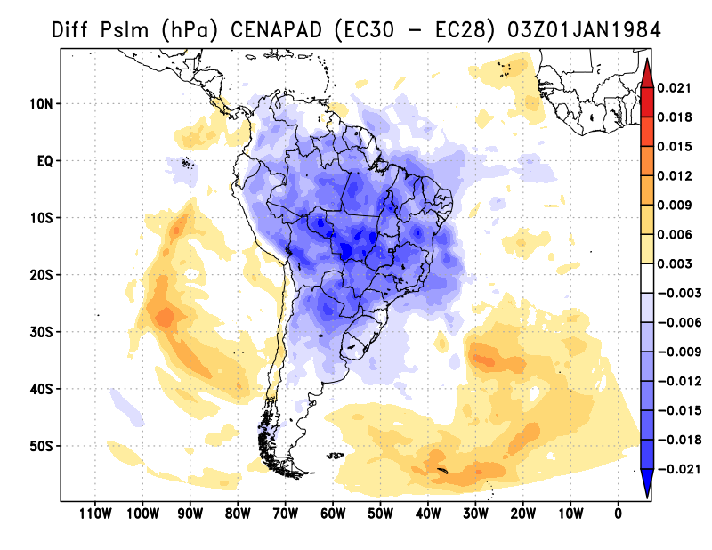
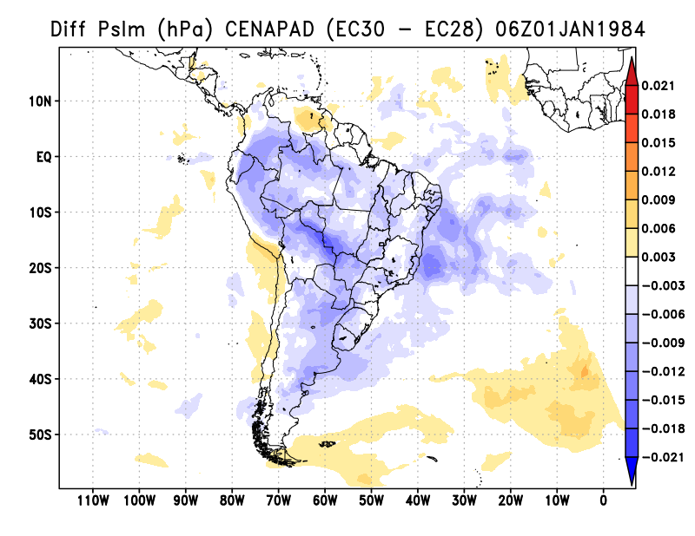
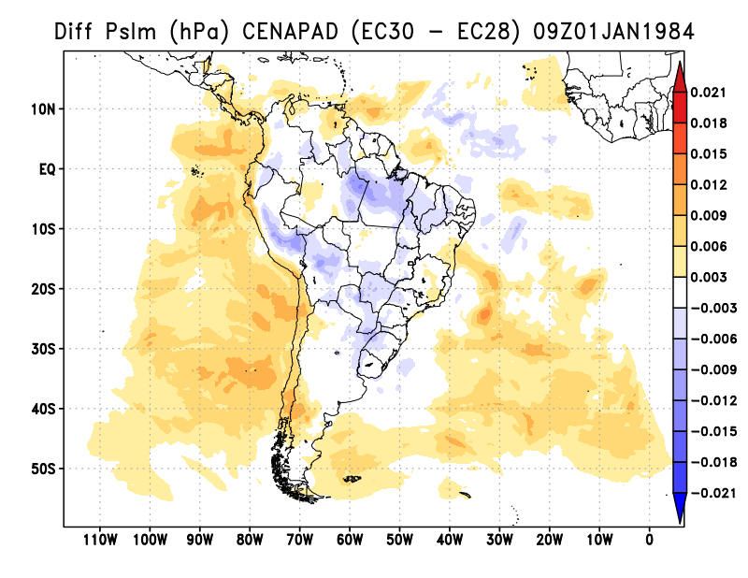
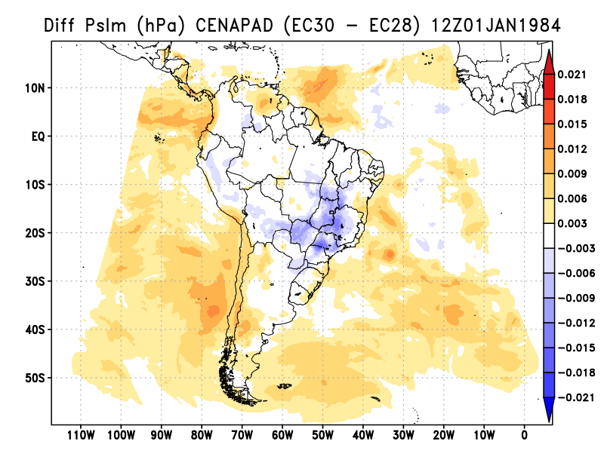
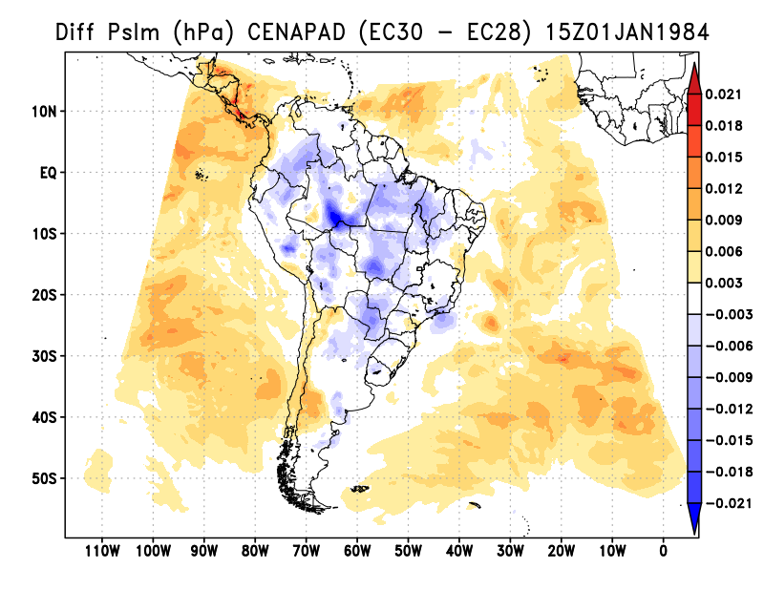
3-Hourly PSLM (hPa) Difference CENAPAD(EC30 – EC28)
2D
00h
03h
06h
09h
12h
15h

Slide 7
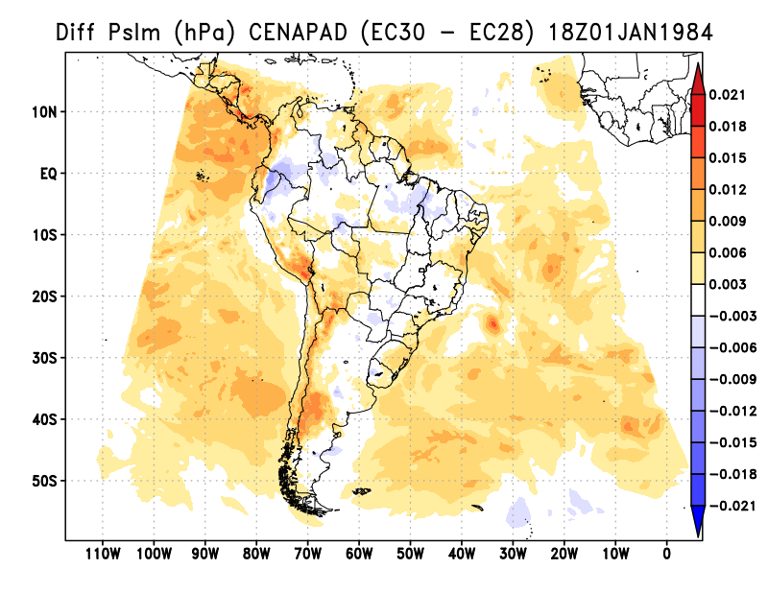
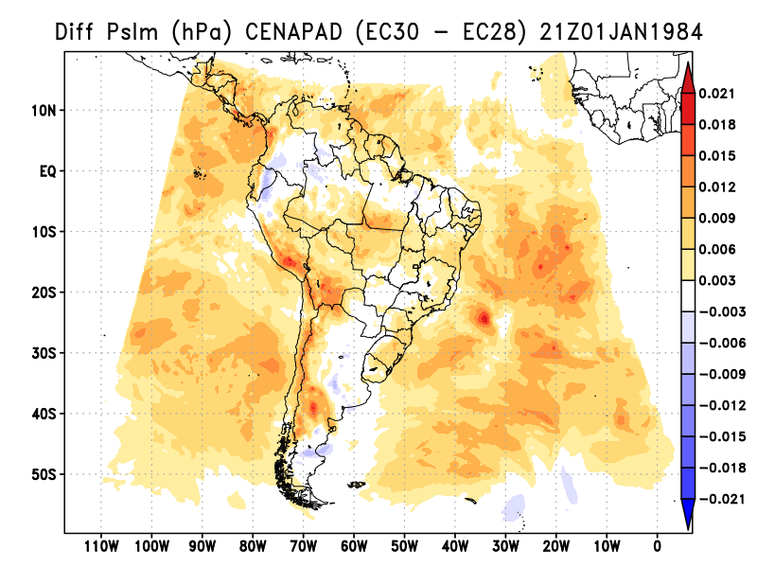
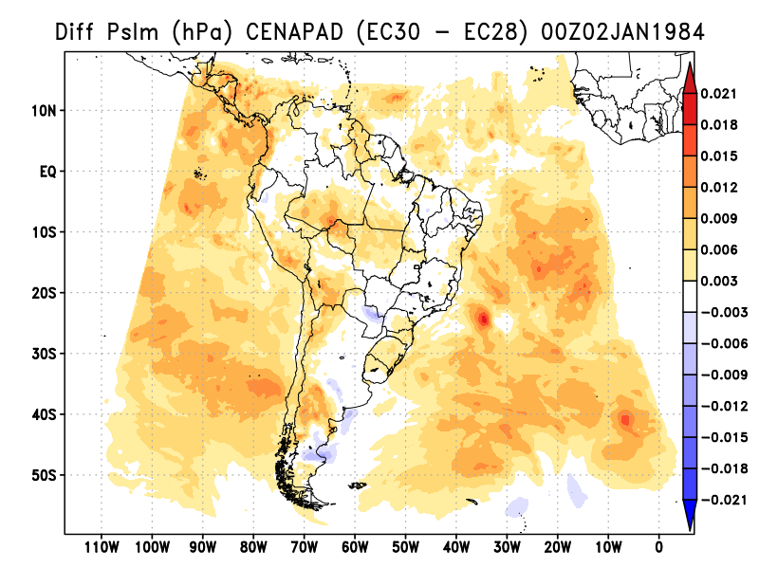
3-Hourly PSLM (hPa) Difference CENAPAD(EC30 – EC28)
2D
18h
21h
00h

Slide 8
EC30 – EC28
CENAPAD (3D)

Slide 9
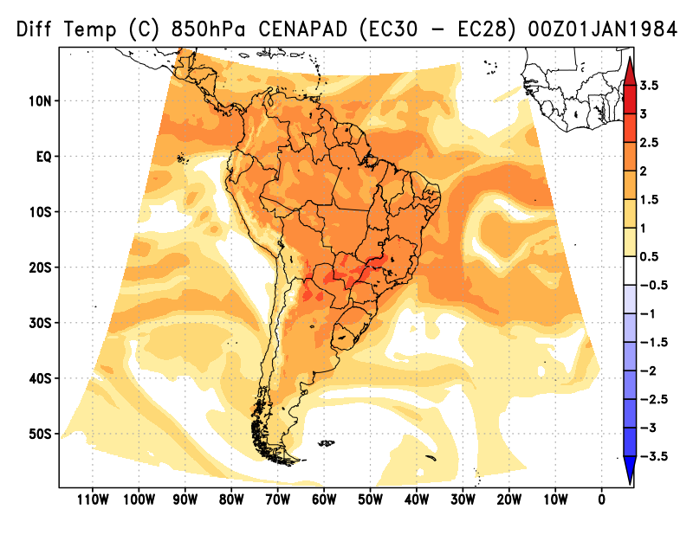
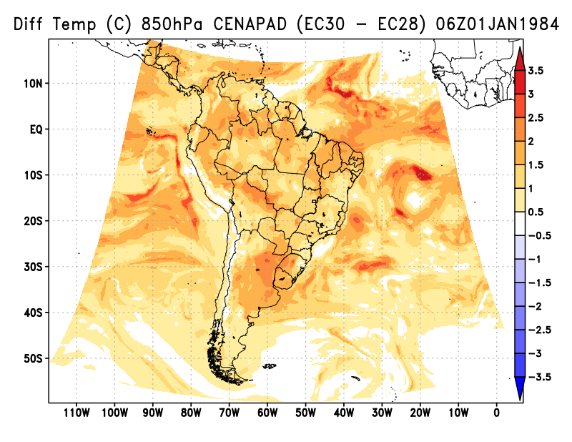
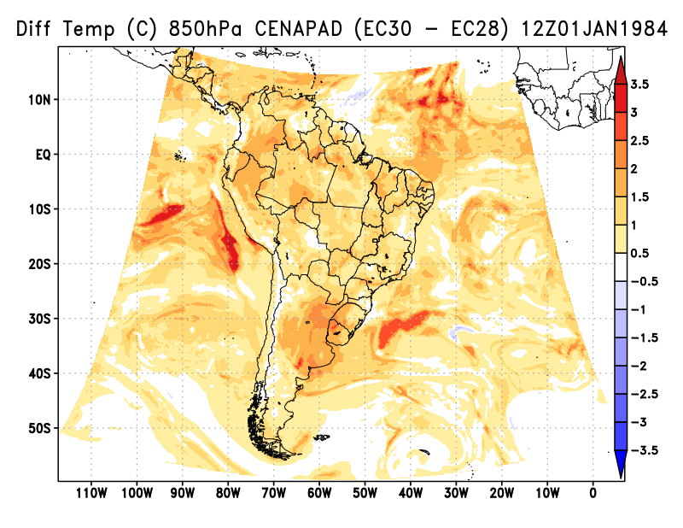
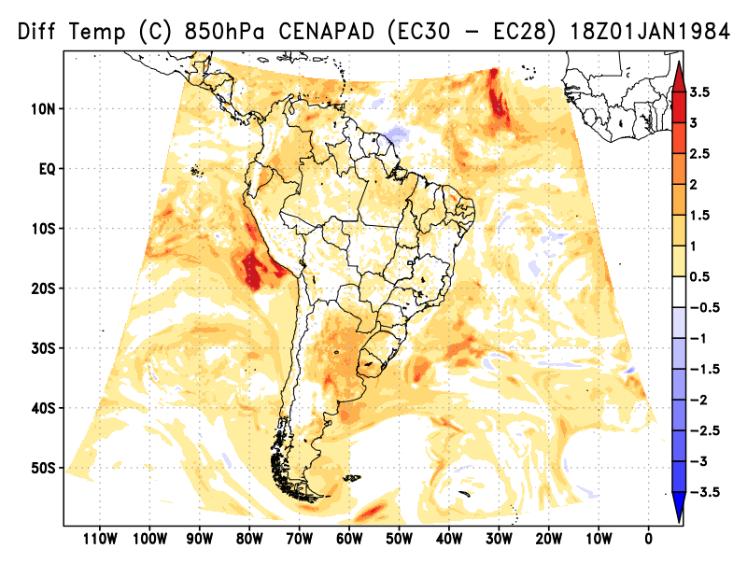
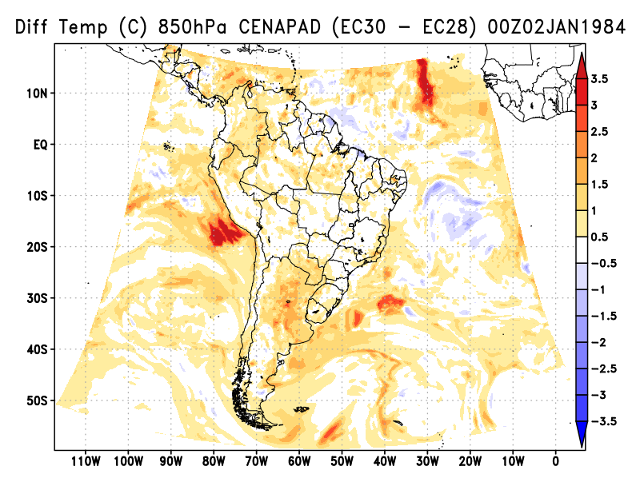
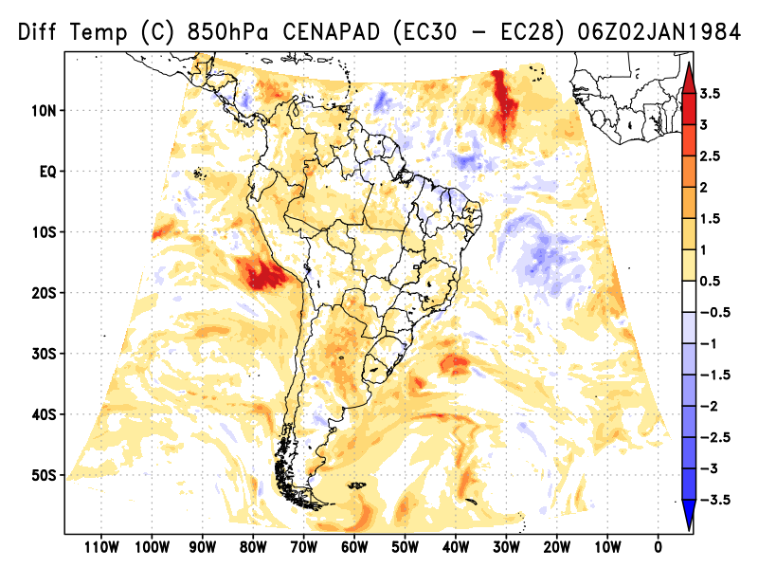
6-Hourly TEMP (°C) Difference CENAPAD(EC30 – EC28) | 850hPa
3D
00h
06h
12h
18h
00h
06h

Slide 10
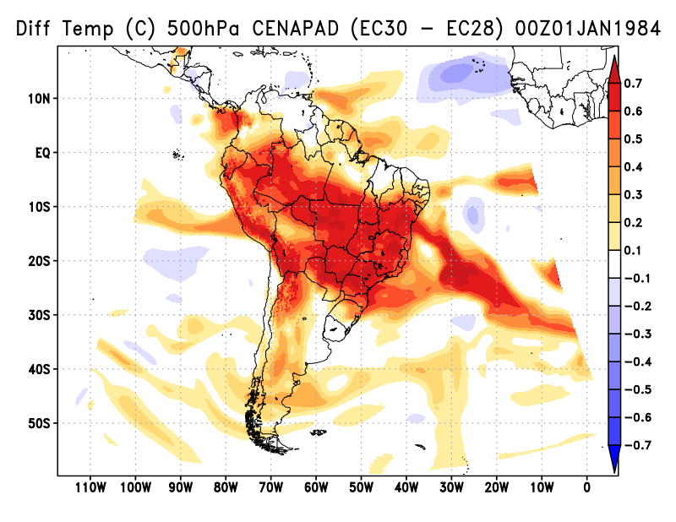
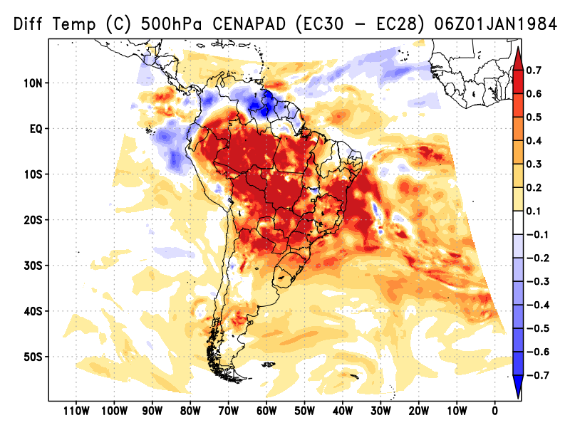
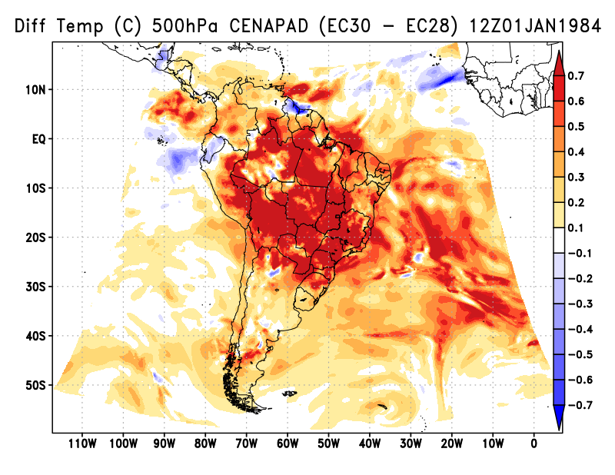
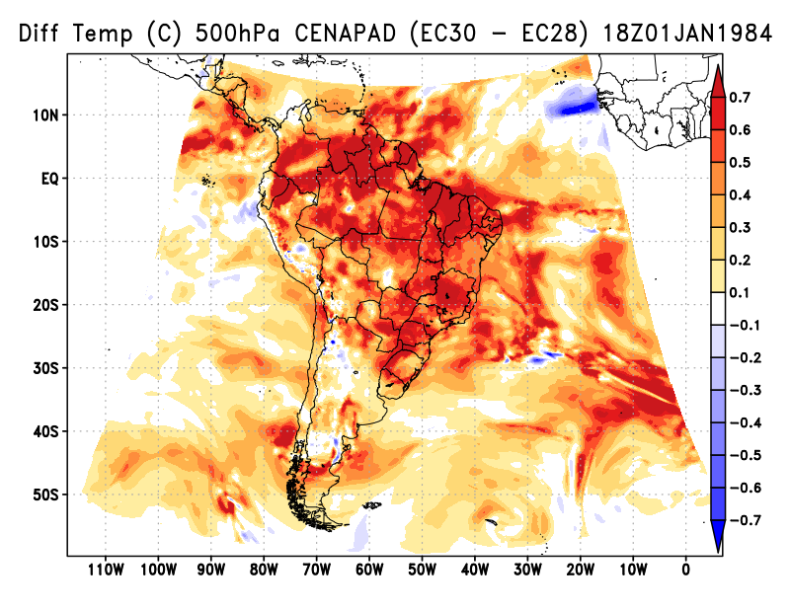
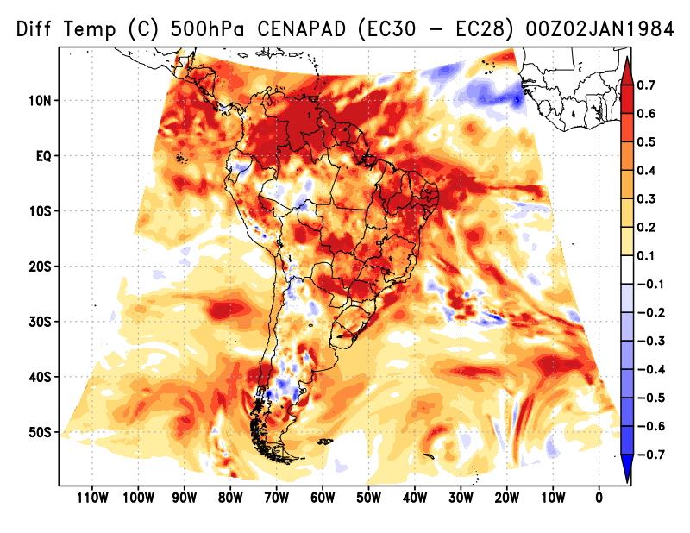
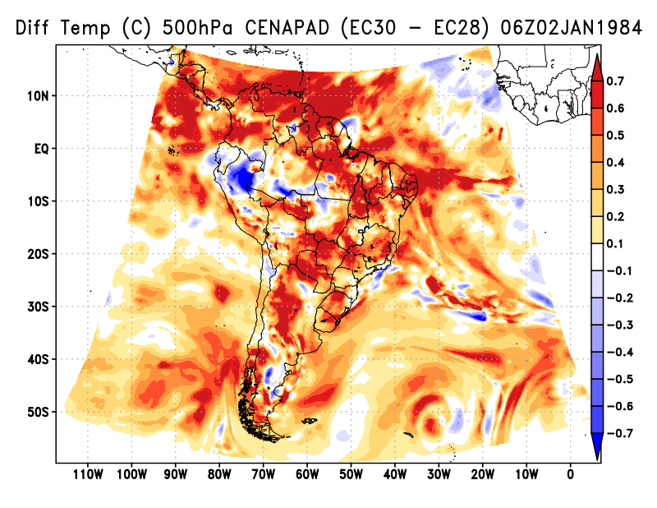
6-Hourly TEMP (°C) Difference CENAPAD(EC30 – EC28) | 500hPa
3D
00h
06h
12h
18h
00h
06h

Slide 11
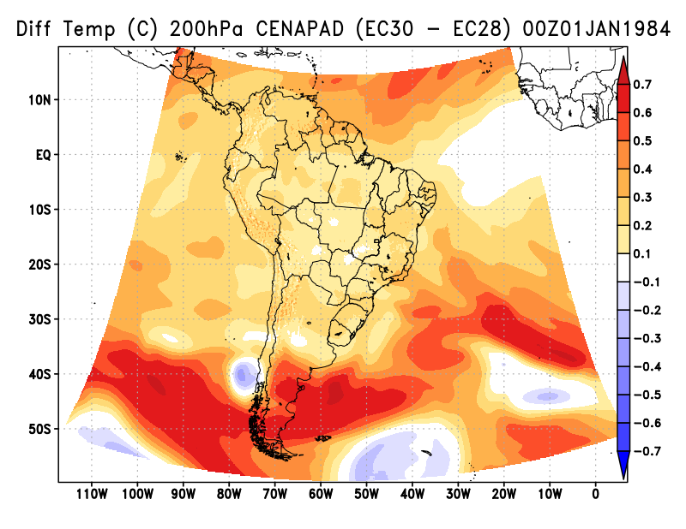
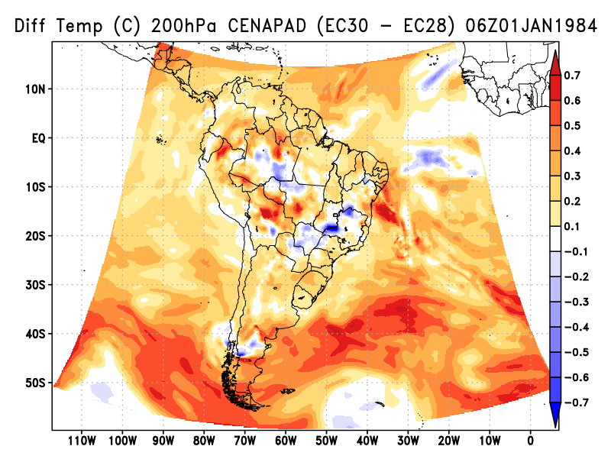
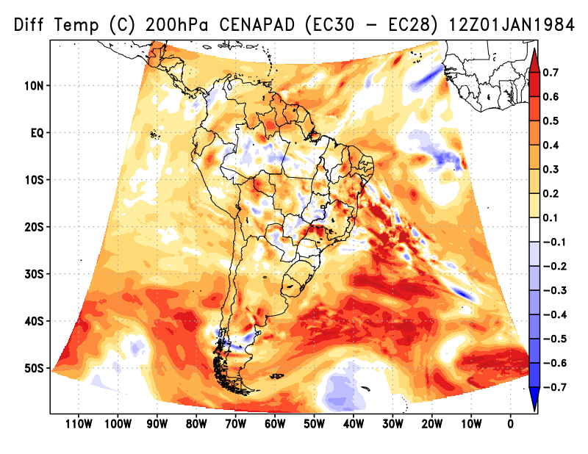
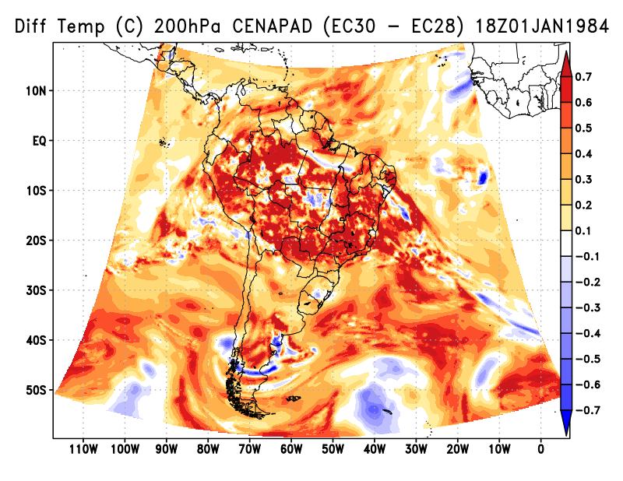
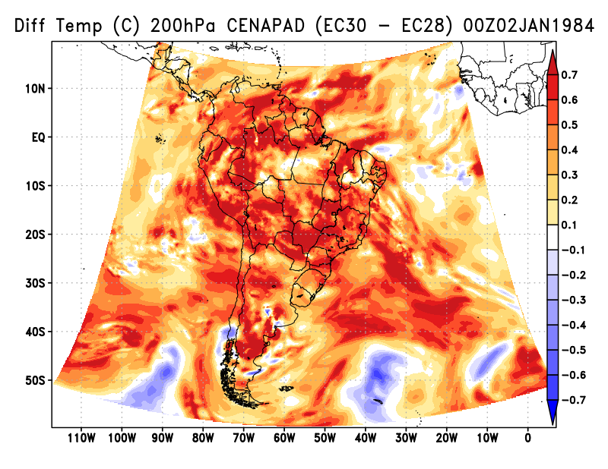
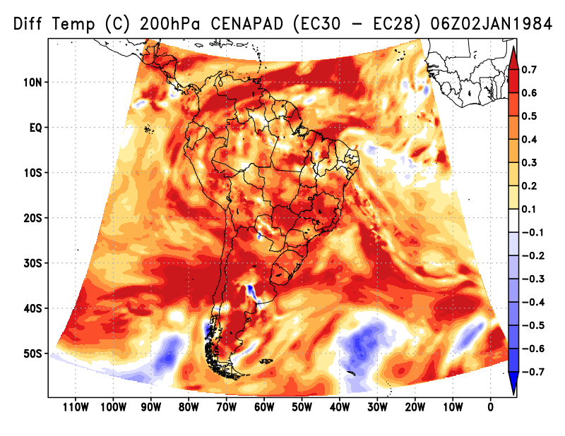
6-Hourly TEMP (°C) Difference CENAPAD(EC30 – EC28) | 200hPa
3D
00h
06h
12h
18h
00h
06h

Slide 12
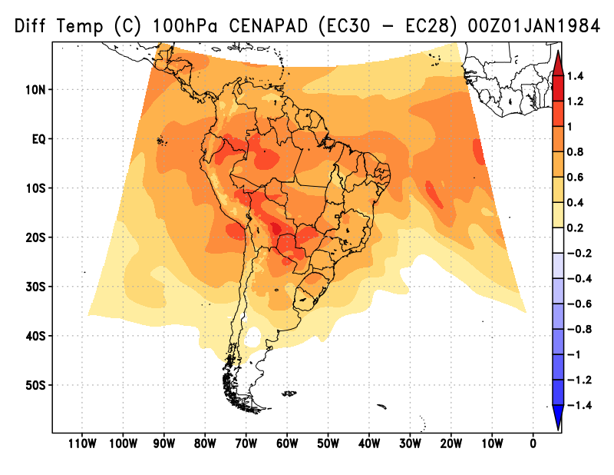
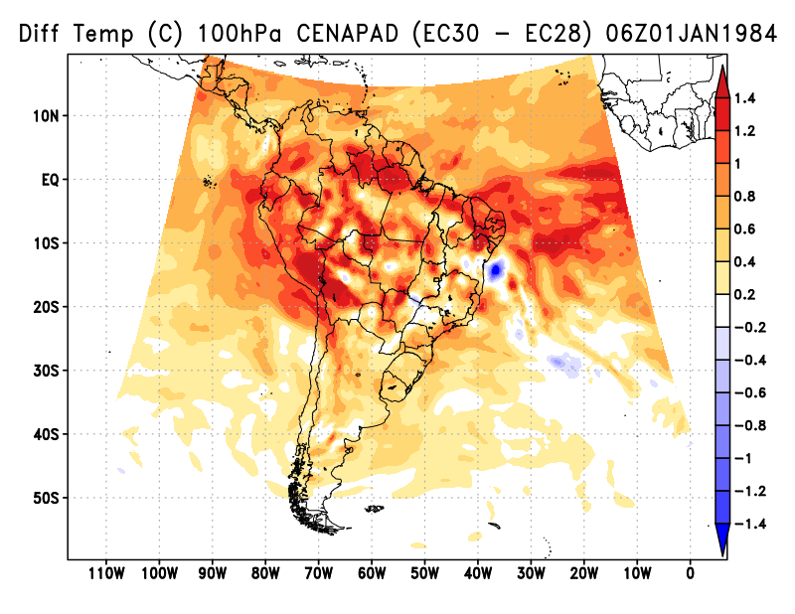
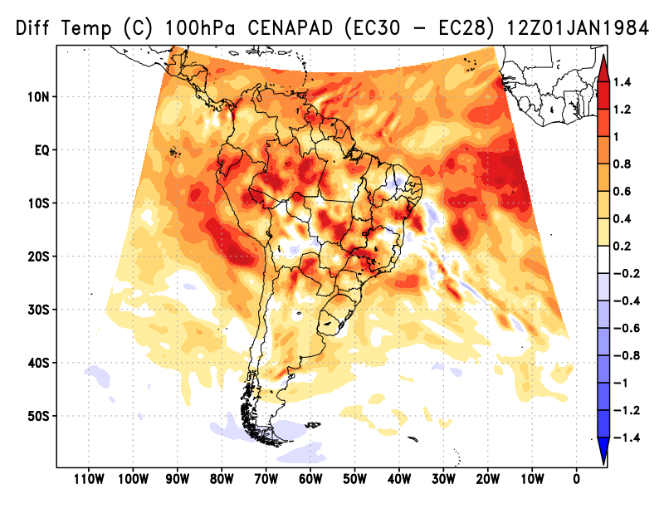
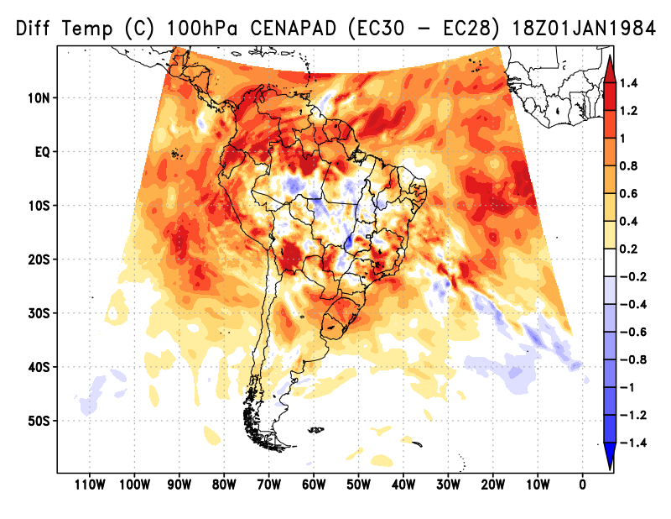
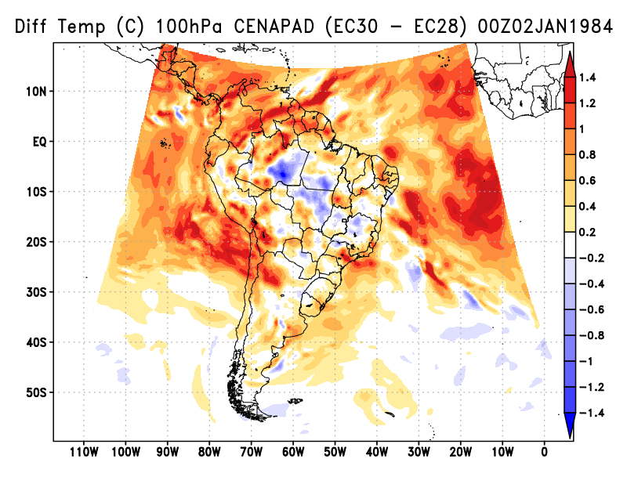

6-Hourly TEMP (°C) Difference CENAPAD(EC30 – EC28) | 100hPa
3D
00h
06h
12h
18h
00h
06h

Slide 13






6-Hourly TEMP (°C) Difference CENAPAD(EC30 – EC28) | 50hPa
3D
00h
06h
12h
18h
00h
06h

Slide 14






6-Hourly ZGEO (m) Difference CENAPAD(EC30 – EC28) | 850hPa
3D
00h
06h
12h
18h
00h
06h

Slide 15






6-Hourly ZGEO (m) Difference CENAPAD(EC30 – EC28) | 500hPa
3D
00h
06h
12h
18h
00h
06h

Slide 16






6-Hourly ZGEO (m) Difference CENAPAD(EC30 – EC28) | 200hPa
3D
00h
06h
12h
18h
00h
06h

Slide 17






6-Hourly ZGEO (m) Difference CENAPAD(EC30 – EC28) | 100hPa
3D
00h
06h
12h
18h
00h
06h

Slide 18






6-Hourly ZGEO (m) Difference CENAPAD(EC30 – EC28) | 50hPa
3D
00h
06h
12h
18h
00h
06h

Slide 19






6-Hourly UVEL (m/s) Difference CENAPAD(EC30 – EC28) | 850hPa
3D
00h
06h
12h
18h
00h
06h

Slide 20






6-Hourly UVEL (m/s) Difference CENAPAD(EC30 – EC28) | 500hPa
3D
00h
06h
12h
18h
00h
06h

Slide 21






6-Hourly UVEL (m/s) Difference CENAPAD(EC30 – EC28) | 200hPa
3D
00h
06h
12h
18h
00h
06h

Slide 22






6-Hourly UVEL (m/s) Difference CENAPAD(EC30 – EC28) | 100hPa
3D
00h
06h
12h
18h
00h
06h

Slide 23






6-Hourly UVEL (m/s) Difference CENAPAD(EC30 – EC28) | 50hPa
3D
00h
06h
12h
18h
00h
06h

Slide 24






6-Hourly VVEL (m/s) Difference CENAPAD(EC30 – EC28) | 850hPa
3D
00h
06h
12h
18h
00h
06h

Slide 25






6-Hourly VVEL (m/s) Difference CENAPAD(EC30 – EC28) | 500hPa
3D
00h
06h
12h
18h
00h
06h

Slide 26






6-Hourly VVEL (m/s) Difference CENAPAD(EC30 – EC28) | 200hPa
3D
00h
06h
12h
18h
00h
06h

Slide 27






6-Hourly VVEL (m/s) Difference CENAPAD(EC30 – EC28) | 100hPa
3D
00h
06h
12h
18h
00h
06h

Slide 28






6-Hourly VVEL (m/s) Difference CENAPAD(EC30 – EC28) | 50hPa
3D
00h
06h
12h
18h
00h
06h

Slide 29






6-Hourly UMES (kg/kg) Difference CENAPAD(EC30 – EC28) | 850hPa
3D
00h
06h
12h
18h
00h
06h

Slide 30






6-Hourly UMES (kg/kg) Difference CENAPAD(EC30 – EC28) | 500hPa
3D
00h
06h
12h
18h
00h
06h

Slide 31






6-Hourly UMES (kg/kg) Difference CENAPAD(EC30 – EC28) | 200hPa
3D
00h
06h
12h
18h
00h
06h

Slide 32






6-Hourly UMES (kg/kg) Difference CENAPAD(EC30 – EC28) | 100hPa
3D
00h
06h
12h
18h
00h
06h

Slide 33






6-Hourly UMES (kg/kg) Difference CENAPAD(EC30 – EC28) | 50hPa
3D
00h
06h
12h
18h
00h
06h

