Slide 1
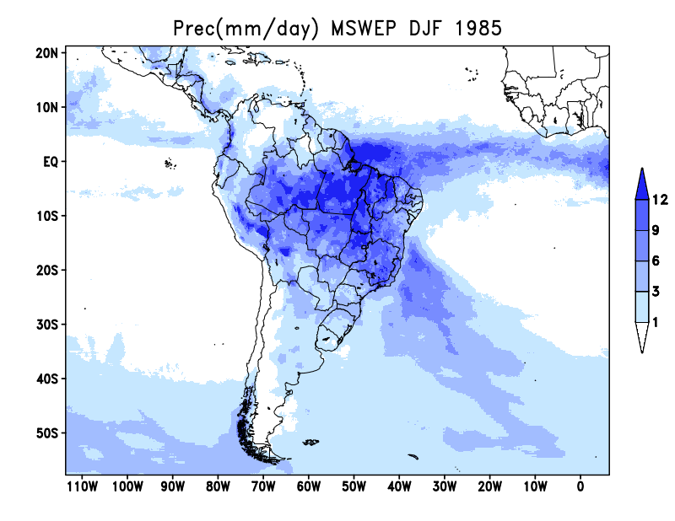
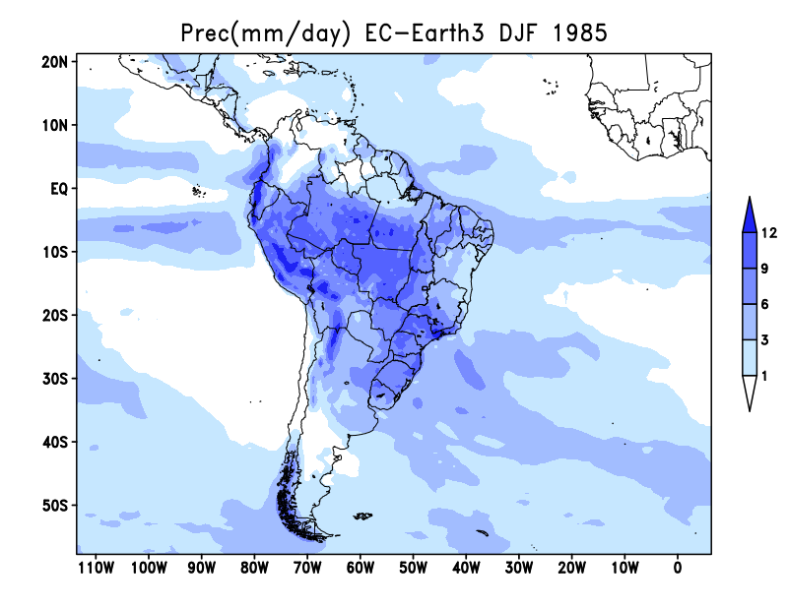
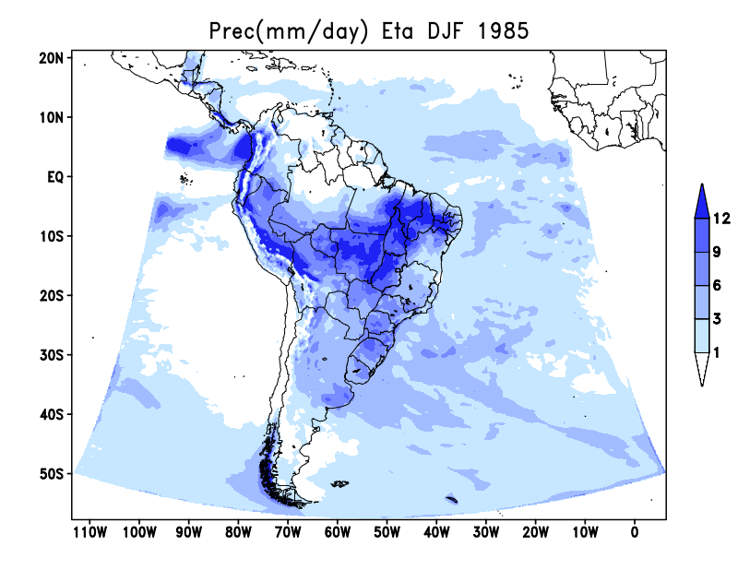
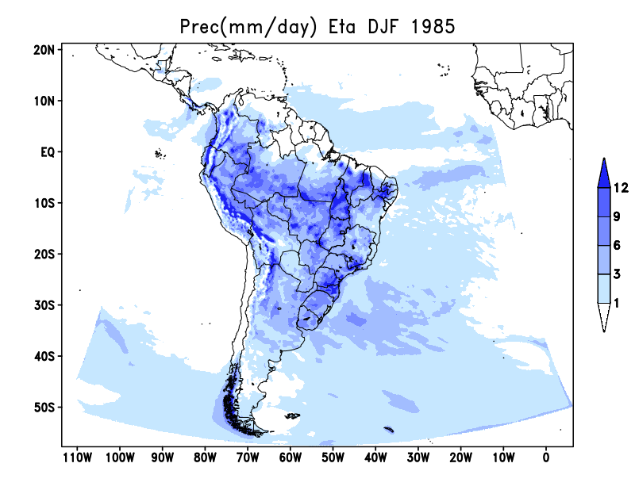
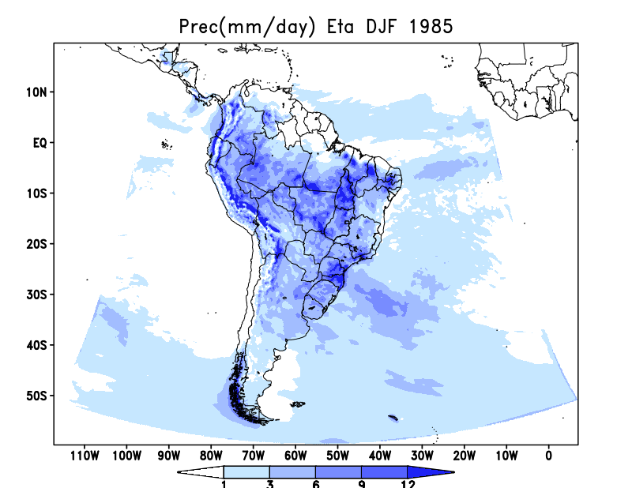
MSWEP
EC-Earth3
DJF 1985
309x553x38 T_dry alb_updt
309x553x38 MIXLEN_23ee alb_clim
289x583x38 MIXLEN_23ee alb_clim

Slide 2
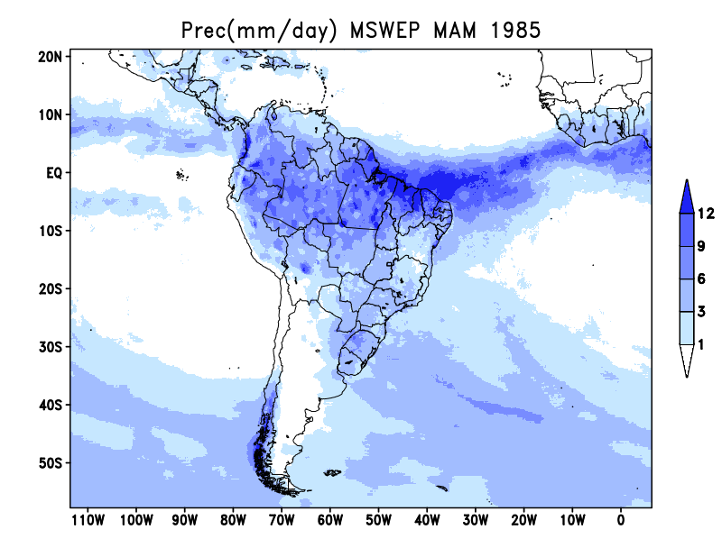
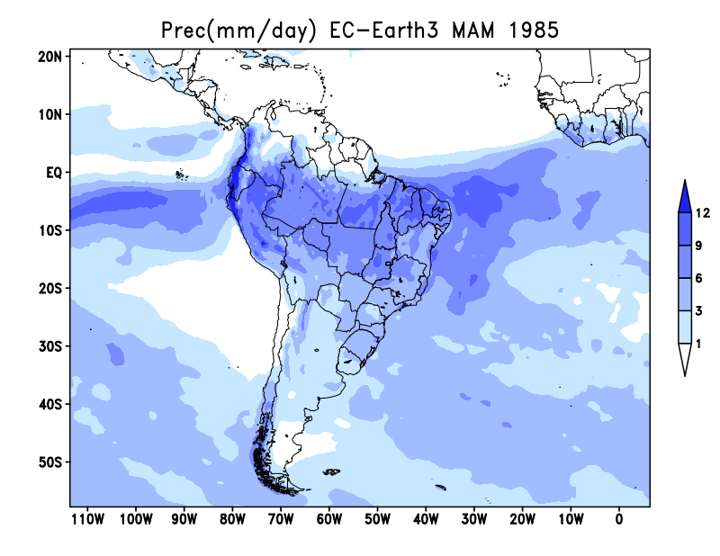
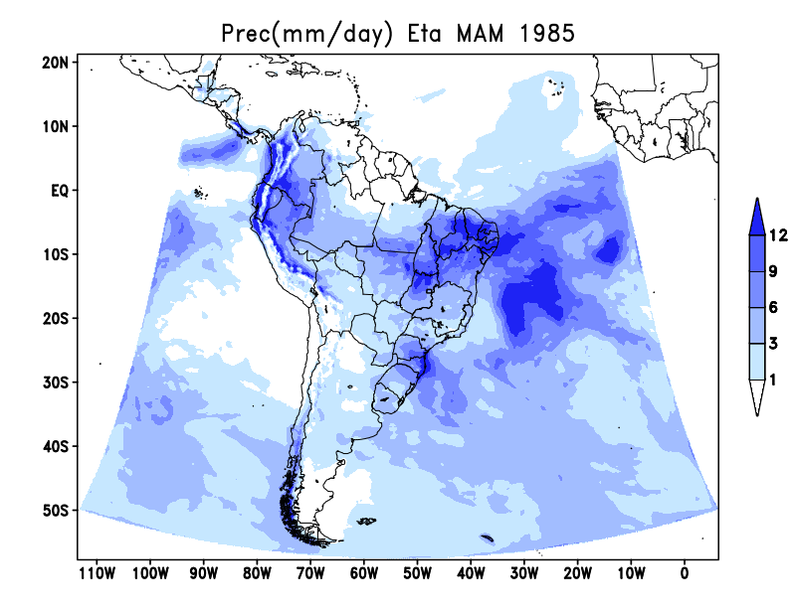
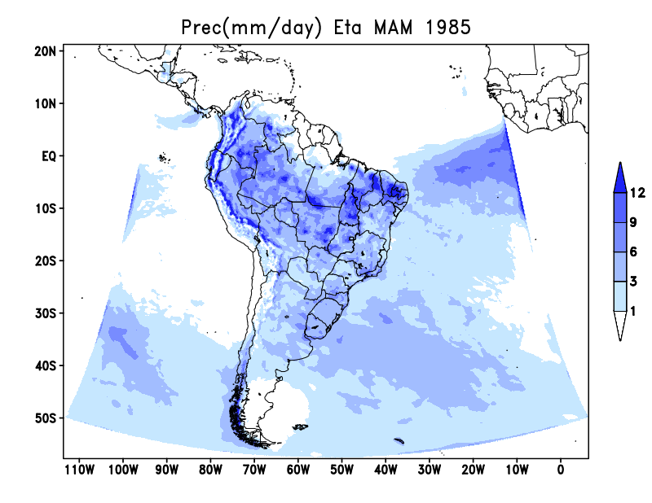
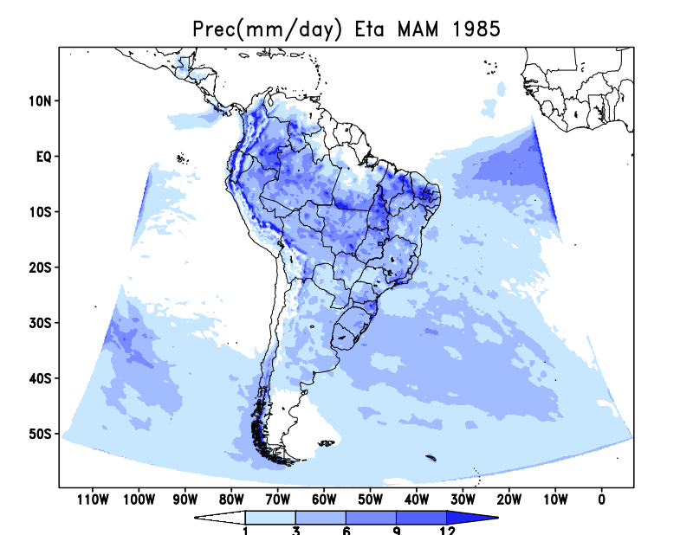
MSWEP
EC-Earth3
MAM 1985
309x553x38 T_dry alb_updt
309x553x38 MIXLEN_23ee alb_clim
289x583x38 MIXLEN_23ee alb_clim

Slide 3
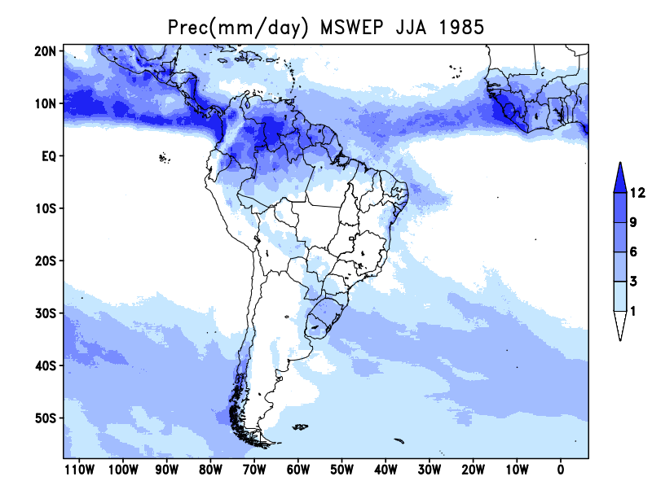
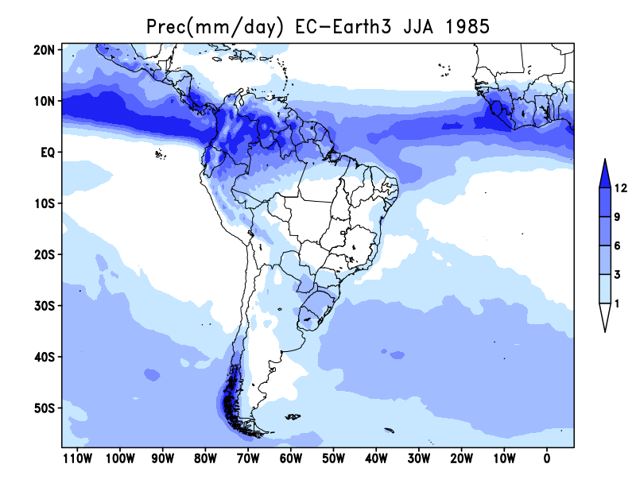
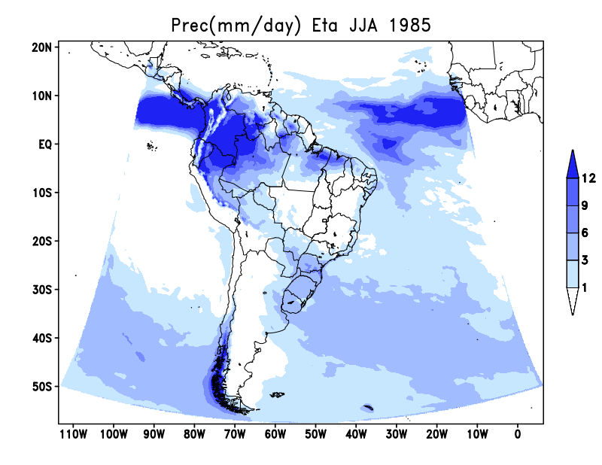
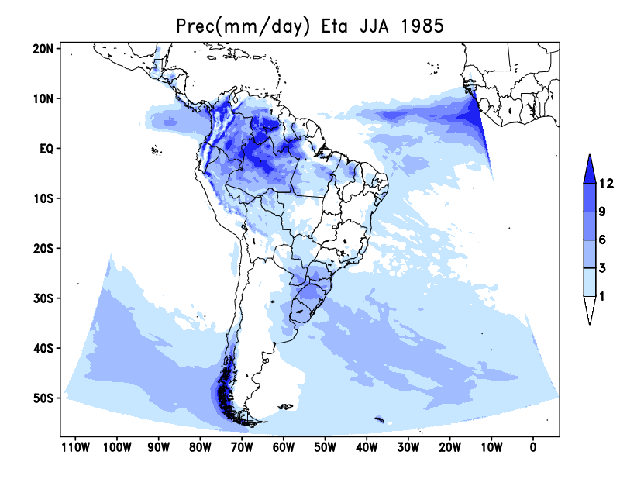
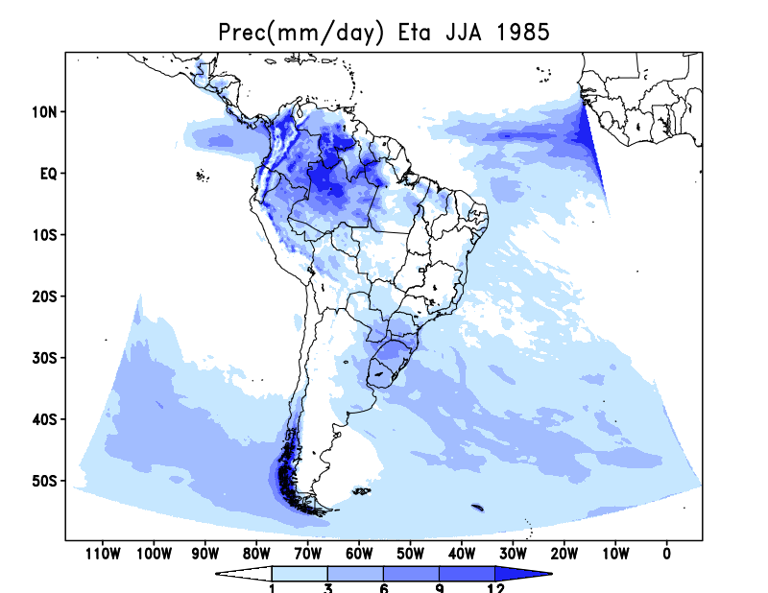
MSWEP
EC-Earth3
JJA 1985
309x553x38 T_dry alb_updt
309x553x38 MIXLEN_23ee alb_clim
289x583x38 MIXLEN_23ee alb_clim

Slide 4
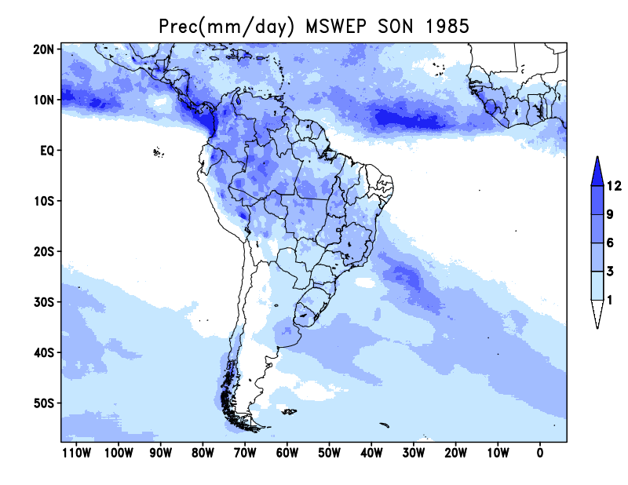
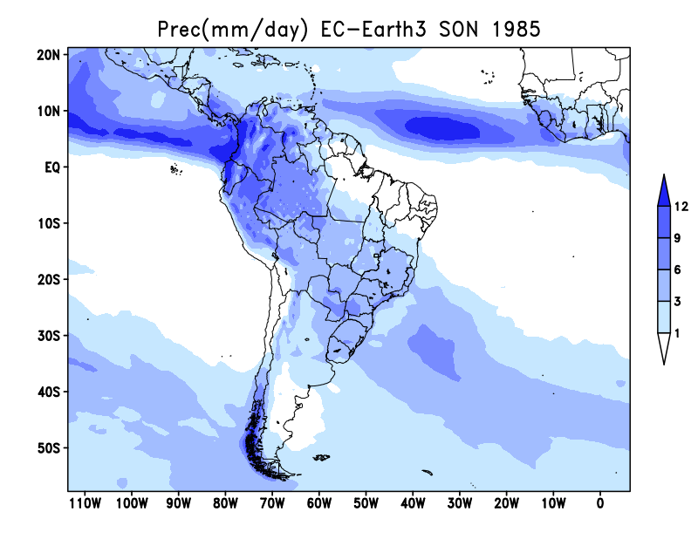
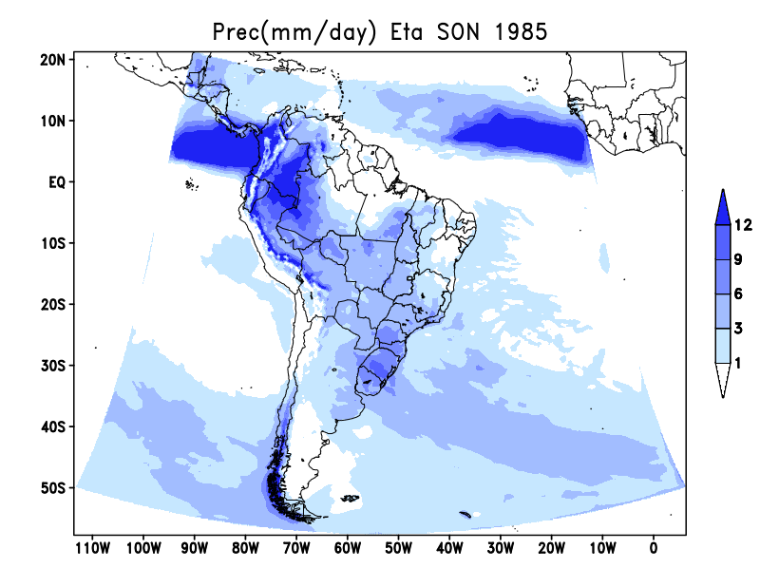
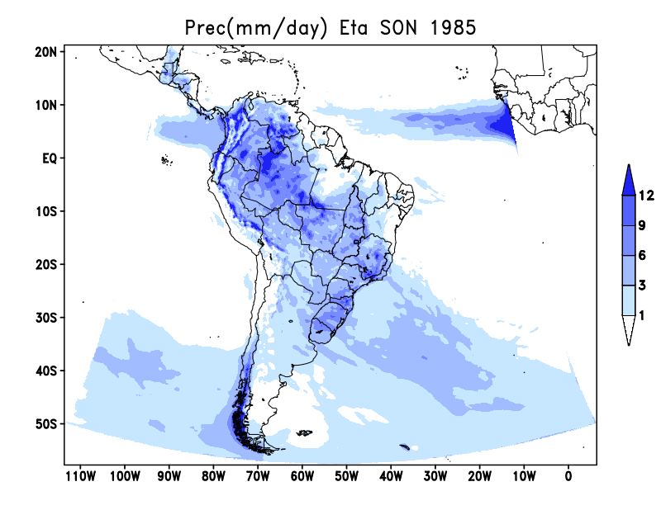
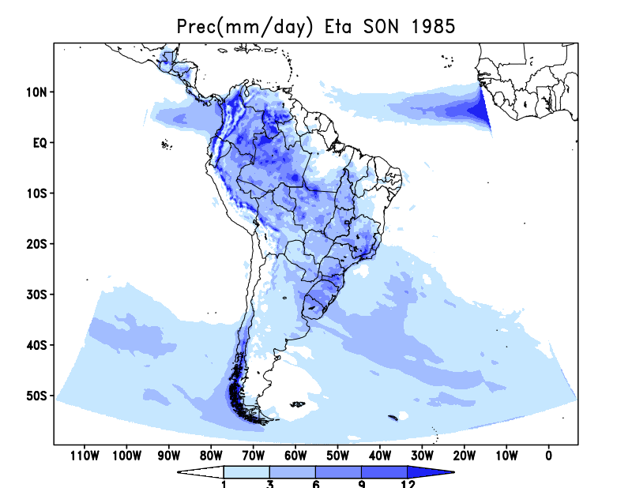
MSWEP
EC-Earth3
SON 1985
309x553x38 T_dry alb_updt
309x553x38 MIXLEN_23ee alb_clim
289x583x38 MIXLEN_23ee alb_clim

Slide 5
Parâ metro | V1.1.0 cuparm -Terceira comunicação Nacional | V1.3.0 cuparm - inicial | V1.3.0 cuparm – Diego Campos | V1.3.0 cuparm – Diego Campos modificado | V1.3.0 cuparm – chou (HDIFFS x HDIFF) | V1.4.0 cuparmdata_MC.dat -Mudanças climáticas
FSS | .85 | .85 | 1.00 | 0.80 | 0.80 | 0.80
DSPBFS | -3875 | -3400 | -4500 | -4500 | -4500 (-3500) | -3500
DSP0FS | -5875 | -4400 | -5500 | -5500 | -5500 | -5500
DSPTFS | -1875 | -1500 | -1875 | -1875 | -1875 | -1875
FSL | .85 | .85 | 1.00 | .95 | 1.00 | 1.00
DSPBFL | -4500 | -4000 | -4000 | -4000 | -4000 | -4000
DSP0FL | -5500 | -4800 | -3500 | -3500 | -5000 | -5000
DSPTFL | -2000 | -1800 | -2000 | -2000 | -2000 | -2000
&CUPARMDATA
STABS=1.0,STABD=0.95,STABFC=1.00,DTTOP=0.0,
RHF=0.10,EPSUP=1.00,EPSDN=1.05,EPSTH=0.0,
PBM=13000.,PQM=20000.,PNO=1000.,PONE=2500.,PSH=29000.,
PFRZ=15000.,PSHU=45000.,
UNIS=.FALSE.,UNIL=.FALSE.,OCT90=.FALSE.,
FSS=0.8,EFIMN=.20,EFMNT=.70,FCC=.50,
DSPBFL=-2000.,DSP0FL=-5000.,DSPTFL=-2000.,FSL=1.0,
DSPBFS=-3500.,DSP0FS=-5500.,DSPTFS=-1850.,
TREL=3250.,EPSNTP=.0010,EFIFC=5.0,
DSPC=-3000.,EPSP=1.E-7,
STEFI=1.,
&END
Notes:
&CUPARMDATA
STABS=1.0,STABD=0.95,STABFC=1.00,DTTOP=0.0,
RHF=0.10,EPSUP=1.00,EPSDN=1.05,EPSTH=0.0,
PBM=13000.,PQM=20000.,PNO=1000.,PONE=2500.,PSH=29000.,
PFRZ=15000.,PSHU=45000.,
UNIS=.FALSE.,UNIL=.FALSE.,OCT90=.FALSE.,
FSS=0.8,EFIMN=.20,EFMNT=.70,FCC=.50,
DSPBFL=-2000.,DSP0FL=-5000.,DSPTFL=-2000.,FSL=1.0,
DSPBFS=-3500.,DSP0FS=-5500.,DSPTFS=-1850.,
TREL=3250.,EPSNTP=.0010,EFIFC=5.0,
DSPC=-3000.,EPSP=1.E-7,
STEFI=1.,
&END

Slide 6
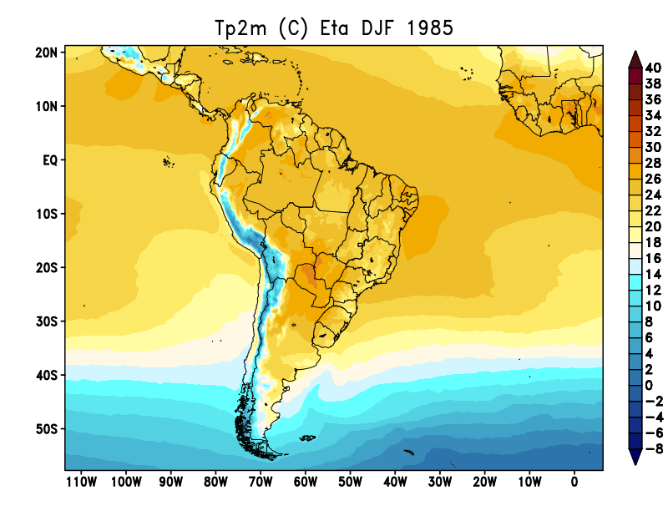
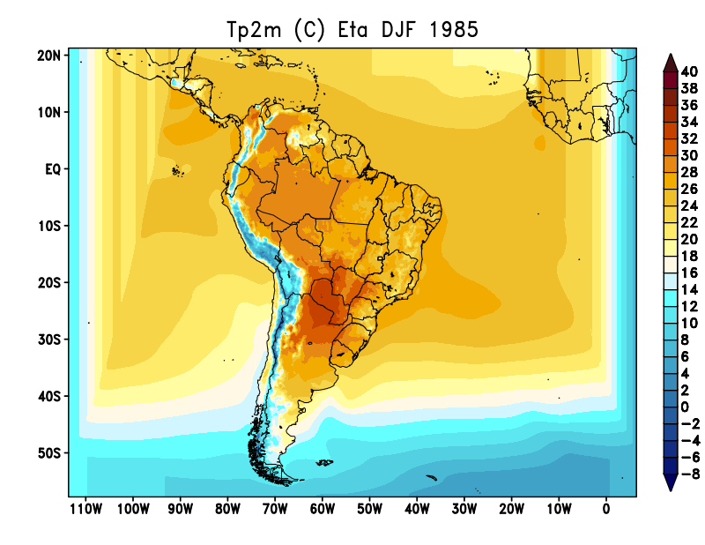
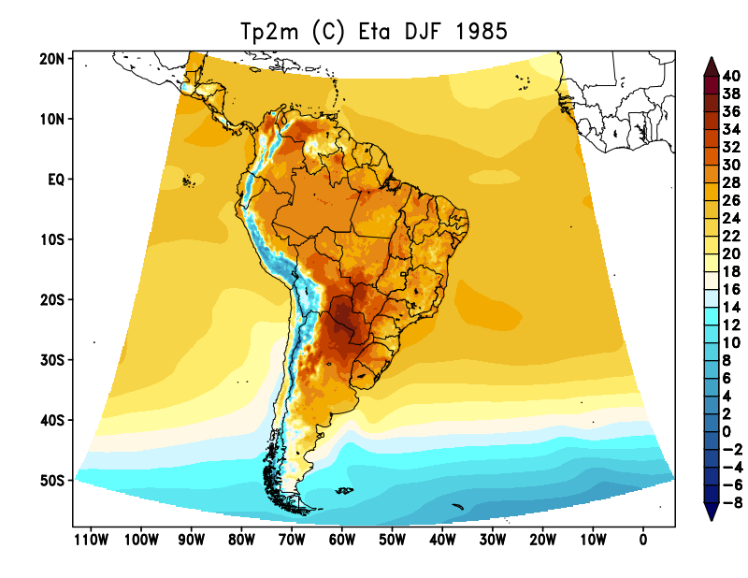
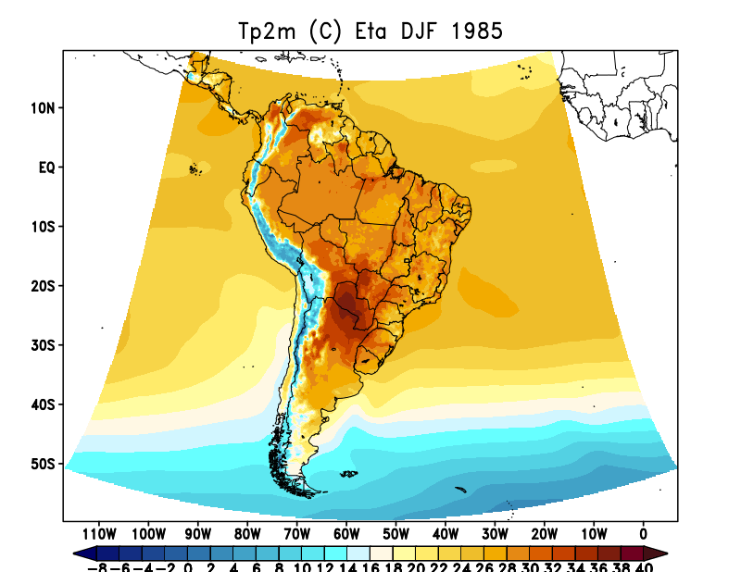
ERA5
DJF 1985
309x553x38 T_dry alb_updt
309x553x38 MIXLEN_23ee alb_clim
289x583x38 MIXLEN_23ee alb_clim

Slide 7
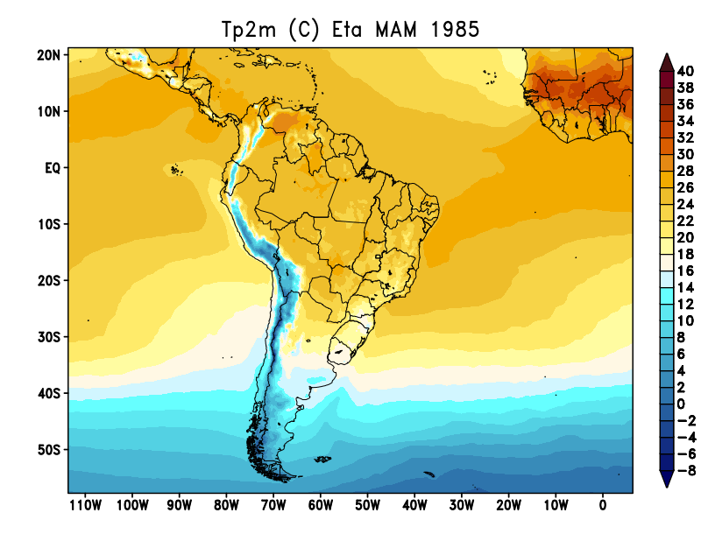
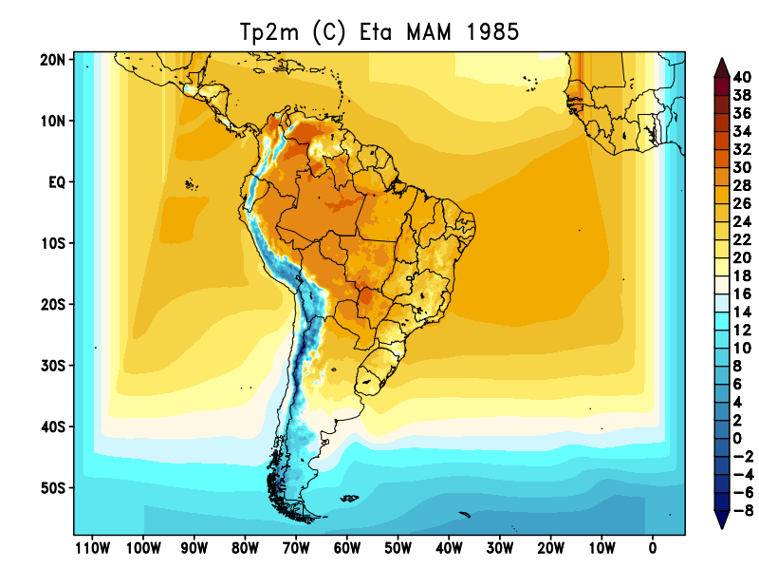
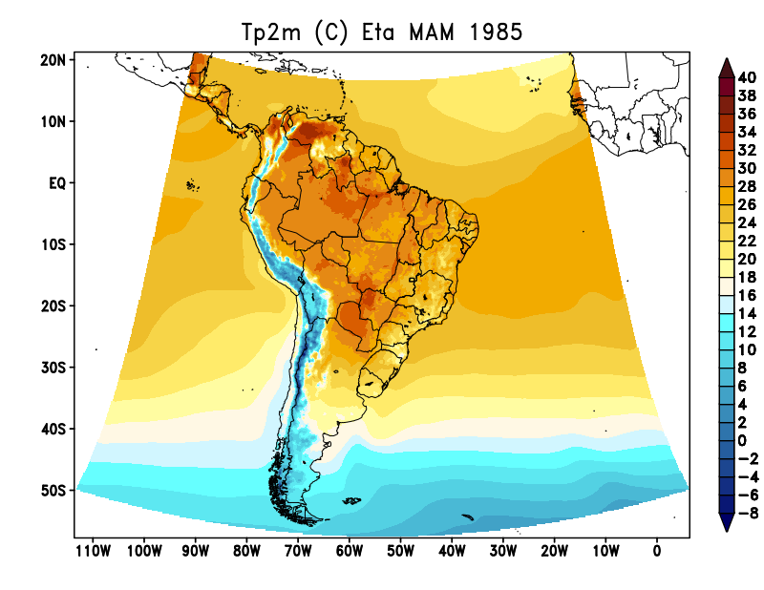
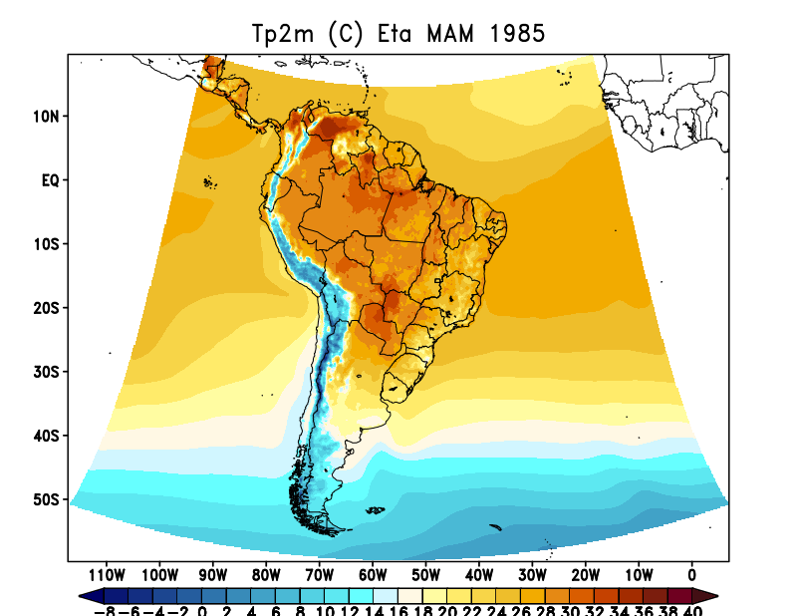
ERA5
MAM 1985
309x553x38 T_dry alb_updt
309x553x38 MIXLEN_23ee alb_clim
289x583x38 MIXLEN_23ee alb_clim

Slide 8
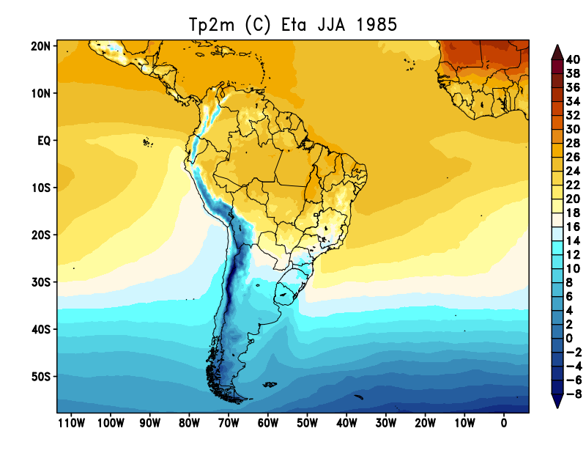
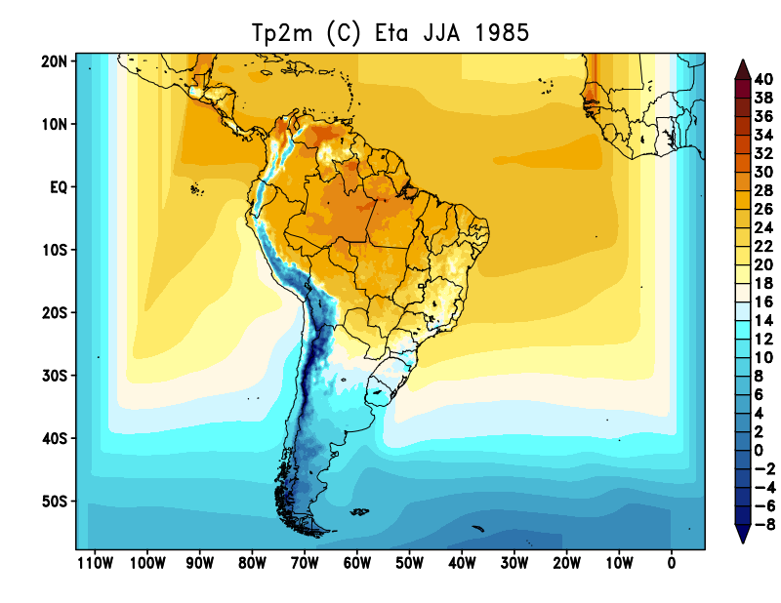
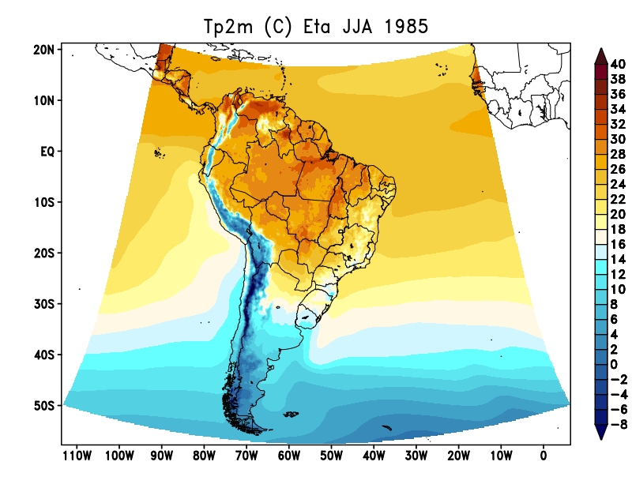
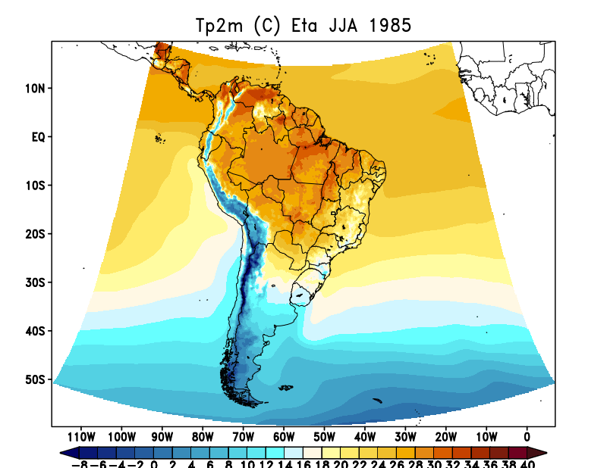
ERA5
DJF 1985
309x553x38 T_dry alb_updt
309x553x38 MIXLEN_23ee alb_clim
289x583x38 MIXLEN_23ee alb_clim

Slide 9
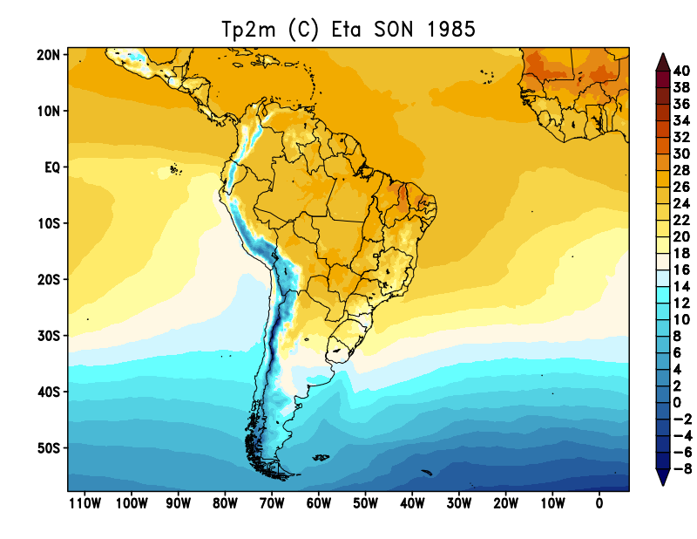
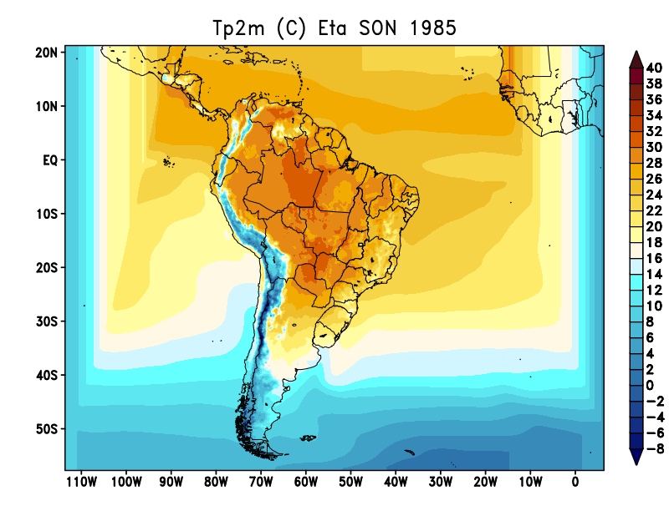
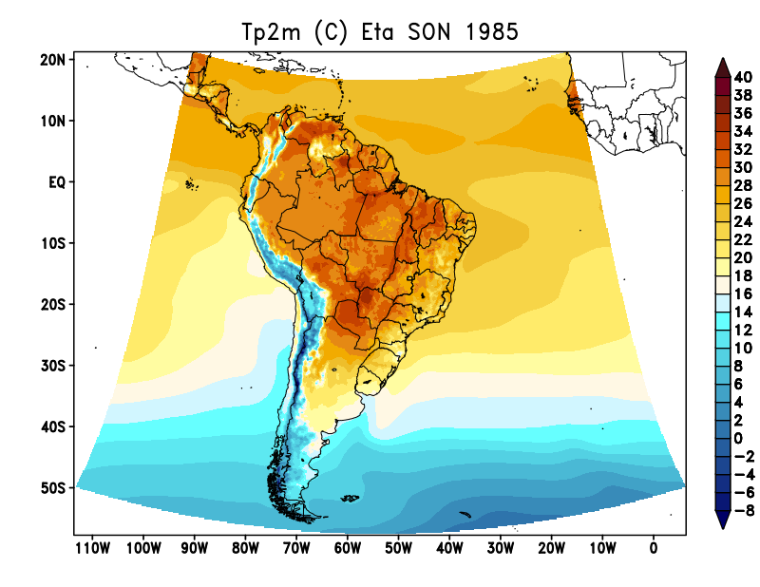
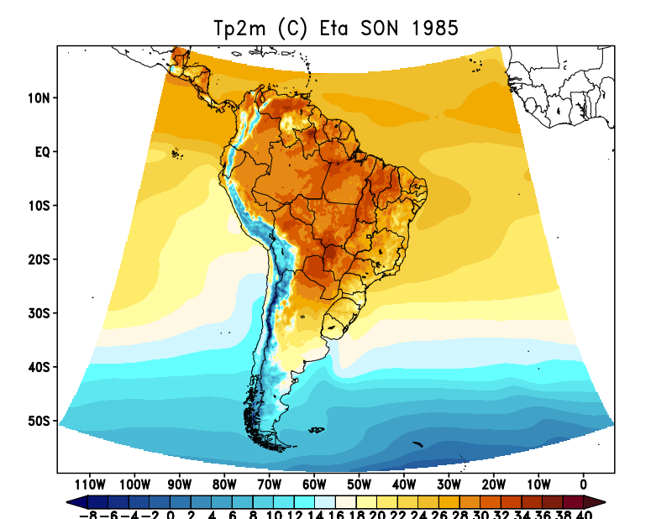
ERA5
DJF 1985
309x553x38 T_dry alb_updt
309x553x38 MIXLEN_23ee alb_clim
289x583x38 MIXLEN_23ee alb_clim

