Slide 1
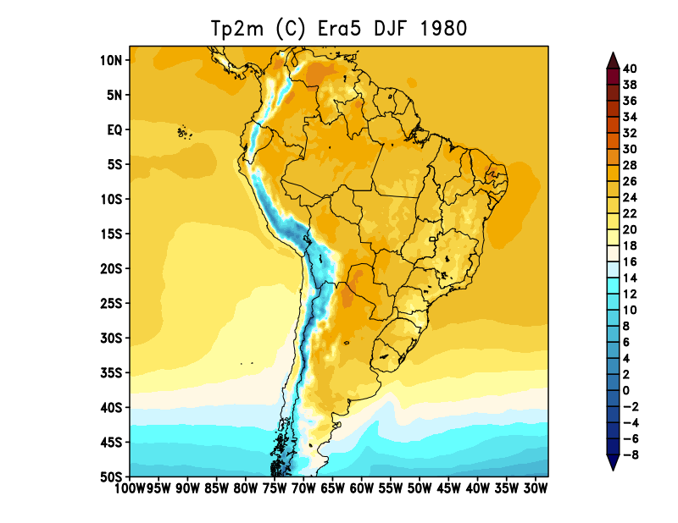
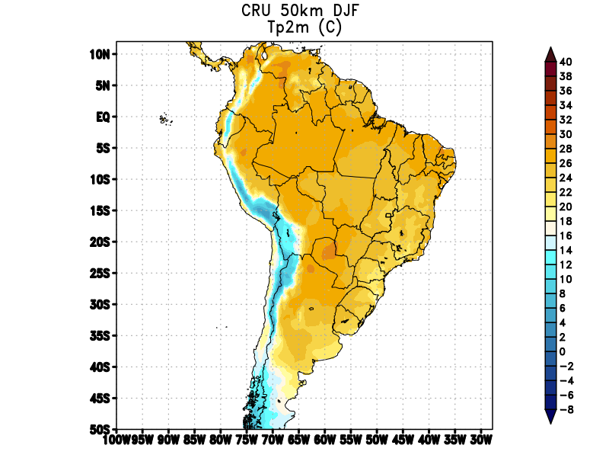
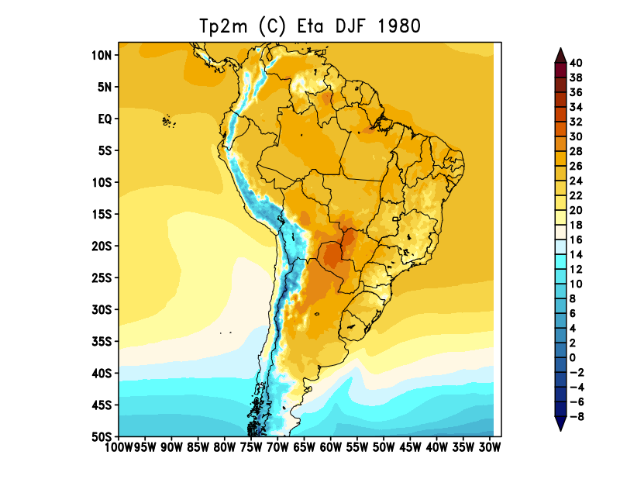
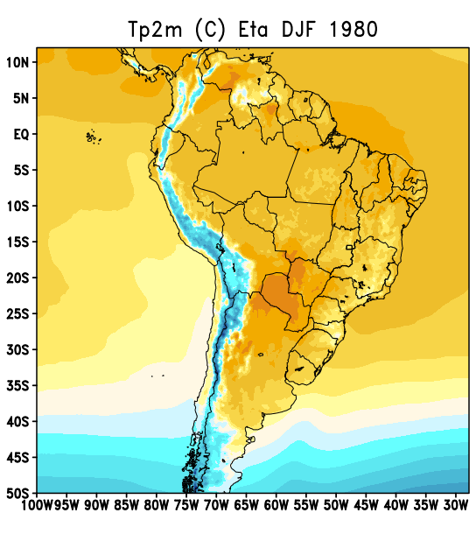
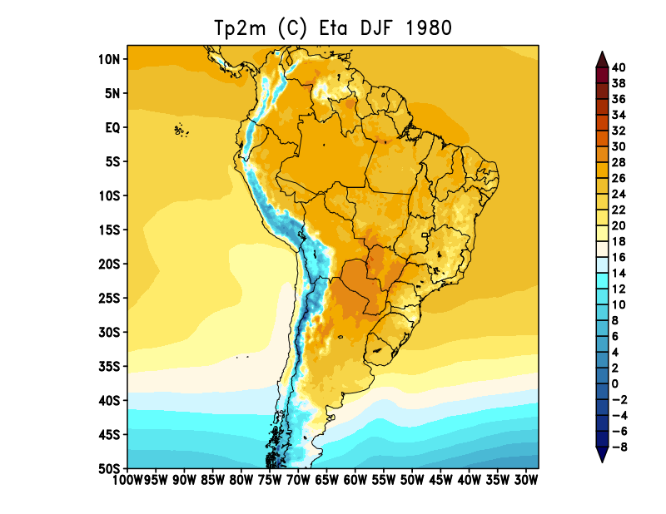
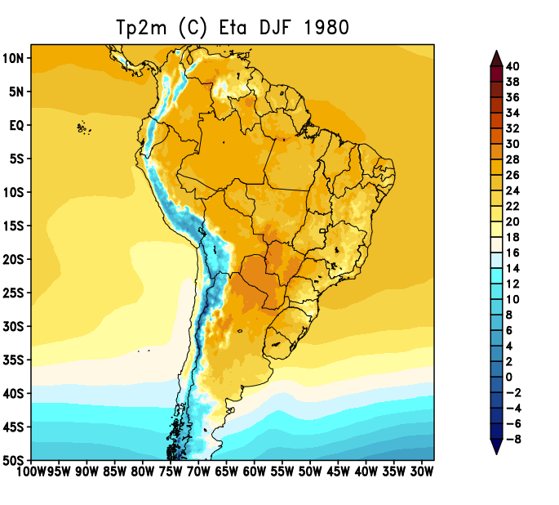
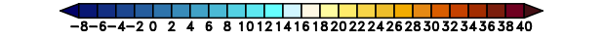
Trimestre
DJF
V 1.1.0
V 1.3.0
V 1.4.0 Dry_T
V 1.4.0 caatinga

Slide 2
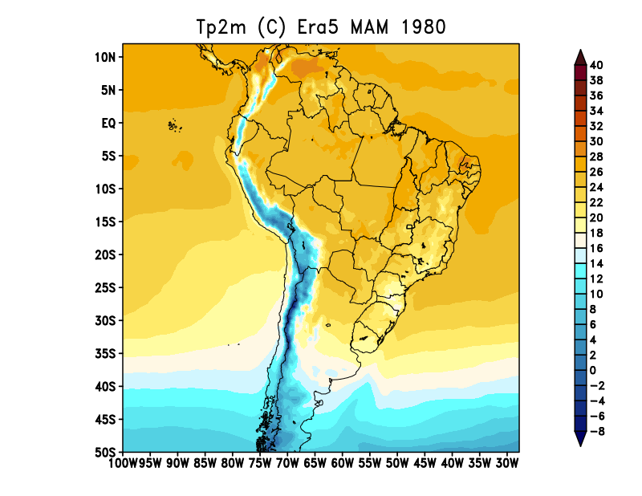
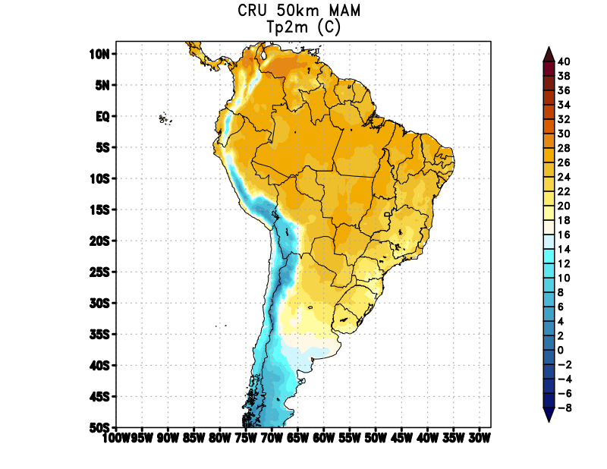
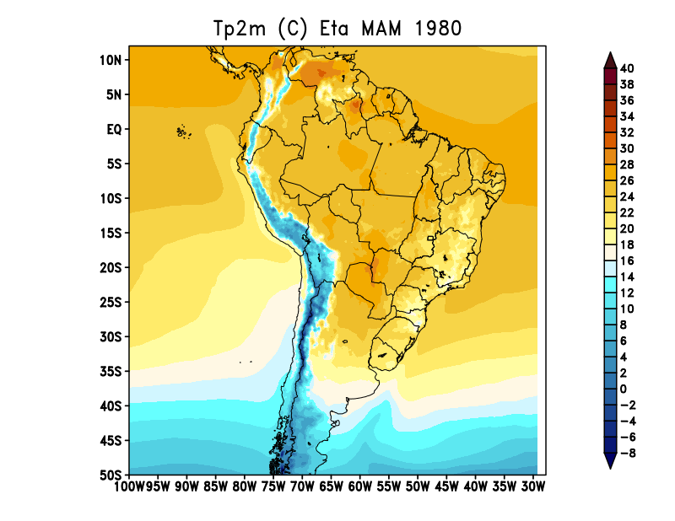
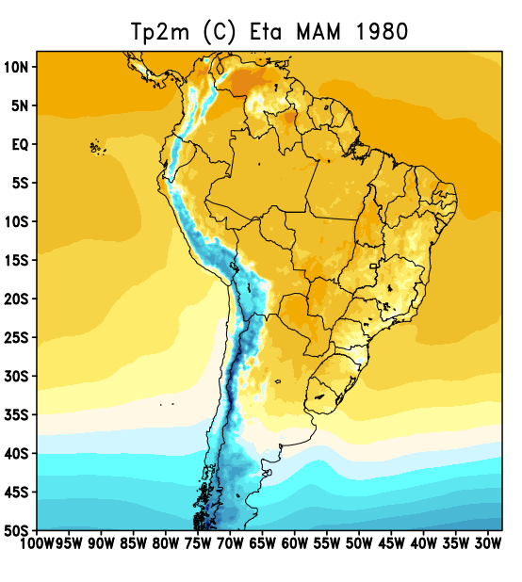
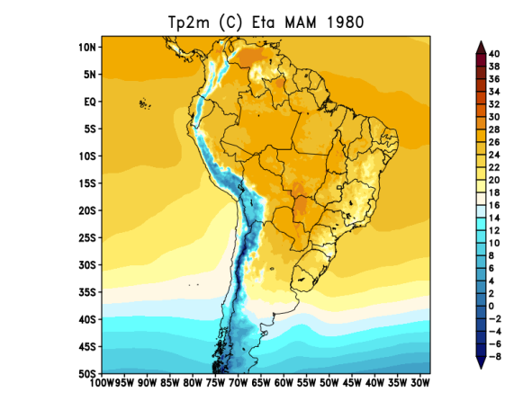
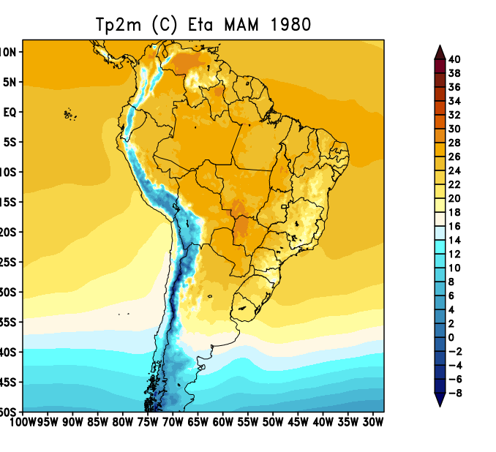
Trimestre
MAM
V 1.1.0
V 1.3.0
V 1.4.0 Dry_T
V 1.4.0 caatinga

Slide 3
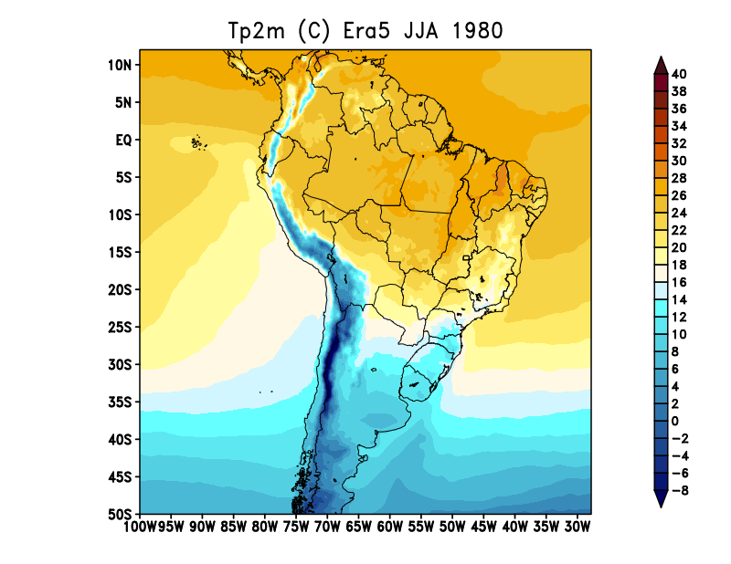
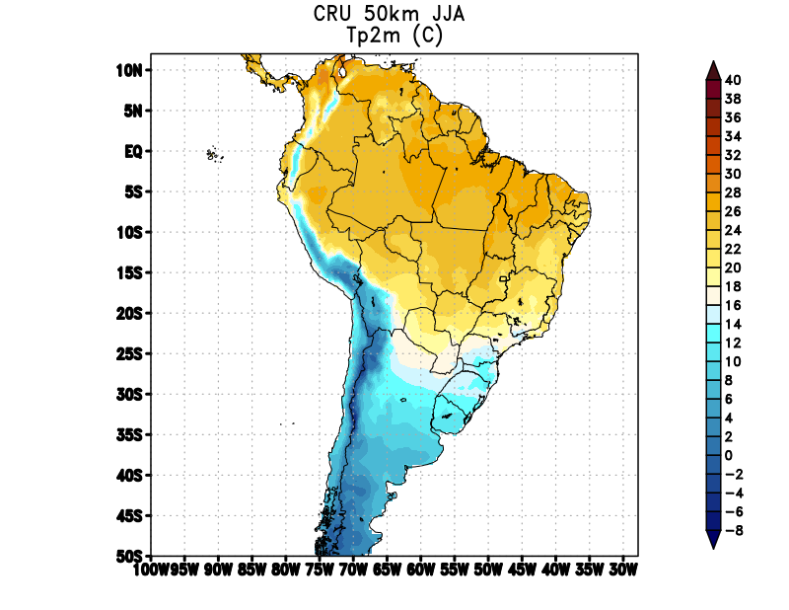
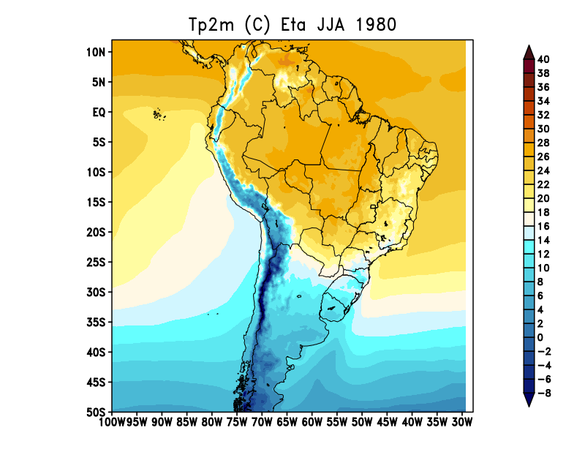
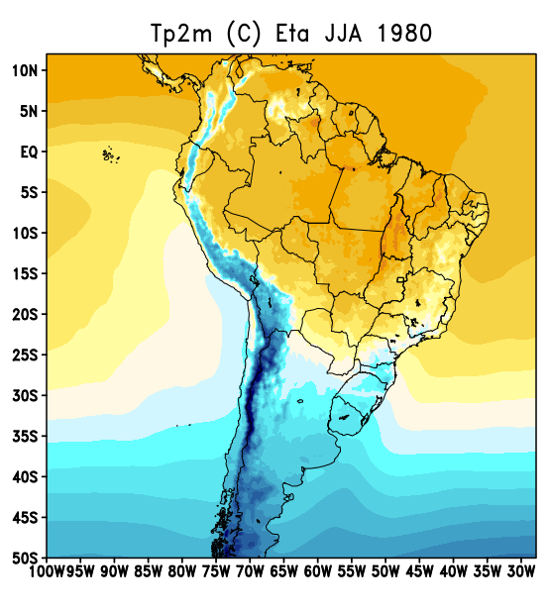
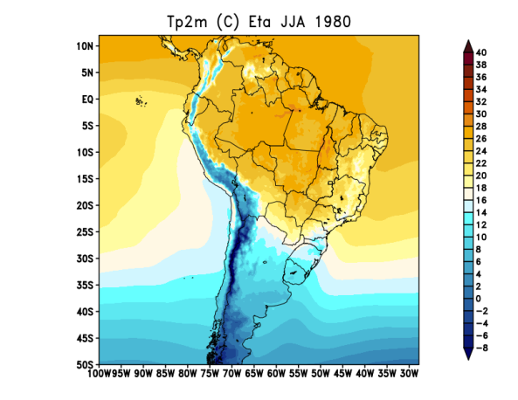

Trimestre
JJA
V 1.1.0
V 1.3.0
V 1.4.0 Dry_T
V 1.4.0 caatinga

Slide 4
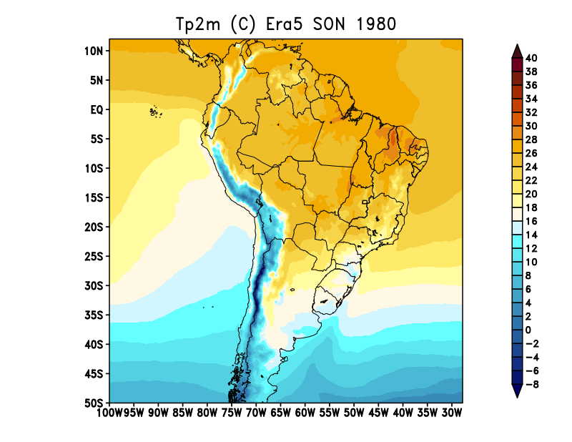
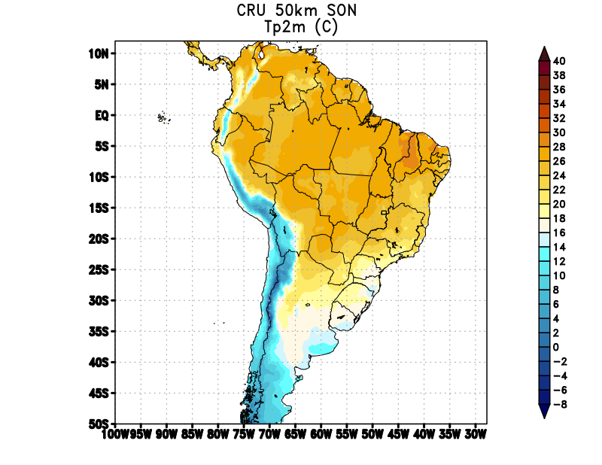
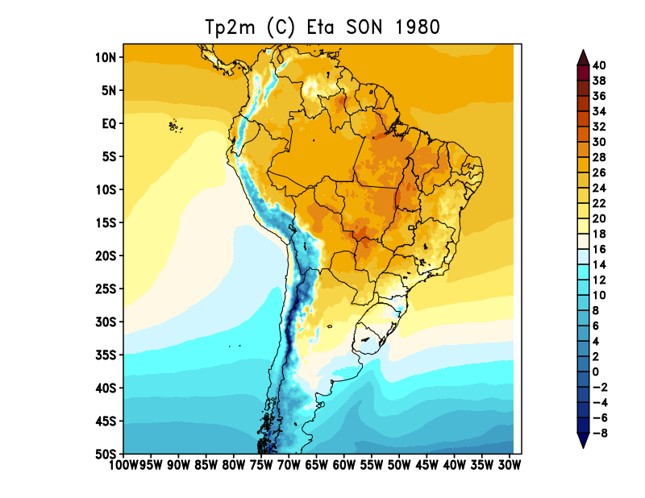
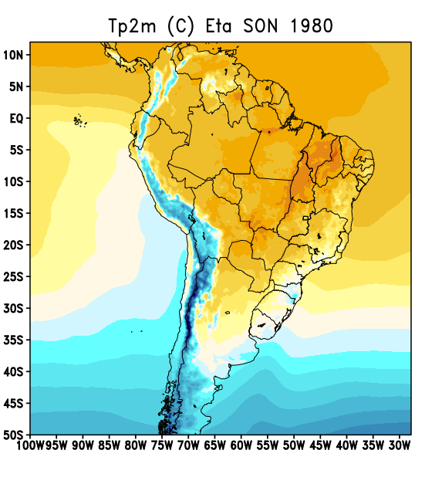
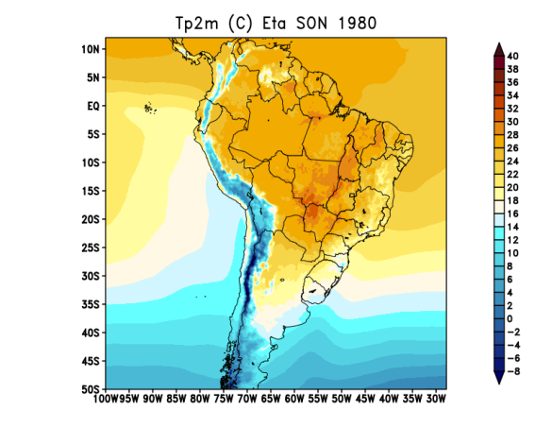

Trimestre
SON
V 1.1.0
V 1.3.0
V 1.4.0 Dry_T
V 1.4.0 caatinga

Slide 5
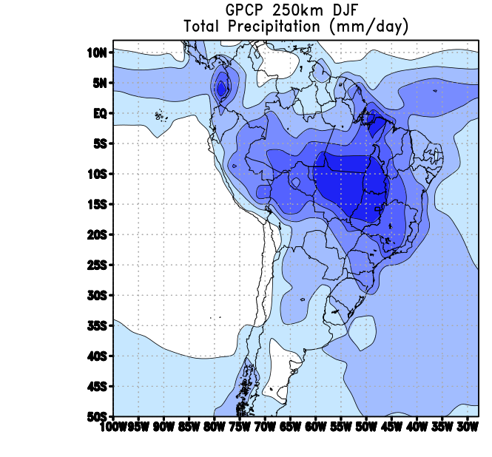
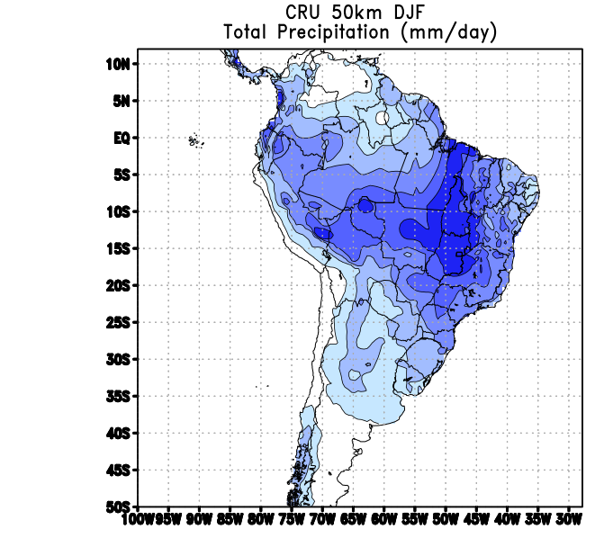
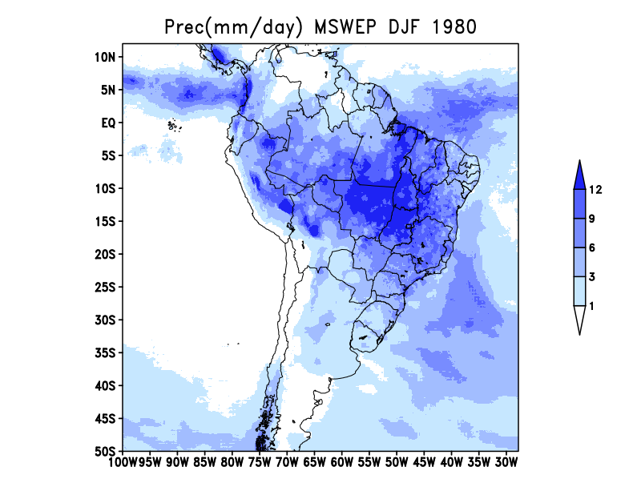
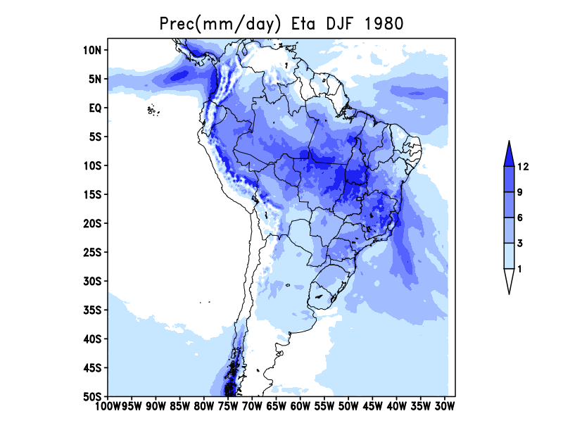
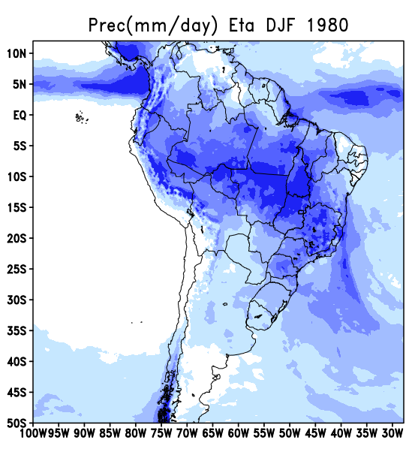
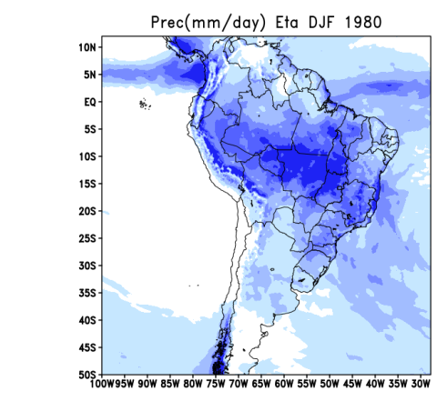
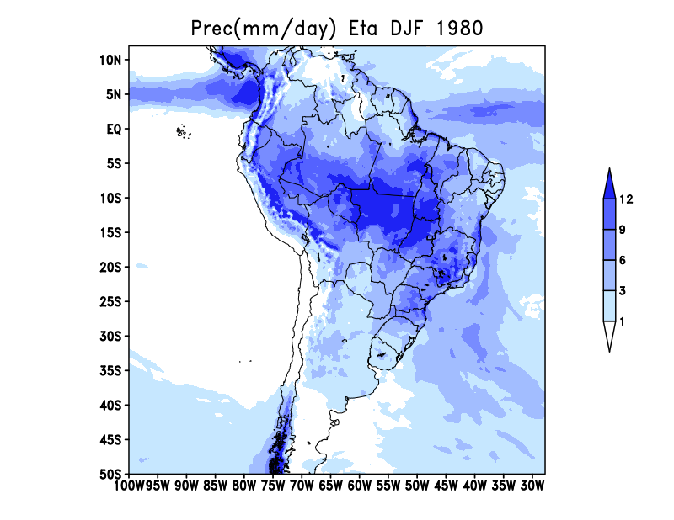
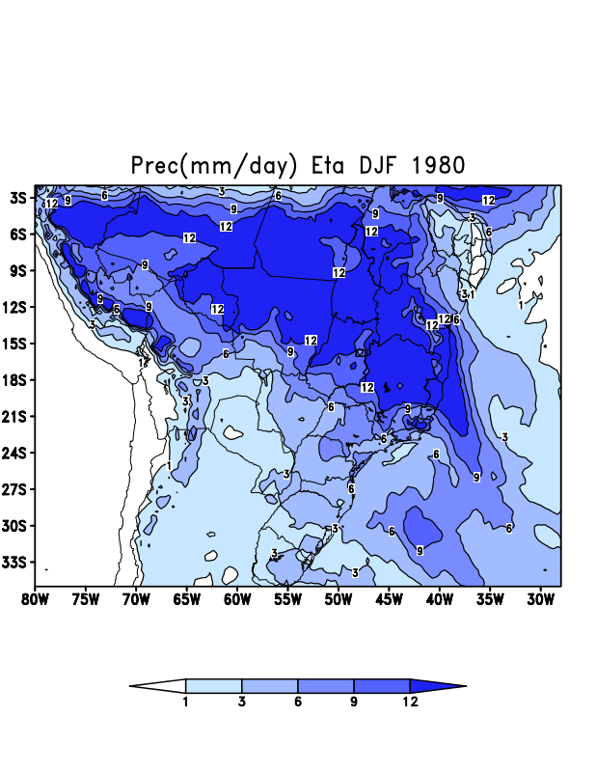
D
J
F
V 1.1.0
V 1.3.0
V 1.4.0 Dry_T
V 1.4.0 caatinga

Slide 6
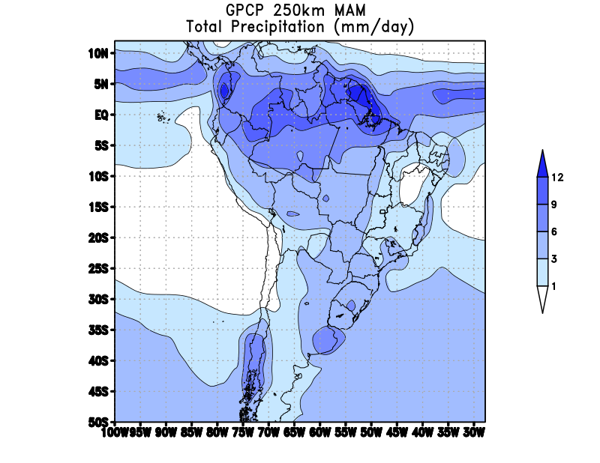
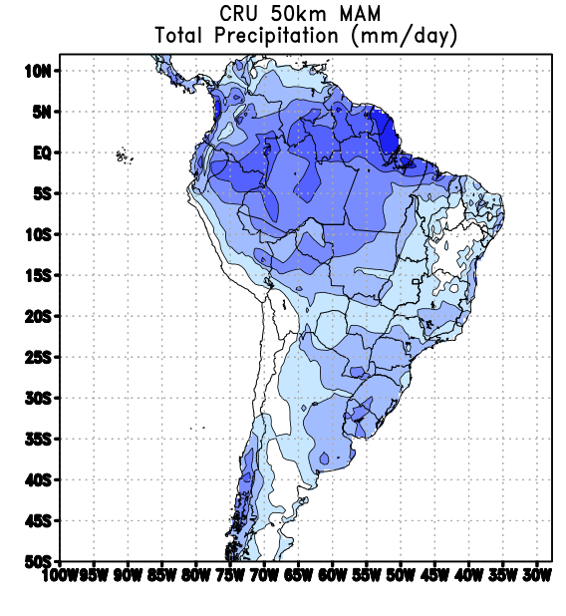
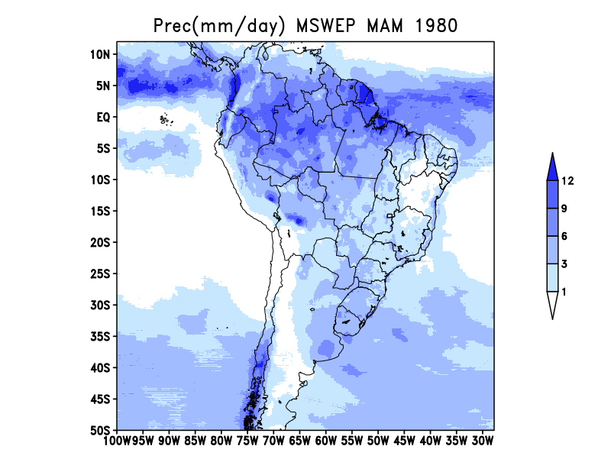
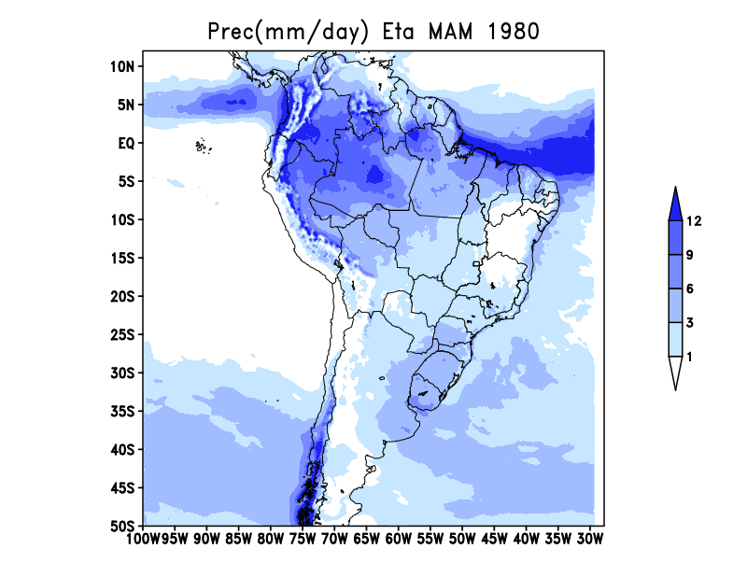
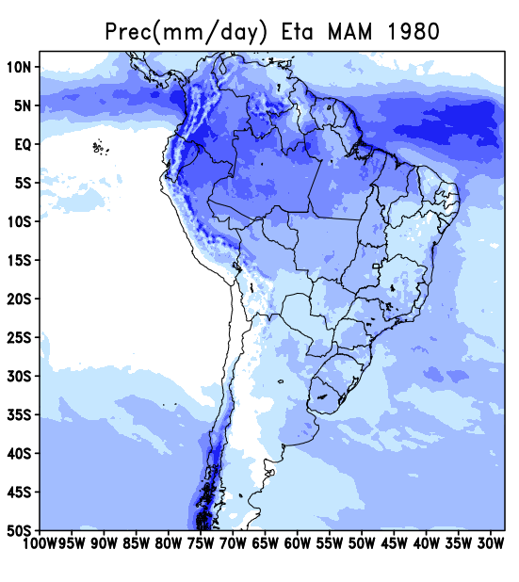
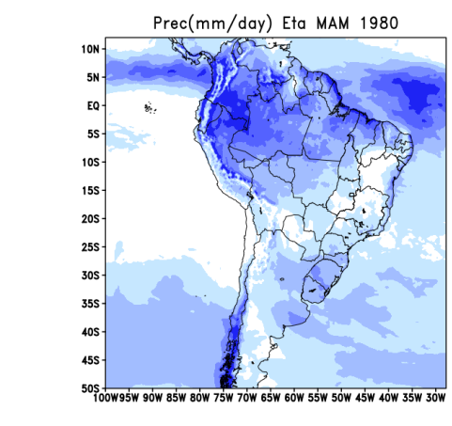
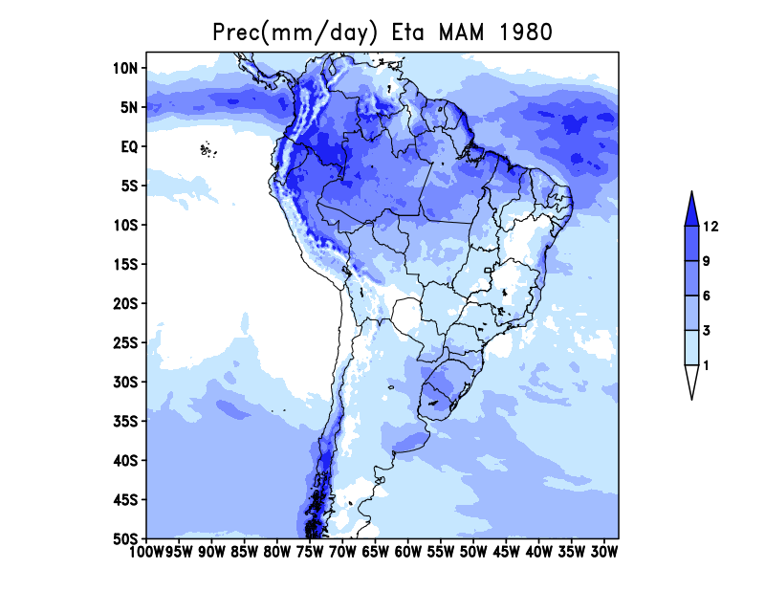
M
A
M
V 1.1.0
V 1.3.0
V 1.4.0 Dry_T
V 1.4.0 caatinga

Slide 7
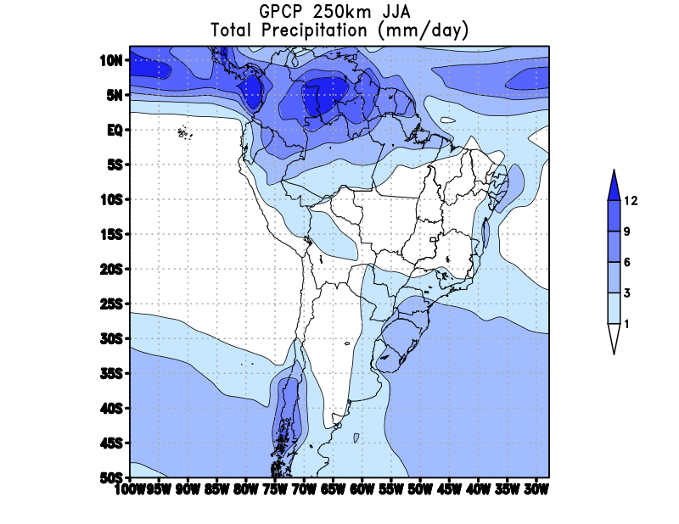
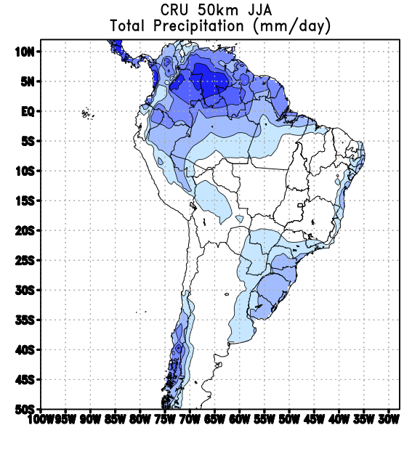
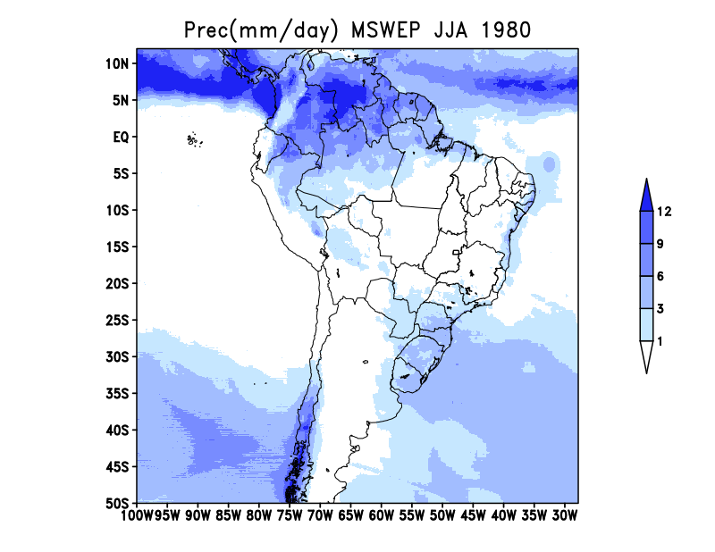
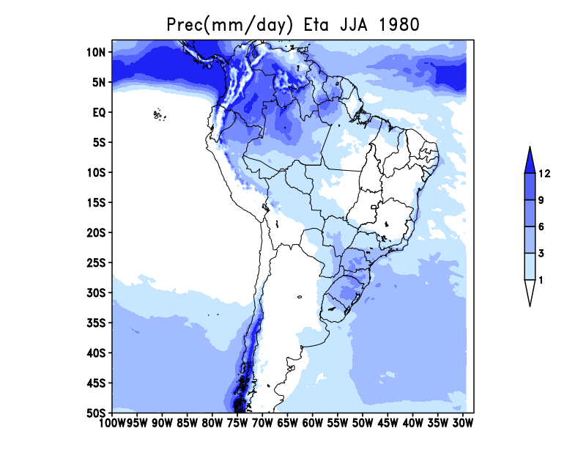
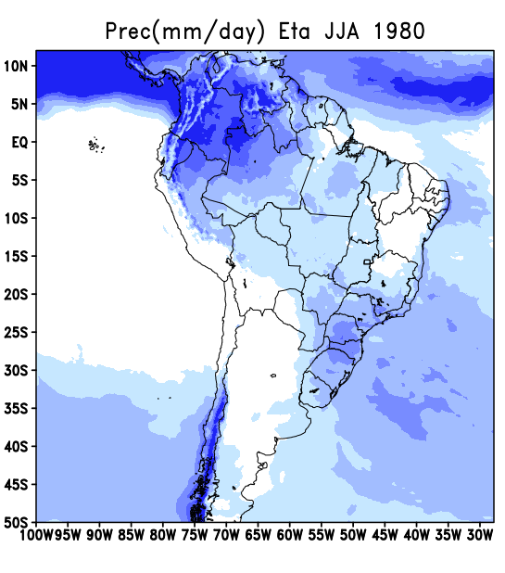
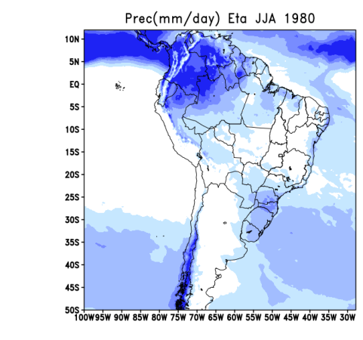
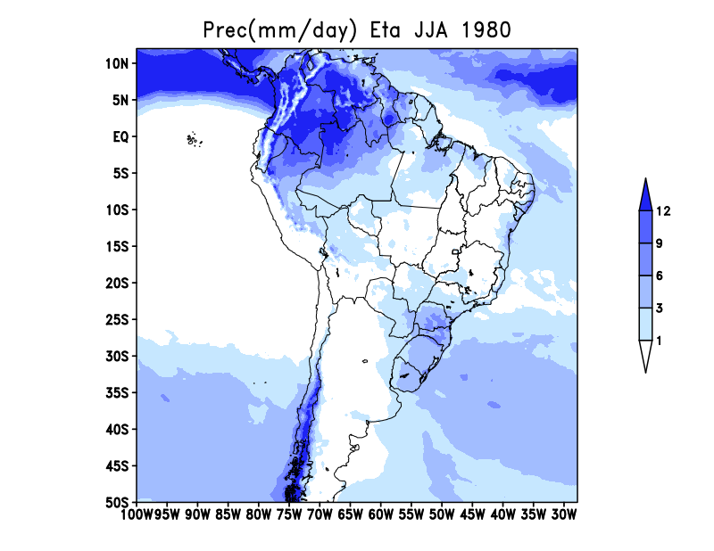
J
J
A
V 1.1.0
V 1.3.0
V 1.4.0 Dry_T
V 1.4.0 caatinga

Slide 8
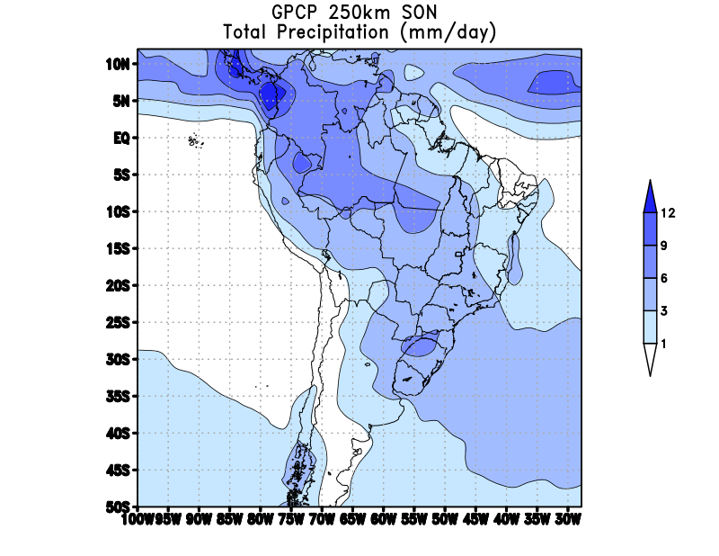
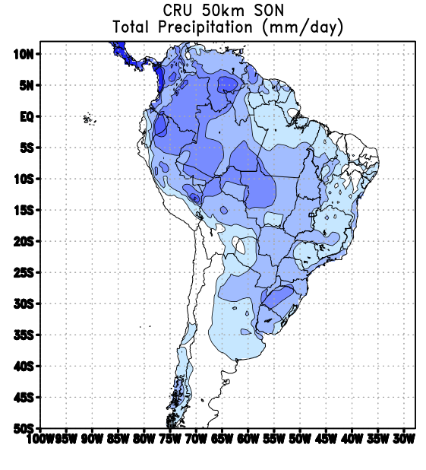
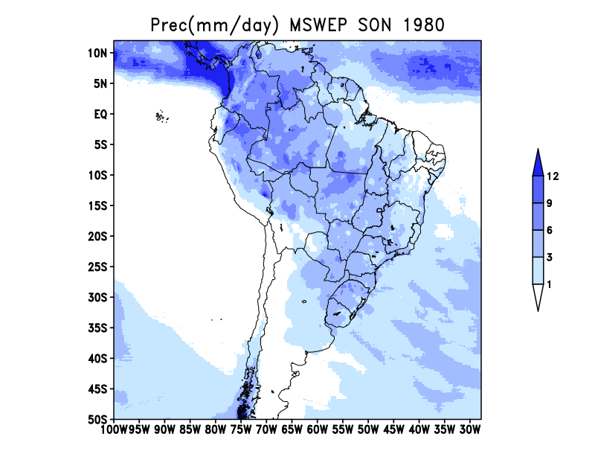
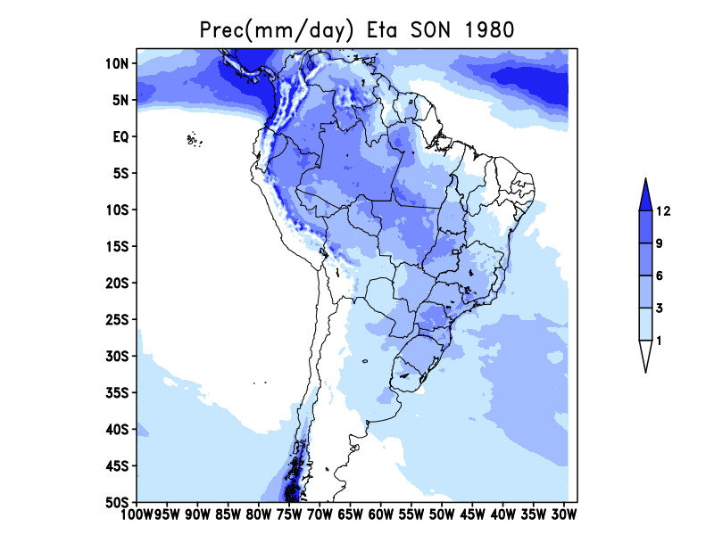
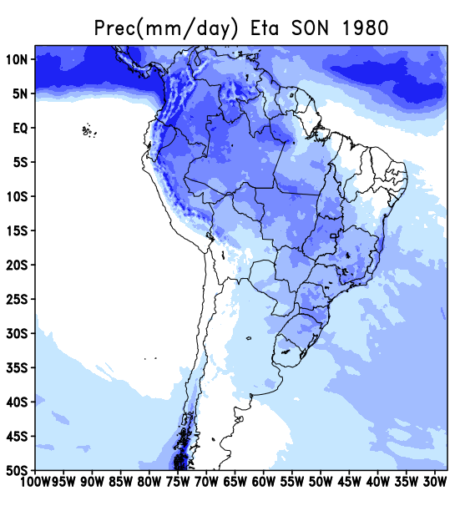


S
O
N
V 1.1.0
V 1.3.0
V 1.4.0 Dry_T
V 1.4.0 caatinga

Slide 9






Era5
Eta v1.1.0
Eta v1.3.0
Eta v1.3.0 HDIFFcwm
Eta v1.4.0 Dry_T
Ciclo Diurno
TP2M
NSA
SAM
NES
SES
SWS

Slide 10





Era5
Eta v1.1.0
Eta v1.3.0
Eta v1.3.0 HDIFFcwm
Eta v1.4.0 Caatinga
Ciclo Diurno
TP2M
NSA
SAM
NES
SES
SWS

Slide 11





Era5
Eta v1.1.0
Eta v1.3.0
Eta v1.3.0 HDIFFcwm
Eta v1.4.0 Dry_T
Ciclo Diurno
TP2M
Diferença
NSA
SAM
NES
SES
SWS

Slide 12





Era5
Eta v1.1.0
Eta v1.3.0
Eta v1.3.0 HDIFFcwm
Eta v1.4.0 Caatinga
Ciclo Diurno
TP2M
Diferença
NSA
SAM
NES
SES
SWS

Slide 13





Era5
Eta v1.1.0
Eta v1.3.0
Eta v1.3.0 HDIFFcwm
Eta v1.4.0 Dry_T
Ciclo Anual
PREC
NSA
SAM
NES
SWS
SES

Slide 14





Era5
Eta v1.1.0
Eta v1.3.0
Eta v1.3.0 HDIFFcwm
Eta v1.4.0 Caatinga
Ciclo Anual
PREC
NSA
SAM
NES
SWS
SES

Slide 15

Ciclo Diurno – TP2M
MAE, RMSE, TCORR, SCORR
Áreas AR6 | Eta v1.1.0 | Eta v1.3.0 |  |  |  |  |  |  |  | Eta v1.4.0
 |  | 16 vegtype | fss 0.80 | no bhs | dspl ori fss.8 | HDIFFS CO2eq | DSPBFS35 HDIFFS | DSPBFS35 HDIFF | CZIL HDIFF(cwm) EPSQ2 0.12 | CO2eq | Dry_T | Caatinga
MAE1 NES | 1.13711 | 1.0259 | 1.24098 | 1.16191 | 1.16569 | 1.24802 | 1.18915 | 1.15732 | 1.17572 | 1.14287 | 1.14478 | 1.14957
RMSE2 NES | 1.48118 | 1.34076 | 1.61661 | 1.50849 | 1.51566 | 1.57399 | 1.55346 | 1.4913 | 1.50965 | 1.45313 | 1.46811 | 1.47382
SCORR NES | 0.852015 | 0.854052 | 0.826201 | 0.830709 | 0.833252 | 0.806948 | 0.814086 | 0.817703 | 0.805685 | 0.826907 | 0.829728 | 0.823139
TCORR NES | 0.97612 | 0.984179 | 0.983168 | 0.981924 | 0.985554 | 0.984455 | 0.982667 | 0.983053 | 0.983999 | 0.983552 | 0.984819 | 0.981911
MAE1 NSA | 1.22697 | 1.10949 | 1.1411 | 1.11274 | 0.988435 | 1.14063 | 1.09171 | 1.09981 | 1.14465 | 1.22384 | 1.12058 | 1.11941
RMSE2 NSA | 1.65506 | 1.47346 | 1.53588 | 1.48858 | 1.37061 | 1.51822 | 1.46595 | 1.47295 | 1.52267 | 1.58677 | 1.49454 | 1.49254
SCORR NSA | 0.785062 | 0.828551 | 0.794183 | 0.785091 | 0.81057 | 0.776591 | 0.789206 | 0.78461 | 0.775875 | 0.775997 | 0.78497 | 0.784731
TCORR NSA | 0.97394 | 0.968424 | 0.970638 | 0.972881 | 0.972228 | 0.97298 | 0.974821 | 0.973501 | 0.972439 | 0.977883 | 0.975196 | 0.975756
MAE1 NWS | 1.26878 | 1.42481 | 1.44615 | 1.37921 | 1.39818 | 1.41453 | 1.38091 | 1.3694 | 1.37787 | 1.37361 | 1.39031 | 1.39791
RMSE2 NWS | 1.75563 | 1.85801 | 1.96575 | 1.8695 | 1.88549 | 1.88401 | 1.87261 | 1.86678 | 1.86527 | 1.85308 | 1.87457 | 1.88013
SCORR NWS | 0.959789 | 0.954024 | 0.956195 | 0.956121 | 0.957469 | 0.955404 | 0.956144 | 0.955625 | 0.954736 | 0.955049 | 0.955334 | 0.954828
TCORR NWS | 0.976125 | 0.984709 | 0.986336 | 0.991827 | 0.991167 | 0.988872 | 0.991351 | 0.991022 | 0.992323 | 0.992897 | 0.990113 | 0.990943
MAE1 SAM | 1.59573 | 1.15707 | 1.4421 | 1.43808 | 1.24093 | 1.49807 | 1.631 | 1.61723 | 1.62225 | 1.80032 | 1.65079 | 1.68496
RMSE2 SAM | 1.92811 | 1.50195 | 1.7791 | 1.74941 | 1.56346 | 1.80947 | 1.94587 | 1.92193 | 1.93341 | 2.10331 | 1.96977 | 1.99841
SCORR SAM | 0.965903 | 0.961858 | 0.971306 | 0.972333 | 0.971231 | 0.970883 | 0.97071 | 0.970319 | 0.96929 | 0.969214 | 0.969289 | 0.969328
TCORR SAM | 0.971023 | 0.982874 | 0.98362 | 0.980992 | 0.985947 | 0.986412 | 0.980992 | 0.98323 | 0.983363 | 0.98478 | 0.984167 | 0.98264

Slide 16
Ciclo Diurno – TP2M
MAE, RMSE, TCORR, SCORR
Áreas AR6 | Eta v1.1.0 | Eta v1.3.0 |  |  |  |  |  |  |  | Eta v1.4.0
 |  | 16 vegtype | fss 0.80 | no bhs | dspl ori fss.8 | HDIFFS CO2eq | DSPBFS35 HDIFFS | DSPBFS35 HDIFF | CZIL HDIFF(cwm) EPSQ2 0.12 | CO2eq | Dry_T | Caatinga
MAE1 SES | 1.24027 | 1.2366 | 1.43862 | 1.38784 | 1.36157 | 1.37402 | 1.42743 | 1.37061 | 1.42838 | 1.59885 | 1.51623 | 1.51593
RMSE2 SES | 1.6603 | 1.59253 | 1.89662 | 1.83363 | 1.79042 | 1.76934 | 1.8727 | 1.79665 | 1.87669 | 2.06773 | 1.95634 | 1.95655
SCORR SES | 0.956695 | 0.952884 | 0.950502 | 0.951113 | 0.950247 | 0.948142 | 0.947201 | 0.949679 | 0.945763 | 0.941014 | 0.943469 | 0.943002
TCORR SES | 0.996352 | 0.994731 | 0.992303 | 0.992997 | 0.992506 | 0.994604 | 0.993559 | 0.994746 | 0.99539 | 0.994504 | 0.99368 | 0.993101
MAE1 SSA | 0.820558 | 0.960733 | 1.34571 | 1.29445 | 1.27926 | 1.10825 | 1.13908 | 1.06061 | 1.07054 | 0.936432 | 1.03607 | 1.03659
RMSE2 SSA | 1.2522 | 1.38915 | 1.95554 | 1.87085 | 1.85178 | 1.57416 | 1.65675 | 1.56068 | 1.56605 | 1.37784 | 1.48741 | 1.48546
SCORR SSA | 0.957795 | 0.948585 | 0.923384 | 0.926781 | 0.926657 | 0.940791 | 0.936603 | 0.940323 | 0.941104 | 0.94953 | 0.946627 | 0.94671
TCORR SSA | 0.99633 | 0.99587 | 0.995702 | 0.995606 | 0.995591 | 0.994553 | 0.99552 | 0.996563 | 0.996393 | 0.997358 | 0.996024 | 0.995729
MAE1 SWS | 1.41603 | 1.286 | 1.45079 | 1.3769 | 1.36535 | 1.37381 | 1.25901 | 1.2282 | 1.25246 | 1.26768 | 1.26158 | 1.26932
RMSE2 SWS | 1.75741 | 1.77453 | 2.04556 | 1.91706 | 1.90865 | 1.81866 | 1.79844 | 1.76684 | 1.77029 | 1.76653 | 1.75042 | 1.75879
SCORR SWS | 0.965068 | 0.955887 | 0.961065 | 0.962218 | 0.962058 | 0.962212 | 0.962991 | 0.963316 | 0.963487 | 0.959841 | 0.963229 | 0.962898
TCORR SWS | 0.994801 | 0.992515 | 0.98998 | 0.991166 | 0.990748 | 0.991441 | 0.991448 | 0.990892 | 0.99093 | 0.990994 | 0.991143 | 0.990659

Slide 17
Ciclo Anual – PREC
TCORR, SCORR
Áreas AR6 | Eta v1.1.0 | Eta v1.3.0 |  |  |  |  |  |  |  |  |  | Eta v1.4.0
 |  | 16 vegtype | dspl c fss.8 | no bhs | dspl ori fss.8 | HDIFFs CO2eq | DSPBFS35 HDIFFS | DSPBFS35 HDIFF | CZIL HDIFF(cwm) EPSQ2 0.12 | HDIFFcwm HPBLmod | HDIFFcwm HPBLmod CZILmod | CO2eq | Dry_T | Caatinga
SCORR CAR v1.1.0 Result value | 0.215339 | 0.304484 | 0.281188 | 0.37975 | 0.374982 | 0.41467 | 0.325622 | 0.190343 | 0.274276 | 0.229876 | 0.323148 | 0.169723 | 0.232776 | 0.264707
TCORR CAR v1.1.0 Result value | 0.570966 | 0.805642 | 0.805063 | 0.567405 | 0.691476 | 0.764648 | 0.670243 | 0.795405 | 0.601854 | 0.642783 | 0.74193 | 0.775959 | 0.383121 | 0.686135
SCORR NES v1.1.0 Result value | 0.608362 | 0.542225 | 0.580835 | 0.59425 | 0.564926 | 0.571614 | 0.595648 | 0.642163 | 0.6248 | 0.640095 | 0.637963 | 0.65101 | 0.624697 | 0.622022
TCORR NES v1.1.0 Result value | 0.946513 | 0.945556 | 0.95736 | 0.952703 | 0.946695 | 0.962851 | 0.960666 | 0.963956 | 0.951701 | 0.970222 | 0.95946 | 0.965292 | 0.982659 | 0.968851
SCORR NSA v1.1.0 Result value | 0.597912 | 0.64291 | 0.65764 | 0.650236 | 0.621221 | 0.666593 | 0.646886 | 0.647005 | 0.655009 | 0.648685 | 0.652561 | 0.650112 | 0.649365 | 0.657869
TCORR NSA v1.1.0 Result value | 0.779083 | 0.73638 | 0.759015 | 0.838691 | 0.834005 | 0.835013 | 0.764253 | 0.734412 | 0.837409 | 0.823413 | 0.859025 | 0.851684 | 0.848881 | 0.865222
SCORR NWS v1.1.0 Result value | 0.732901 | 0.705045 | 0.720814 | 0.720384 | 0.728662 | 0.715742 | 0.729019 | 0.701476 | 0.704481 | 0.699972 | 0.700921 | 0.69607 | 0.683314 | 0.682706
TCORR NWS v1.1.0 Result value | 0.279332 | 0.36698 | 0.453484 | 0.374964 | 0.232082 | 0.475644 | 0.441035 | 0.338772 | 0.462115 | 0.45027 | 0.332632 | 0.218909 | 0.358117 | 0.285766
SCORR SAM v1.1.0 Result value | 0.516276 | 0.437217 | 0.47597 | 0.502062 | 0.514707 | 0.478136 | 0.487192 | 0.500828 | 0.486224 | 0.514277 | 0.483654 | 0.532386 | 0.485083 | 0.501163
TCORR SAM v1.1.0 Result value | 0.973479 | 0.990128 | 0.985595 | 0.980062 | 0.987927 | 0.98159 | 0.970716 | 0.971794 | 0.962335 | 0.979082 | 0.972907 | 0.973282 | 0.977585 | 0.976431
SCORR SCA v1.1.0 Result value | 0.584746 | 0.51145 | 0.478735 | 0.498534 | 0.512463 | 0.547112 | 0.521958 | 0.505775 | 0.537441 | 0.522175 | 0.53823 | 0.517677 | 0.535932 | 0.528642
TCORR SCA v1.1.0 Result value | 0.80455 | 0.807713 | 0.849642 | 0.858005 | 0.860491 | 0.862609 | 0.811595 | 0.857573 | 0.8556 | 0.804579 | 0.798938 | 0.751545 | 0.833737 | 0.843787
SCORR SES v1.1.0 Result value | 0.615617 | 0.493988 | 0.60874 | 0.605304 | 0.587145 | 0.624135 | 0.625776 | 0.611478 | 0.608408 | 0.622247 | 0.596547 | 0.571404 | 0.598549 | 0.605926
TCORR SES v1.1.0 Result value | 0.904276 | 0.863308 | 0.788539 | 0.809291 | 0.830143 | 0.815626 | 0.809357 | 0.876577 | 0.866557 | 0.895497 | 0.861865 | 0.909215 | 0.906017 | 0.909498
SCORR SSA v1.1.0 Result value | 0.70575 | 0.686617 | 0.705773 | 0.710274 | 0.691404 | 0.699822 | 0.69712 | 0.696793 | 0.744182 | 0.742385 | 0.731538 | 0.697028 | 0.705627 | 0.697512
TCORR SSA v1.1.0 Result value | 0.908057 | 0.932751 | 0.93236 | 0.932687 | 0.925683 | 0.922372 | 0.917189 | 0.934981 | 0.914865 | 0.917435 | 0.909543 | 0.914356 | 0.920968 | 0.931062
SCORR SWS v1.1.0 Result value | 0.853439 | 0.826238 | 0.851484 | 0.85584 | 0.853284 | 0.832044 | 0.849316 | 0.840149 | 0.861468 | 0.862927 | 0.858932 | 0.846299 | 0.85445 | 0.851244
TCORR SWS v1.1.0 Result value | 0.988129 | 0.98013 | 0.987885 | 0.990398 | 0.991554 | 0.98423 | 0.9888 | 0.984332 | 0.98531 | 0.989459 | 0.988344 | 0.98859 | 0.991986 | 0.992393
Somatorio | 12.584727 | 12.578762 | 12.880122 | 12.82084 | 12.74885 | 13.154451 | 12.812391 | 12.793812 | 12.934035 | 12.955379 | 12.948138 | 12.680541 | 12.572864 | 12.870936

Slide 18





Cloud water
Eta v1.3.0
Eta v1.4.0
D
J
F
D
J
F
J
J
A
J
J
A

Slide 19



Cloud water
Eta v1.3.0
Eta v1.4.0
M
A
M
M
A
M
S
O
N
S
O
N

Slide 20


Cloud water
Eta v1.4.0 Dry_T caatinga
Eta v1.4.0
D
J
F
D
J
F
J
J
A
J
J
A

Slide 21


Cloud water
Eta v1.4.0 Dry_T caatinga
Eta v1.4.0
M
A
M
M
A
M
S
O
N
S
O
N

Slide 22




Precipitação Convectiva
Eta v1.3.0
Eta v1.4.0
D
J
F
J
J
A

Slide 23




Precipitação Convectiva
Eta v1.3.0
Eta v1.4.0
M
A
M
S
O
N

Slide 24




Precipitação Grande Escala
Eta v1.3.0
Eta v1.4.0
D
J
F
J
J
A

Slide 25




Precipitação Grande Escala
Eta v1.3.0
Eta v1.4.0
M
A
M
S
O
N

Slide 26


Verificação da atualização da SST

Slide 27


Verificação do modo RESTRT

Slide 28
Parâ metro | V1.1.0 cuparm -Terceira comunicação Nacional | V1.3.0 cuparm - inicial | V1.3.0 cuparm – Diego Campos | V1.3.0 cuparm – Diego Campos modificado | V1.3.0 cuparm – chou (HDIFFS x HDIFF) | V1.4.0 cuparmdata_MC.dat -Mudanças climáticas
FSS | .85 | .85 | 1.00 | 0.80 | 0.80 | 0.80
DSPBFS | -3875 | -3400 | -4500 | -4500 | -4500 (-3500) | -3500
DSP0FS | -5875 | -4400 | -5500 | -5500 | -5500 | -5500
DSPTFS | -1875 | -1500 | -1875 | -1875 | -1875 | -1875
FSL | .85 | .85 | 1.00 | .95 | 1.00 | 1.00
DSPBFL | -4500 | -4000 | -4000 | -4000 | -4000 | -4000
DSP0FL | -5500 | -4800 | -3500 | -3500 | -5000 | -5000
DSPTFL | -2000 | -1800 | -2000 | -2000 | -2000 | -2000
Notes:
DSPBFL=-4000.,DSP0FL=-5000.,DSPTFL=-2000.,FSL=1.00,
DSPBFS=-4500.,DSP0FS=-5500.,DSPTFS=-1875.,

