Slide 1

REUNIÃO BRAMS 2016
Julliana Freire
Cachoeira Paulista
Agosto de 2016

Slide 2
SUMÁRIO
ETAPAS CONCLUÍDAS
ETAPAS EM ANDAMENTO
ETAPAS FUTURAS

Slide 3

1. ETAPAS CONCLUÍDAS
● Participação no projeto:
“Evaluating aerosols impacts on Numerical Weather Prediction”
(WMO/WGNE)
Saulo Freitas; Maurício Zarzur; Valter Oliveira; Denis Eiras
● Início do Doutorado 2015.2
- Créditos requeridos pela instituição
- Exame de qualificação

Slide 4
Evaluating aerosols impacts on Numerical Weather
This project aims to improve our understanding about the following questions:
How important are aerosols for predicting the physical system (NWP, seasonal, climate) as distinct from predicting the aerosols themselves?
How important is atmospheric model quality for air quality forecasting?
What are the current capabilities of NWP models to simulate aerosol impacts on weather prediction?

Slide 5
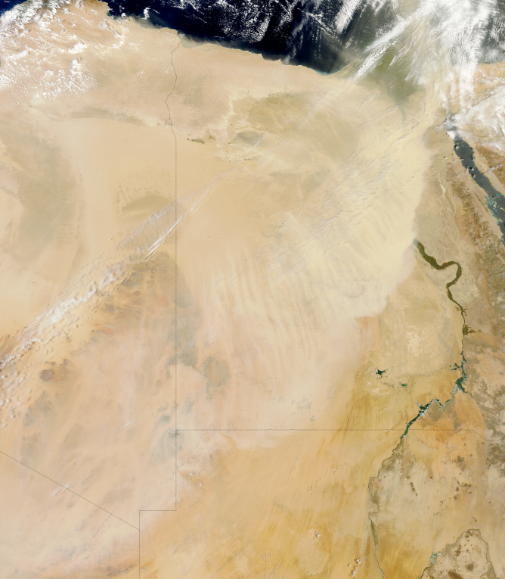
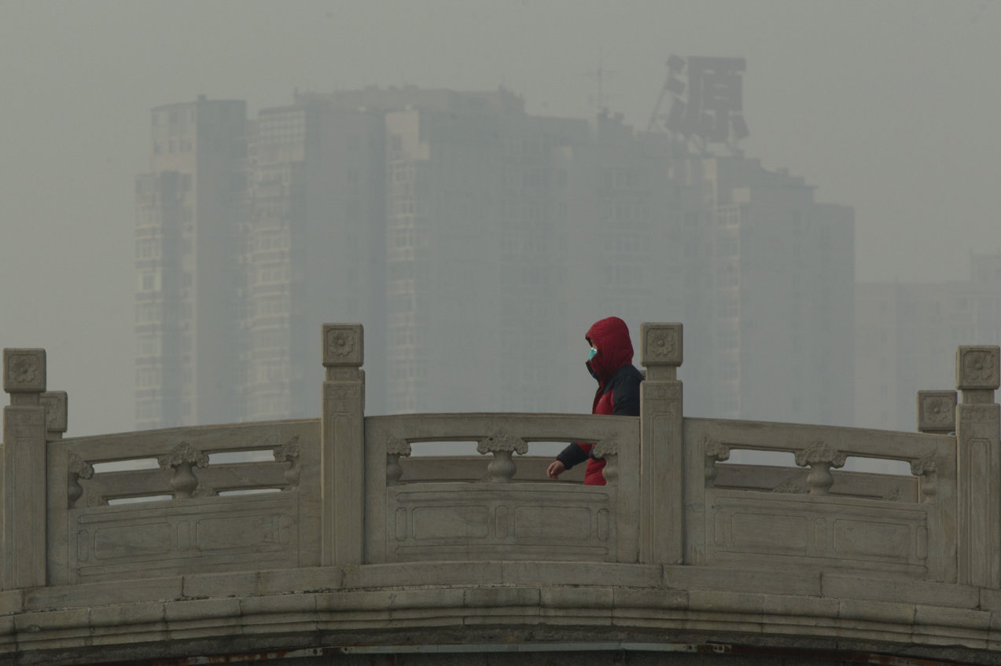
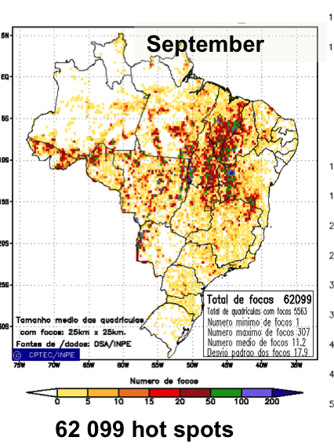
Case Studies
Dust over Egypt: 4/2012
2) Pollution in China: 1/2013
3) Smoke in Brazil: 9/2012

Slide 6
Participants
Participants | Case 1 | Case 2 | Case 3 | Type of model | Status of the data | People Involved
CPTEC |  |  | X | R | aerosol direct effect only | Saulo Freitas, Mauricio Zarzur, Julliana Larise
JMA | X | X | X | G | ind, dir, ind+dir, no-aer | Taichu Tanaka, Chiasi Muroi
ECMWF | X | X | X | G | (aerosol direct effect only | Angela Benedetti, Samuel Remy, Jean-Noel Thepaut
Météo-France/Met. Serv. Algeria | X |  |  | R | aerosol direct effect only | Morad Mokhtari, Bouyssel Francois
ESRL/NOAA |  | X | X | R | aerosol direct and indirect effect only | Georg Grell
NASA/Goddard | X | X | X | G | (direct effect only) | Arlindo da Silva
NCEP | X |  |  | G | (direct effect only) | Sarah Lu, Yu-Tai Hou, Shrinivas Moorthi, and Fanglin Yang
Barcelona Super. Ctr. | X |  |  | R | (aerosol direct effect only) | Oriol Jorba Casellas

Slide 7
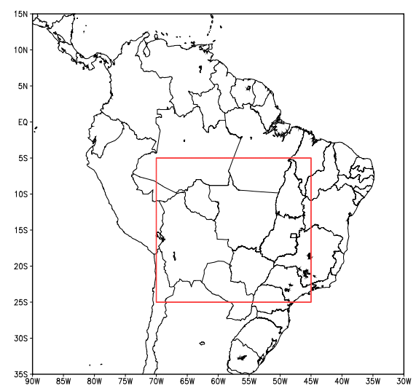
Case 1 – Smoke in Brazil Quantitative evaluation for the SAMBBA case
Parameters:
2-meter temperature.
10-meter wind (mag and direction)
rainfall
Observational data: meteo surface stations over S. America.
Evaluated time period: 5 – 14 SEP, up to 240-hour forecast.
DOMAIN of EVALUATION
Notes:
O erro médio para a hora 1 de previsão = SOMA (erro médio da hora 1 para cada uma das 10 previsões) / 10 ?

Slide 8
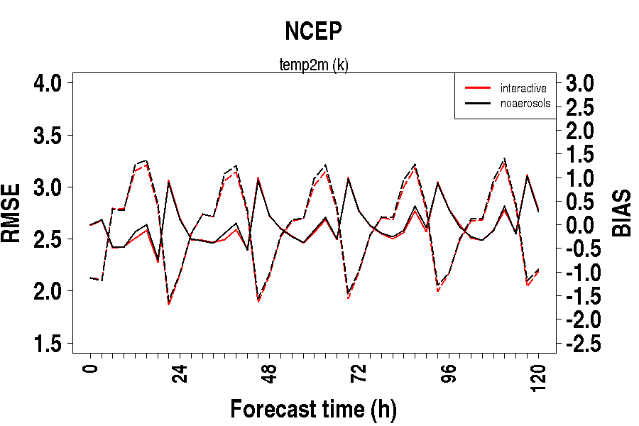
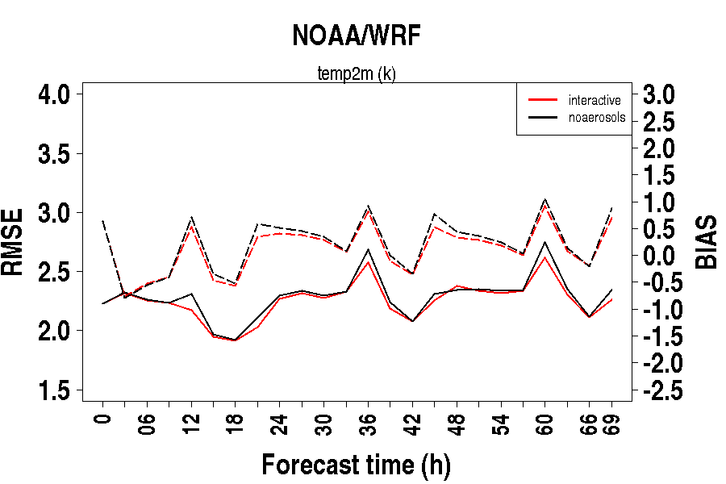
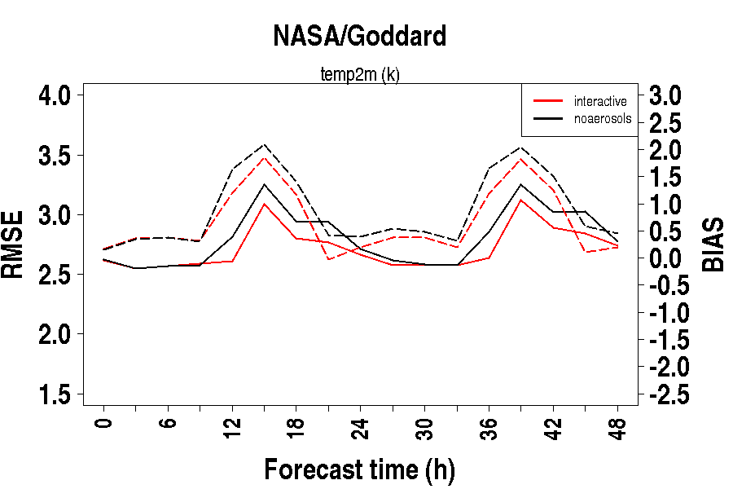
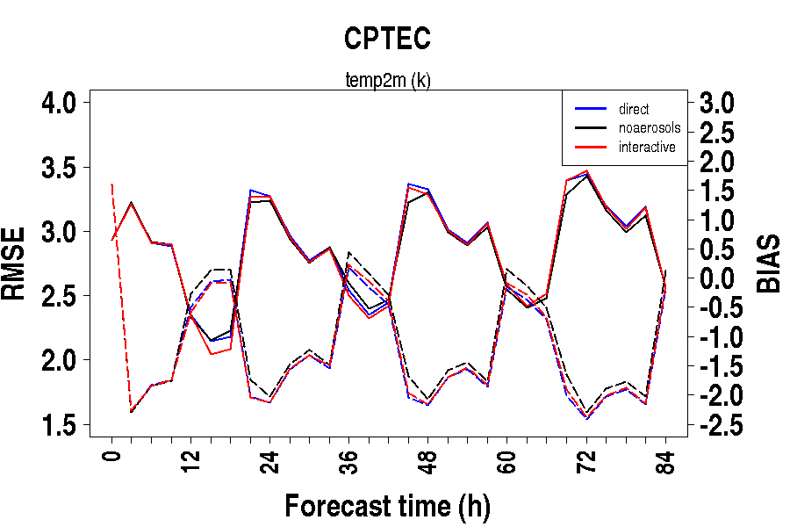
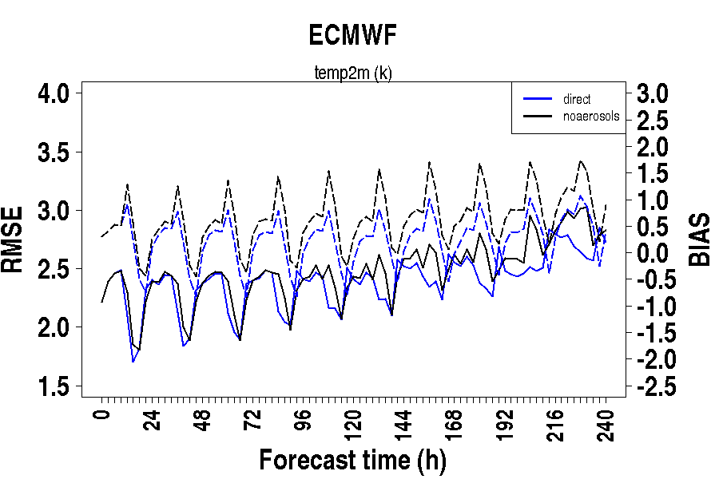
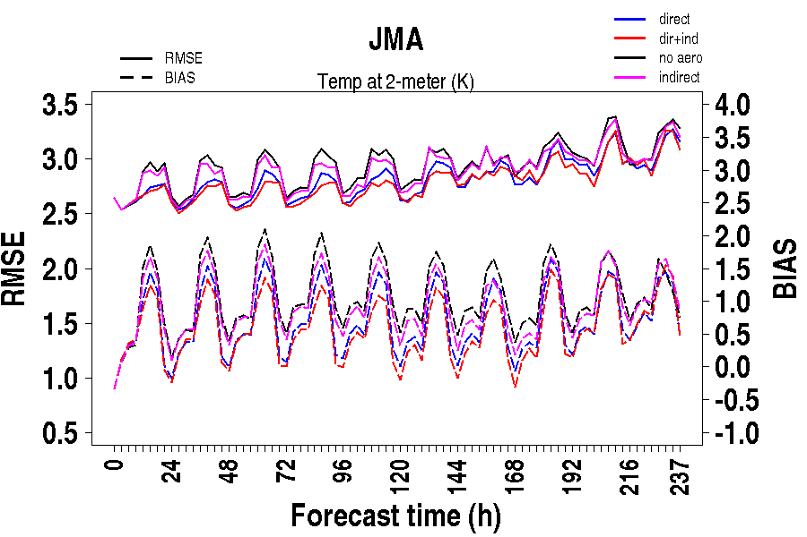
RMSE/BIAS: 2-m Temperature (K)
RMSE and BIAS: 2-m Temperature
BIAS: dashed line RMSE: continuous line
Notes:
RMSE – continuous line
BIAS - dashed line
ECMWF, NASA, JMA, NOAA and CPTEC: Consistent and significative RMSE/BIAS reduction
NCEP : negligible change
JMA : Better RMSE reduction with the aerosol treatment complexity (more complex, lower RMSE)

Slide 9
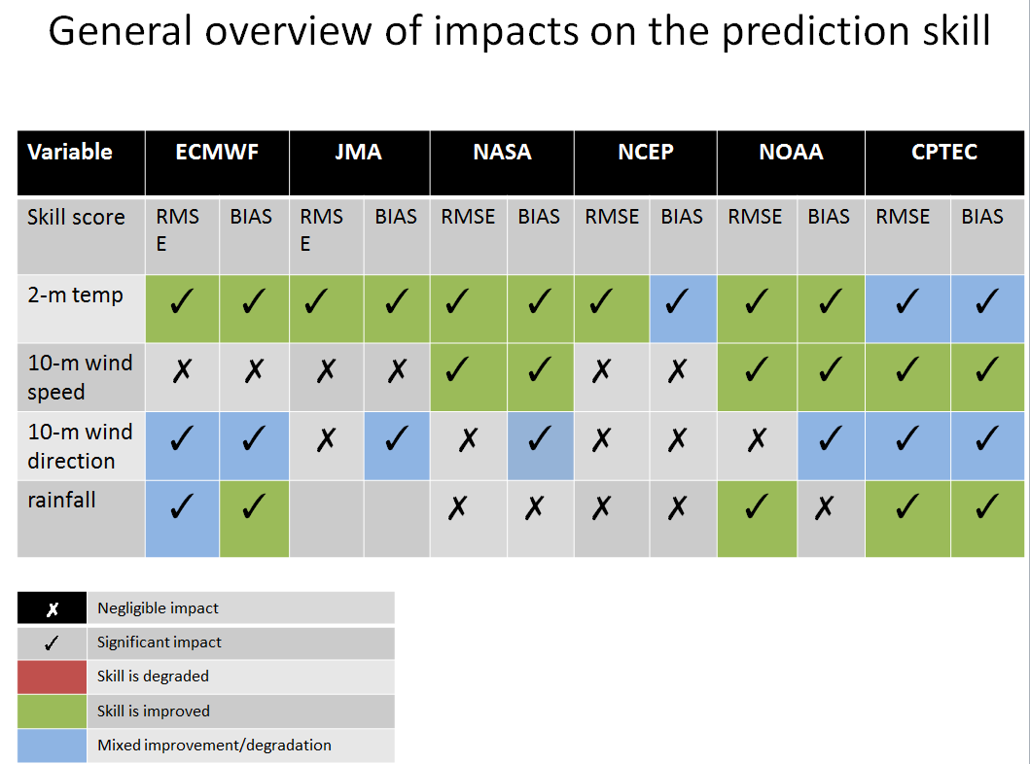

Slide 10
Quantitative evaluation for the SAMBBA case
Parameters:
2-meter temperature: more significant impact
10-meter wind (mag and direction): low impact
Precipitation : low impact
Notes:
O erro médio para a hora 1 de previsão = SOMA (erro médio da hora 1 para cada uma das 10 previsões) / 10 ?

Slide 11
Case 2- Extreme Pollution in Beijing
January 2013
Forecasts
January 7-21 2013
From 0 or 12 UTC
10 day forecasts
Center of domain
116E, 40N
Model configuration
Same as for NWP
Direct & Indirect effects
With updates from JMA
Notes:
Aerosol effects: forecast with and without interactive aerosols, including direct and indirect effects.
Ideally four experiments should be performed:
Duration and time period: 14 days, from January 7 to January 21 2012
Length: 10 days forecasts from the 00UTC or 1200UTC analysis with and without interactive aerosols.
Center of the model domain (for limited area models): 116⁰ E, 40⁰ N
Model configuration should be compatible with the configuration of the operational system used currently for NWP.
Initial and boundary conditions for meteo fields will be provided upon demand by ECMWF (eg MACC) for the limited area models.

Slide 12
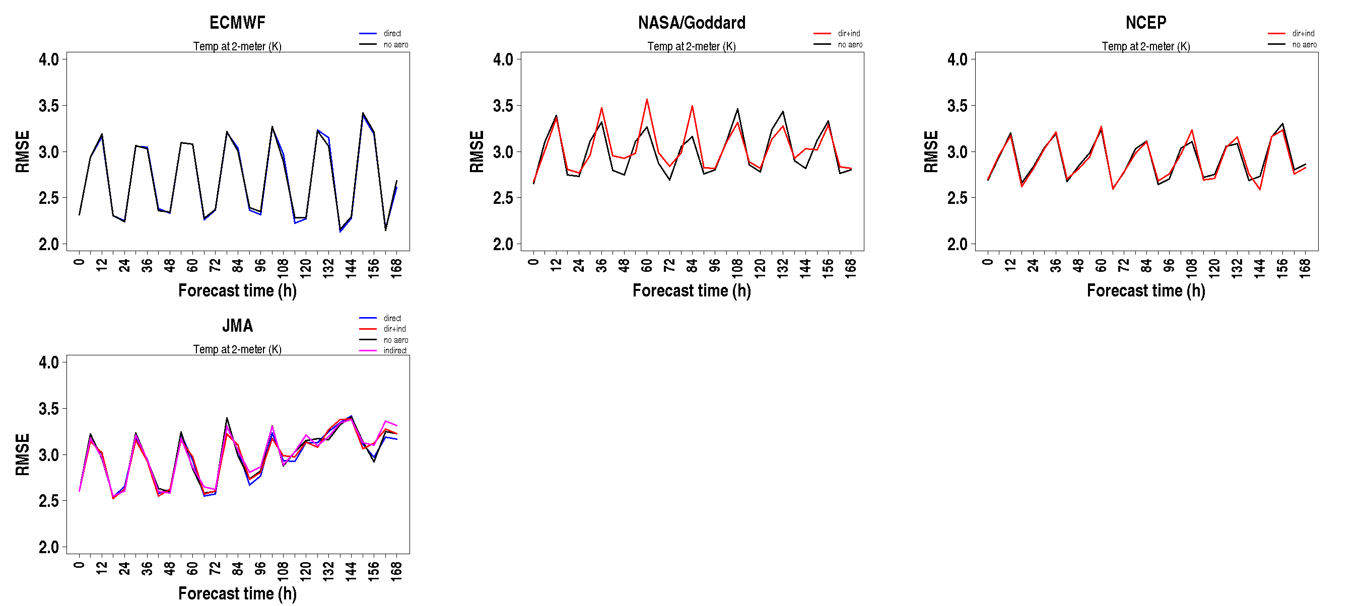
RMSE: 2-m Temperature (K)
Notes:
RMSE da temp a 2-m
BIAS - dashed line
ECMWF, NASA, JMA, NOAA and CPTEC: Consistent and significative RMSE/BIAS reduction
NCEP : negligible change
JMA : Better RMSE reduction with the aerosol treatment complexity (more complex, lower RMSE)

Slide 13
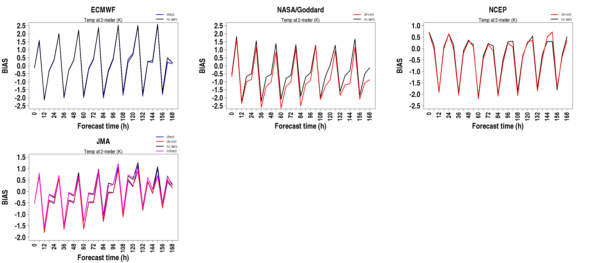
BIAS: 2-m Temperature (K)
Notes:
RMSE – continuous line
BIAS - dashed line
ECMWF, NASA, JMA, NOAA and CPTEC: Consistent and significative RMSE/BIAS reduction
NCEP : negligible change
JMA : Better RMSE reduction with the aerosol treatment complexity (more complex, lower RMSE)

Slide 14
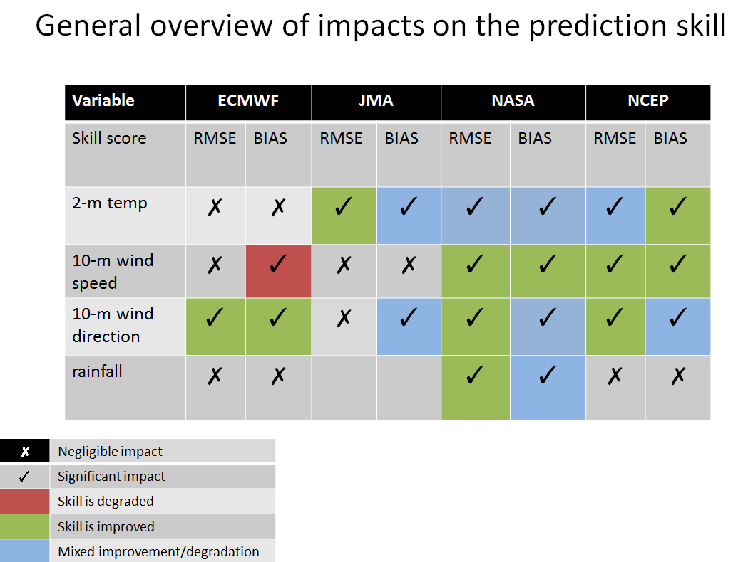

Slide 15
2. ETAPAS EM ANDAMENTO
Impacto dos aerossóis de queimadas na previsão climática sazonal
● Elaboração projeto FAPESP (~ 50%)
Prazo: set 2016
● Escrevendo proposta para o Doutorado (~40%)
Prazo: nov 2016

Slide 16

3. ETAPAS FUTURAS
● Estágio Doutorado Sanduíche (2017)
NASA/Goddard – Saulo Freitas
● Escrever o artigo/tese (2018.1)
● Defesa da tese(2018.2)

Slide 17
OBRIGADA!

