Slide 1
Ongoing work to improve convection in the UM
Keith Williams (most of the work by Martin Willett)
WGNE-31, 28/04/16

Slide 2
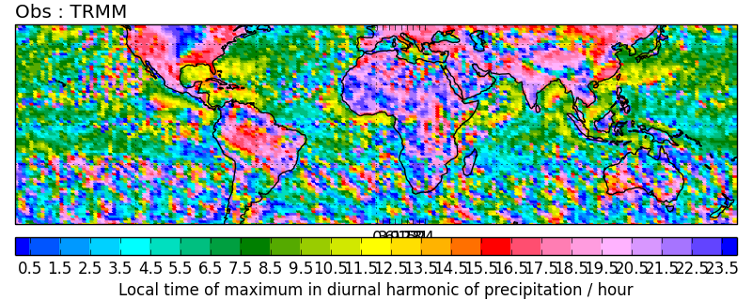
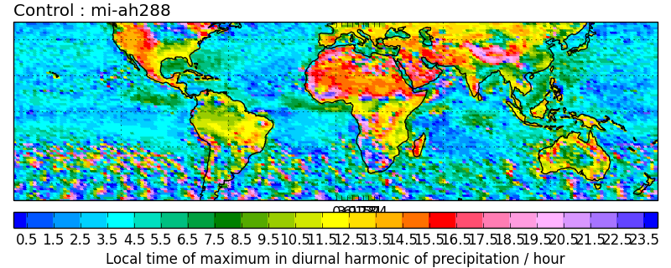
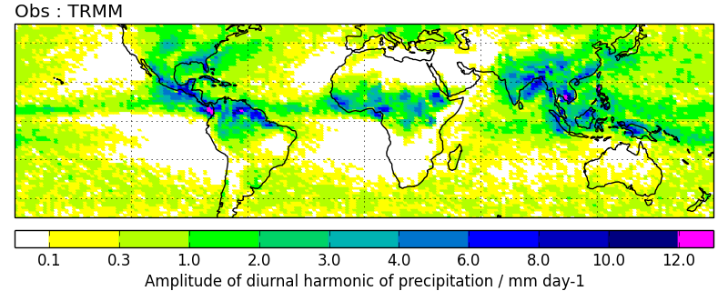
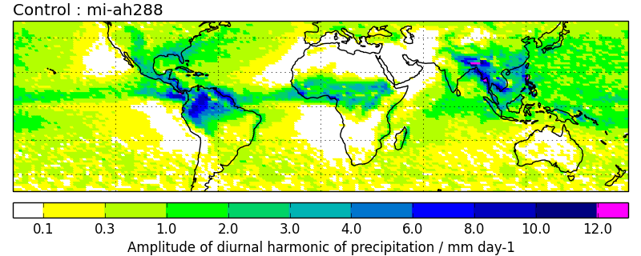
Current problems
Diurnal harmonic – convection peaks too early
TRMM
Model
Phase
Amplitude
Convection peaks over land at local noon rather than late evening

Slide 3
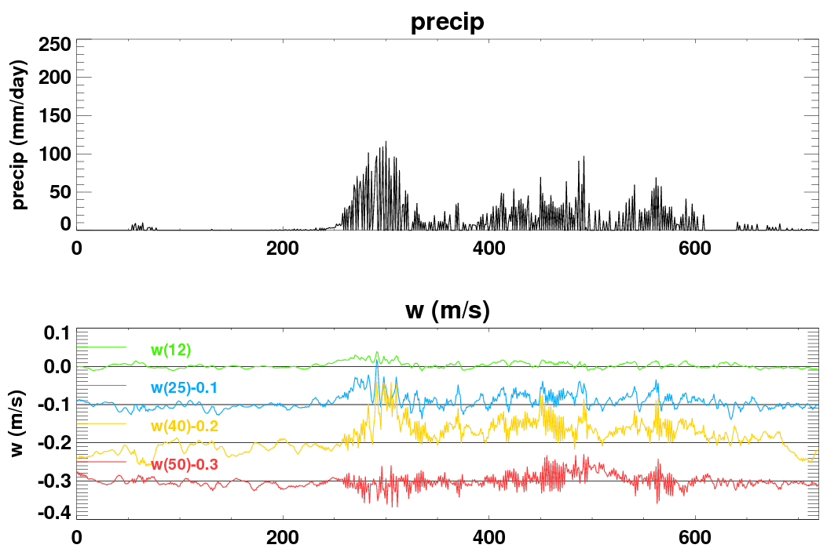
Current problems
Convective temporal intermittency
10 day time series from a single grid point
day 0
day 10

Slide 4
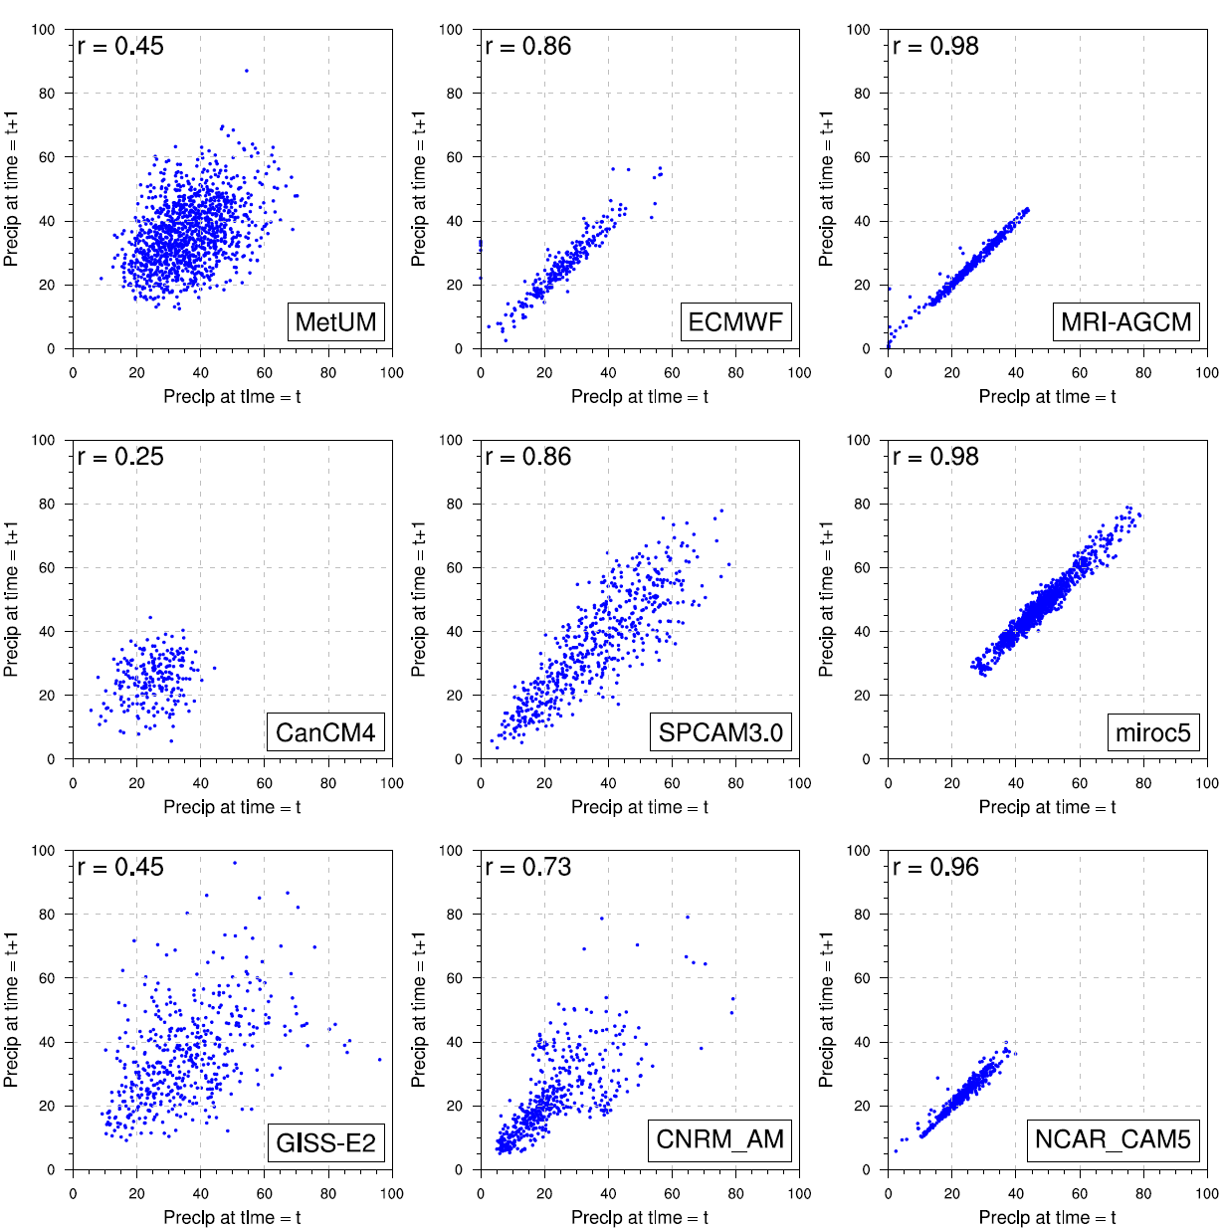
Time-step intermittency
precip (t) vs prec (t+1)
Prince Xavier
MJO-TF – GASS diabatic processes project
Notes:
Intermittency in models rainfall is a good tests for validating the parameterisation scheme. This figure looks at the precip(t) and precip(t+1) for a 24 hours period during the convective phase. The two models that are are having little relationship between timesteps are MetUM, CanCM4 and GISS, while MRI and MIROC have near persistant rainfall from one time step to the other.

Slide 5
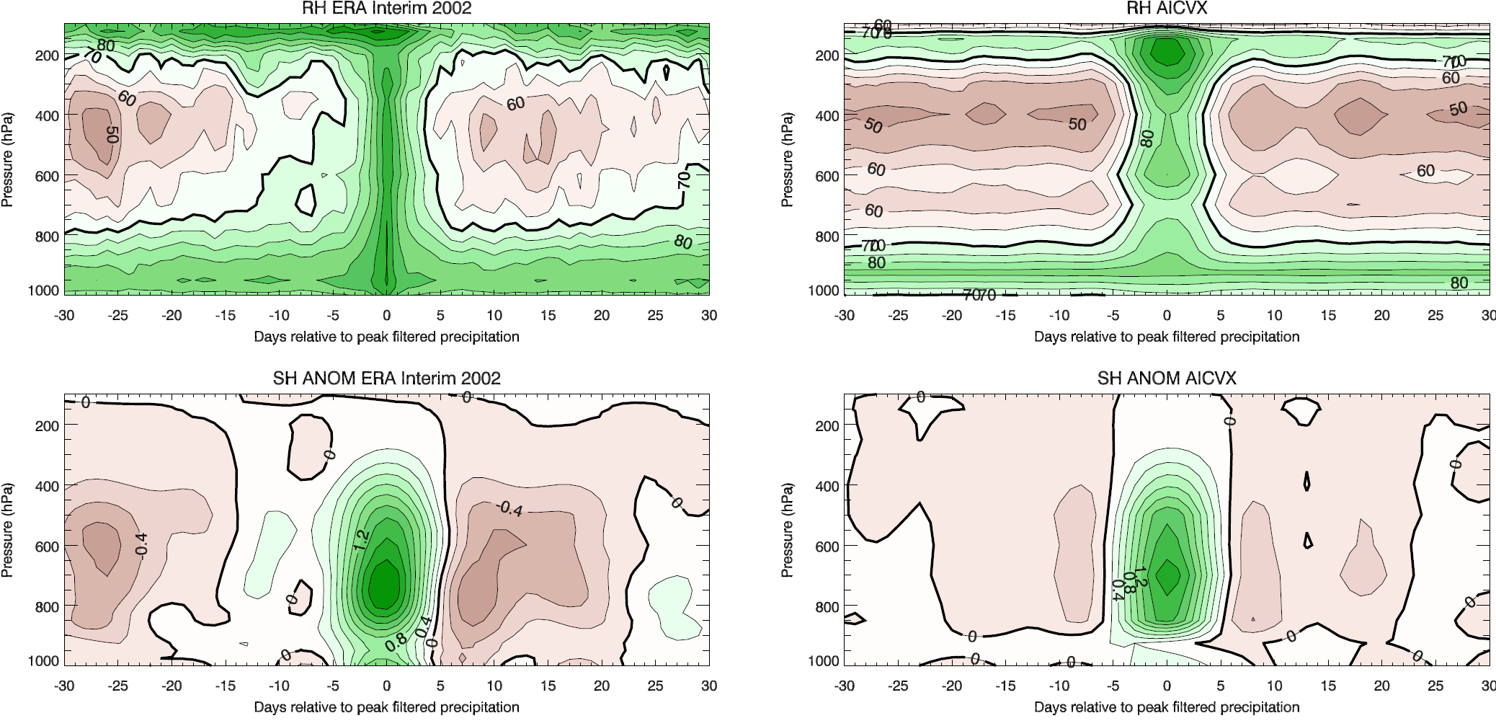
Current problems
Convection does not evolve through congestus phase
(example in build up of the MJO)
ERA-I
Model
Prince Xavier – MJO lead-lag composite of RH

Slide 6
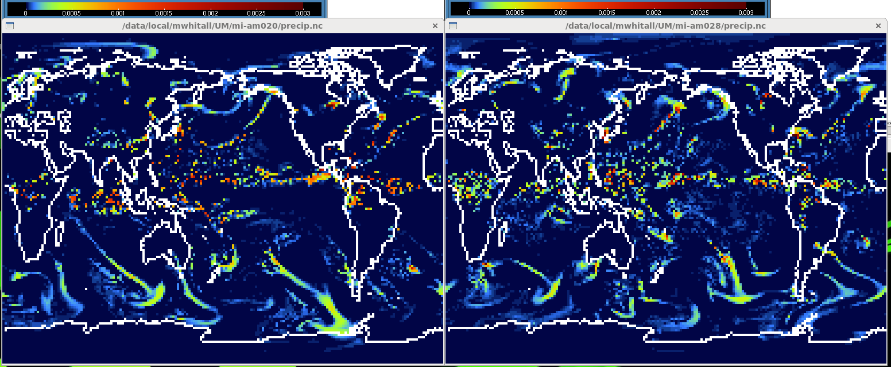
Current problems
Convective spatial intermittency (lack of organisation)
Precip / mm day-1
GA6
GA7
N96 AMIP simulations.
Michael Whitall

Slide 7

Current problems
Convective spatial intermittency (lack of organisation)
Precip / mm day-1
GA6
GA7
N96 AMIP simulations.
Michael Whitall

Slide 8

Current problems
Convective spatial intermittency (lack of organisation)
Precip / mm day-1
GA6
GA7
N96 AMIP simulations.
Michael Whitall

Slide 9
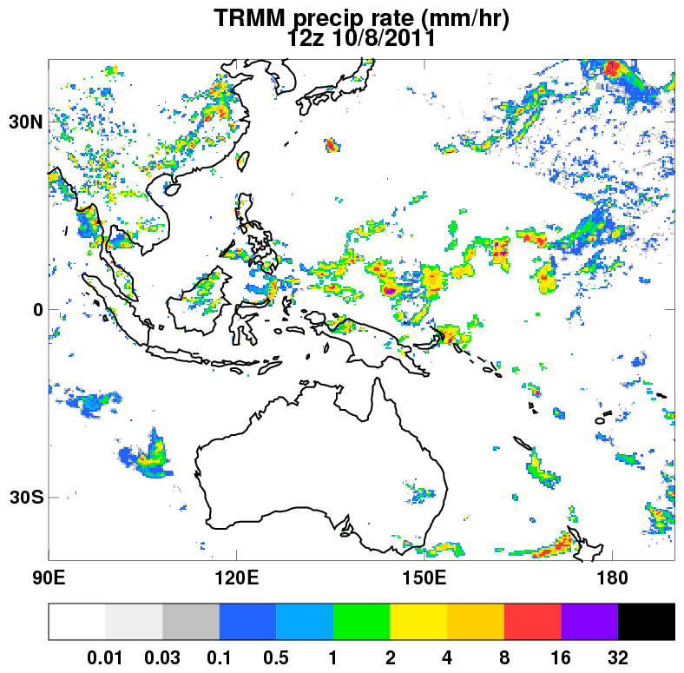
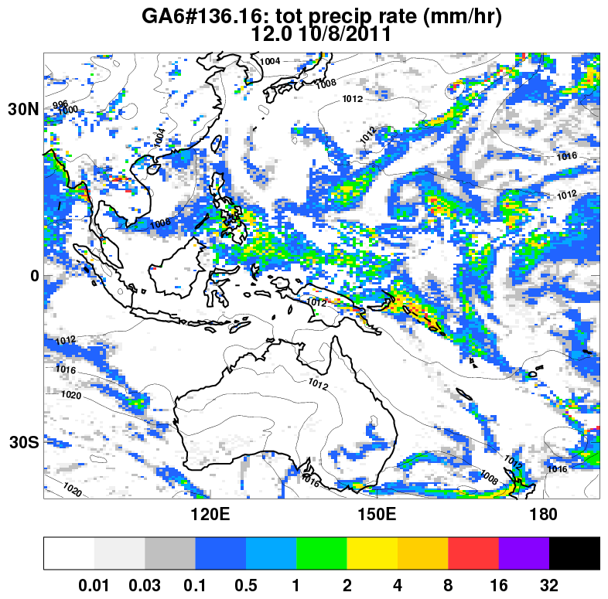
Current problems
When accumulated too many points have a little rain, too few have a lot
TRMM
Model

Slide 10
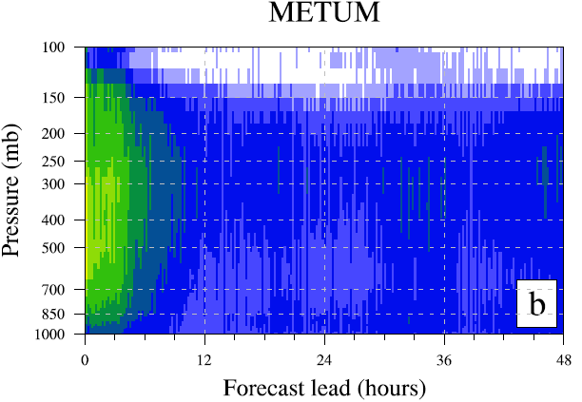

Current problems
No correlation with dynamics at timestep/gridpoint level (although well correlated when meaned)
Prince Xavier – correlation between w and precip.
Harun Rashid (CSIRO)

Slide 11
Convective Memory

Slide 12
(Lack of) Memory
The real atmosphere has “memory” on all spatial scales
  Scales that we can resolve (gridbox mean)
  Scales that we cannot resolve (subgrid deviation)
But the model only has memory on resolved scales, i.e.
Convection develops and operates on unresolved scales
  Need to parameterize it
  Tries to determine from
Could the convection parameterization be improved if we had memory of convective scales?

Slide 13
Convective memory
New 3-dimensional prognostic P̅
Measure of recent convective activity
Based on convective precipitation at the surface
Non-precipitating convection also contributes a bit
Source non-zero on levels where convection is operating
Fully advected
source
decay
vertical expansion
surface precip

Slide 14
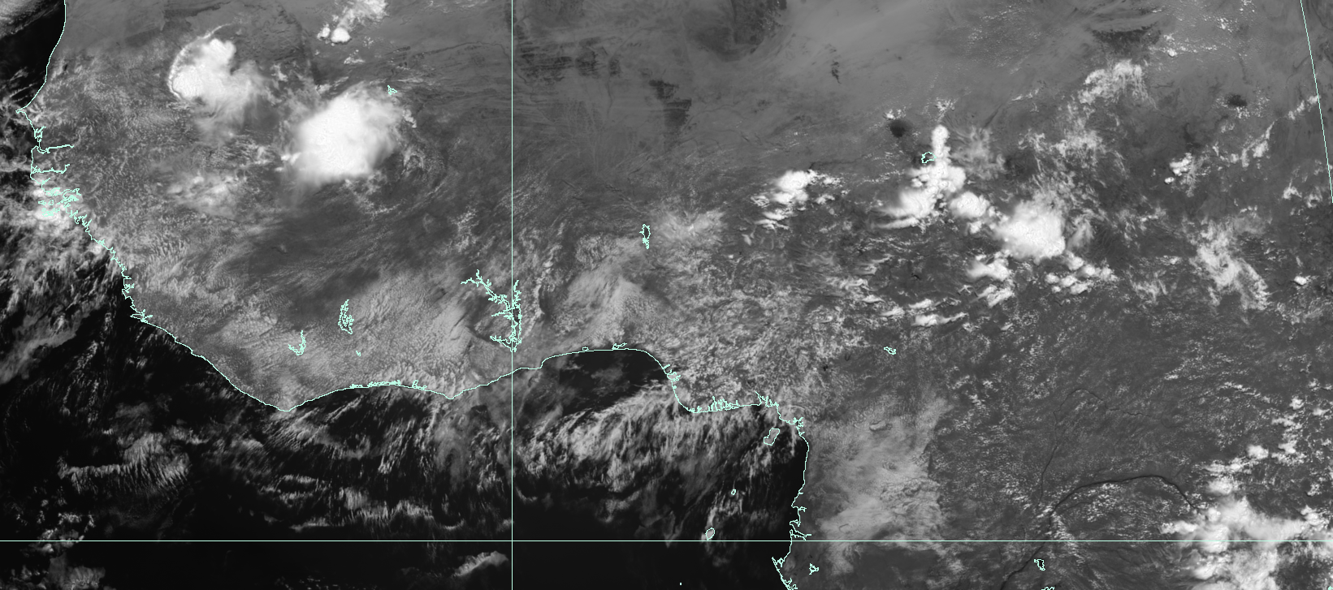
Adding convective memory
High recent convective activity
Large convective clouds
Low entrainment rates
Low recent convective activity
Small convective clouds
High entrainment rates

Slide 15
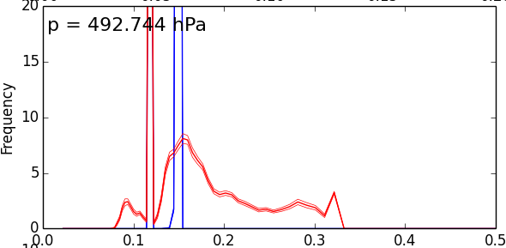
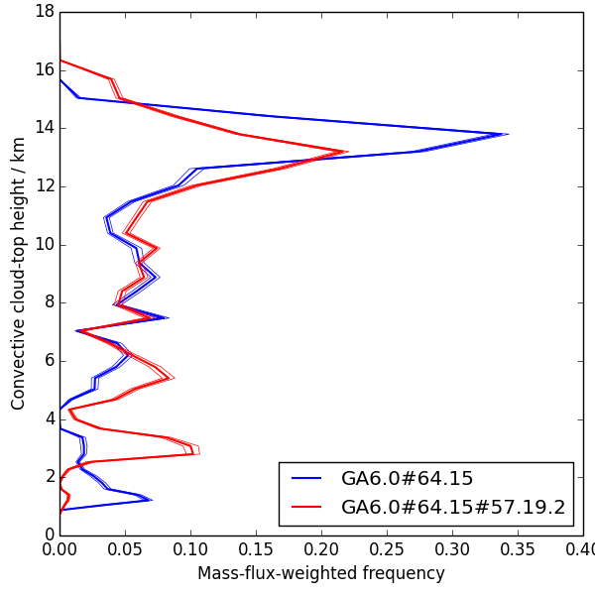
SCM: Toga Coare
Control (blue)
    single entrainment rate for deep convection
Convective memory (red)
    broad spectrum of entrainment rates
    Deepest convection is deeper
    More terminating at mid-levels (congestus)
Frequency
Entrainment rate (km^-1)
Convective cloud-top height (km)
Michael Whitall
Frequency

Slide 16
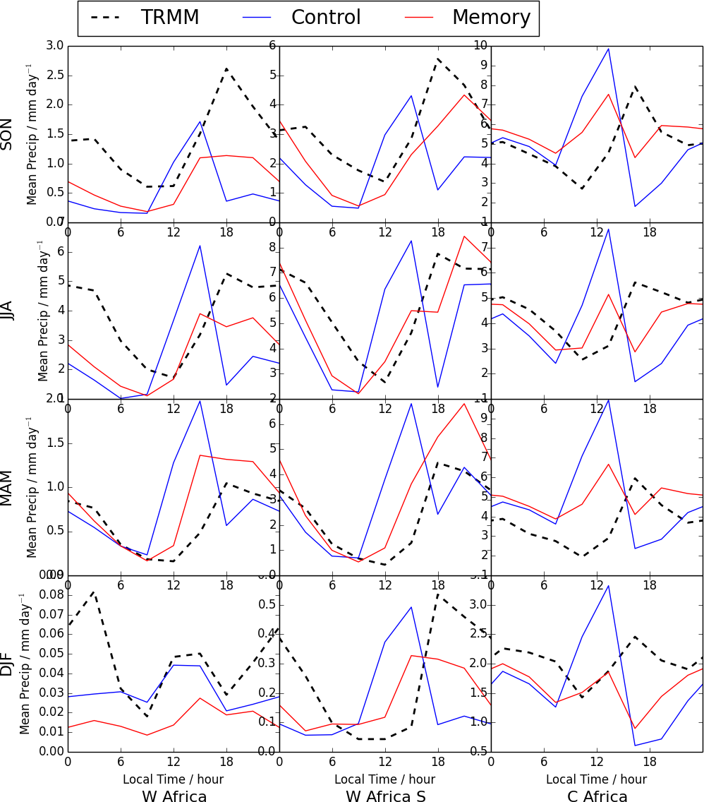
Impact on diurnal cycle
Control (blue)
Peak around local noon
Too little overnight
Memory (red)
Peak delayed
Reduced amplitude
More overnight
But sometimes still have
Spurious minimum in model precip in the late afternoon ...
... which often coincides with observed peak

Slide 17
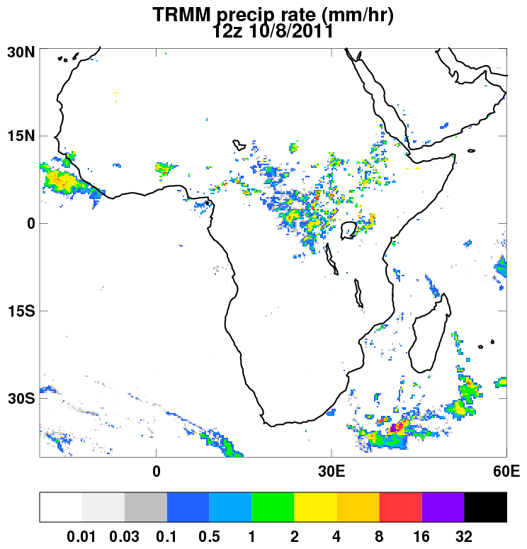
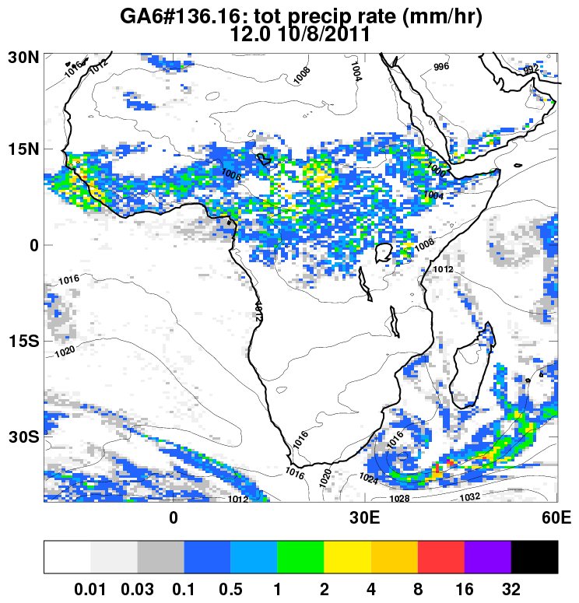
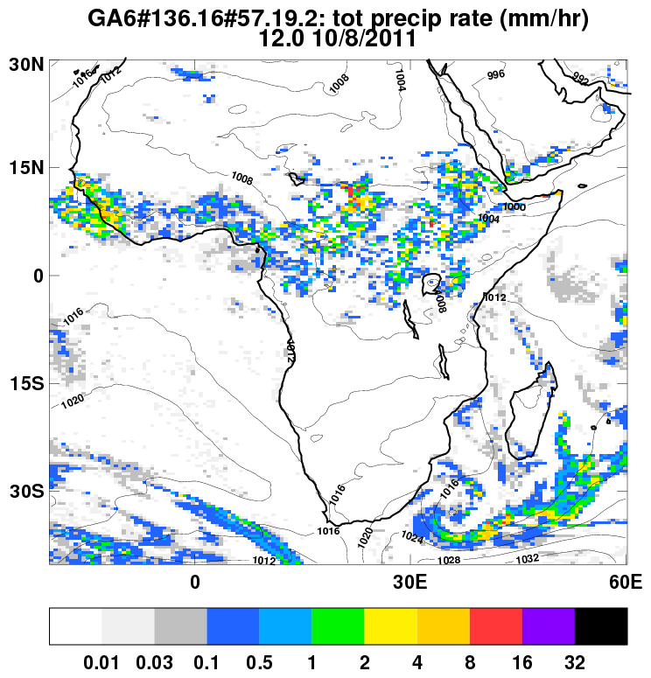
N320 NWP case study
TRMM
Control
Memory
Convective memory reduces the amount of “light” precipitation
Increases the frequency of heavy precipitation and generates more coherent structure
Starting to look a little more realistic but limited skill?

Slide 18
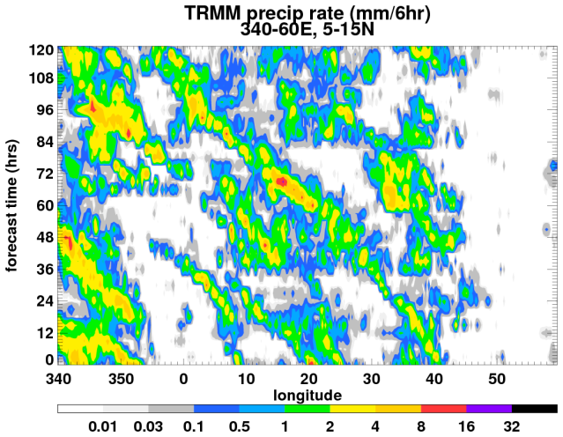
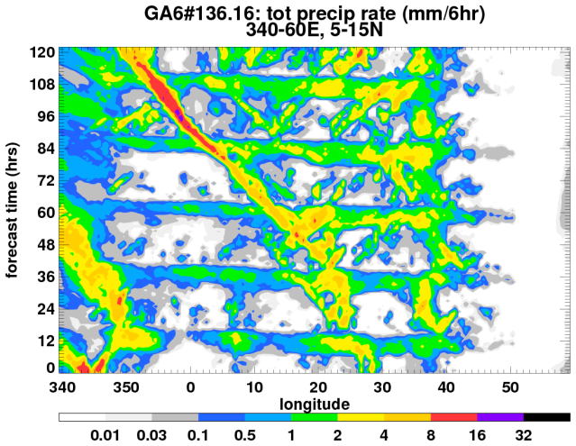
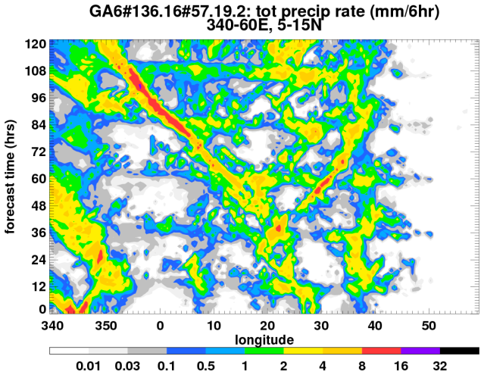
N320 NWP case study
TRMM
Control
Memory
Control and Memory both capture AEW
  Possibly too fast and too strong in this case
Control has a spurious peak in convection around local noon
Memory reduces this peak

Slide 19
Summary
There are a number of problems related to convection in the UM (diurnal cycle, temporal intermittency, lack of spatial organisation, …).
Currently testing adding memory to the convection scheme using a new prognostic that measures recent convective activity:
  Vary entrainment rate in a physically plausible manner
  NWP performance and mean climate are not degraded
  Instantaneous structure of precipitation is improved
  Diurnal cycle of convection is improved
Still more work to do, especially around intermittency and coupling to dynamics.

Slide 21
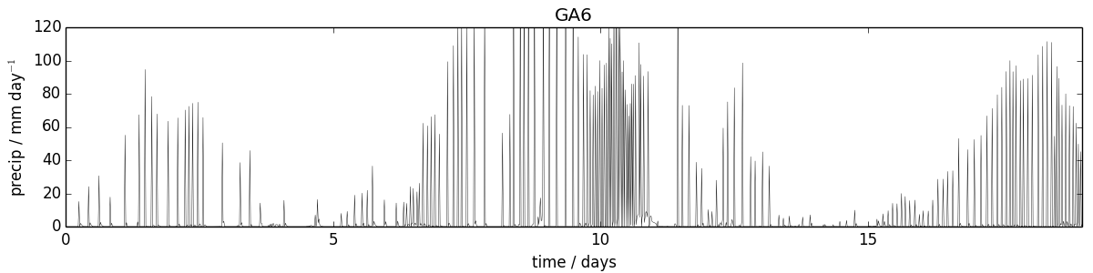
Starting to look at the convective closure
Here, the convective closure is redundant.
The mean convective mass-flux / rainfall over several timesteps is controlled by the % of timesteps on which convection is active.
Max (hourly-mean) rain-rate happens here even though the closure implies smaller instantaneous mass-fluxes than earlier.
The convective trigger is actually what controls the (hourly-mean) rainfall. Considering allowing triggering to control the closure

